Slide 1
Fraternity Circle Sustainability Proposal
By: Lindsay Travers

Slide 2
What is sustainability?
“Sustainable development is development that meets the needs of the present without compromising the ability of future generations to meet their own needs” (UN World Commission on Environment and Development)

Slide 3
My Honors Project
I sent a 30 question survey regarding the waste production and sustainability efforts practiced in the houses located on Fraternity Circle to each of the Housing Directors.
Responses were gathered from 11 out of the 13 houses
With the data gathered I have formed a proposal for more sustainable options.

Slide 4
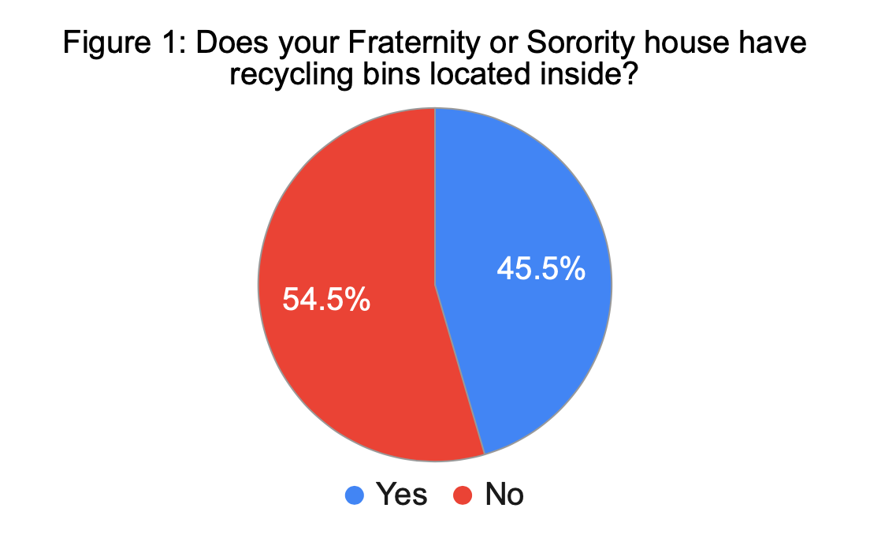
Survey Results
Over 50% of the houses do not have recycling bins for their members to use.

Slide 5
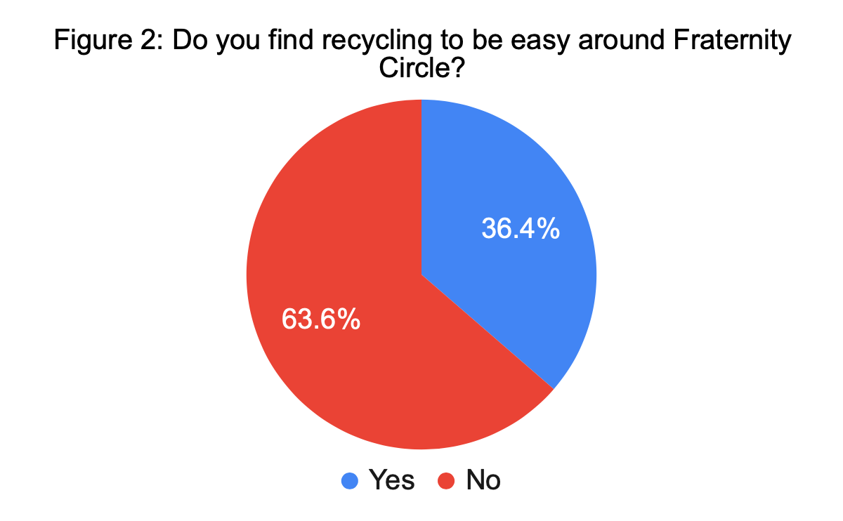
Survey Results Continued
Additionally, 63.6% of the houses surveyed do not find recycling to be easy around Fraternity Circle.

Slide 6
Survey Results Cont.
Question: Does your sorority or fraternity have an educational program regarding recycling?
Results: 100% of the houses responded “No”

Slide 7
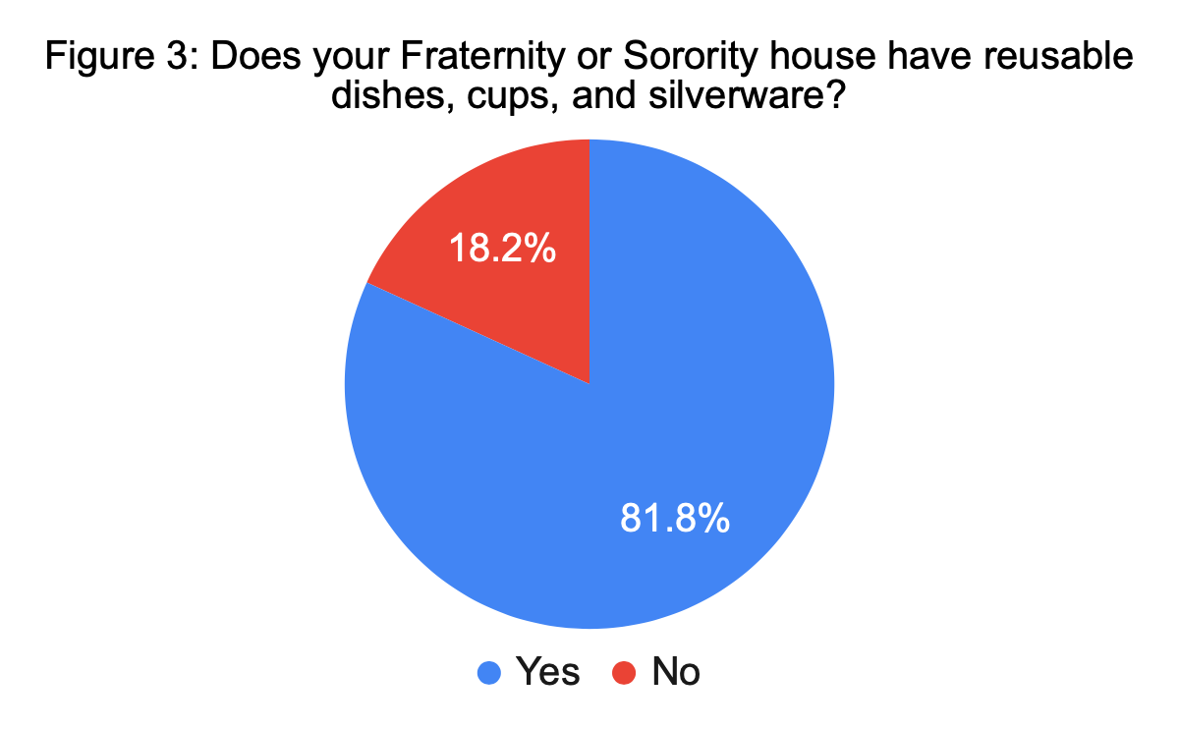
Survey Results Cont.
81.8% of the houses use reusable dishes which is a great way to reduce waste!

Slide 8
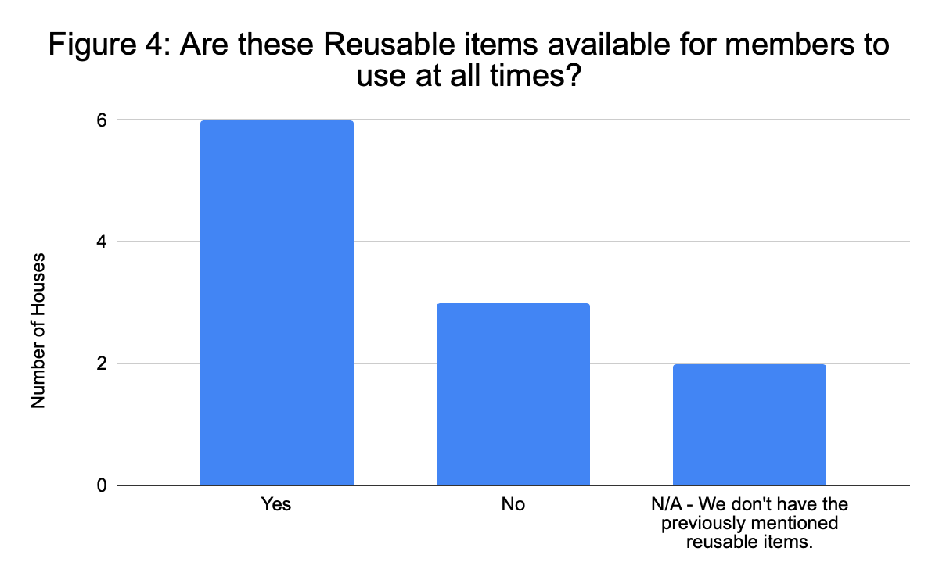
Survey Results Cont.
While reusable items are available for members, some houses do not have them available at all times
Reasons for this include: not enough to use at all times, chefs prefer using disposable items, only used when meals are served.

Slide 9
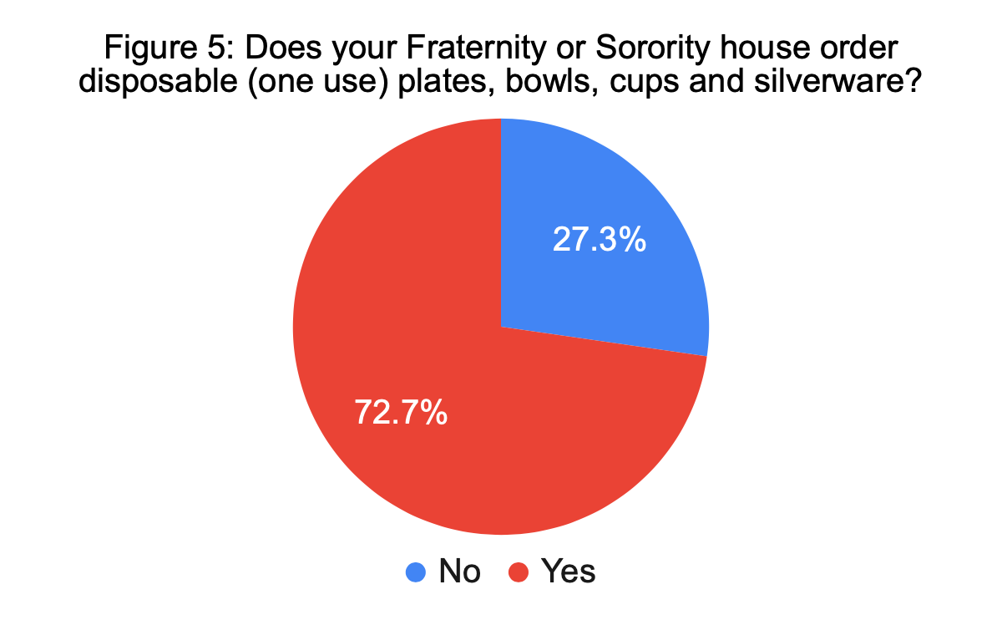
Survey Results Cont.
While most houses have reusable items, 72.7% of the houses use disposable items as well
All but 1 of the houses that use disposable items make them available to members at all times

Slide 10
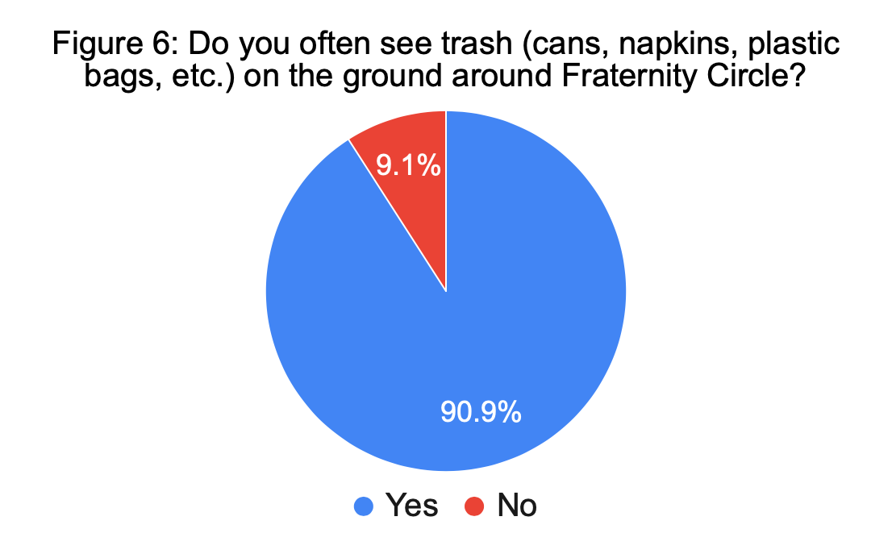
Survey Results Cont.
90% of the houses surveyed often see trash and waste on the ground around Fraternity Circle

Slide 11
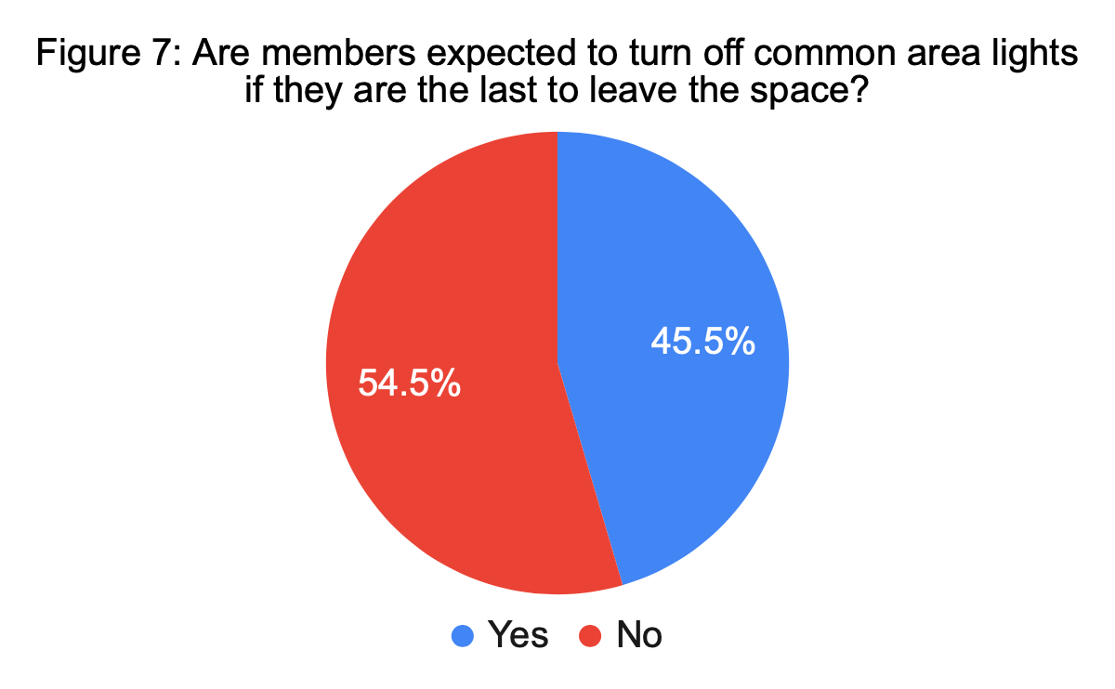
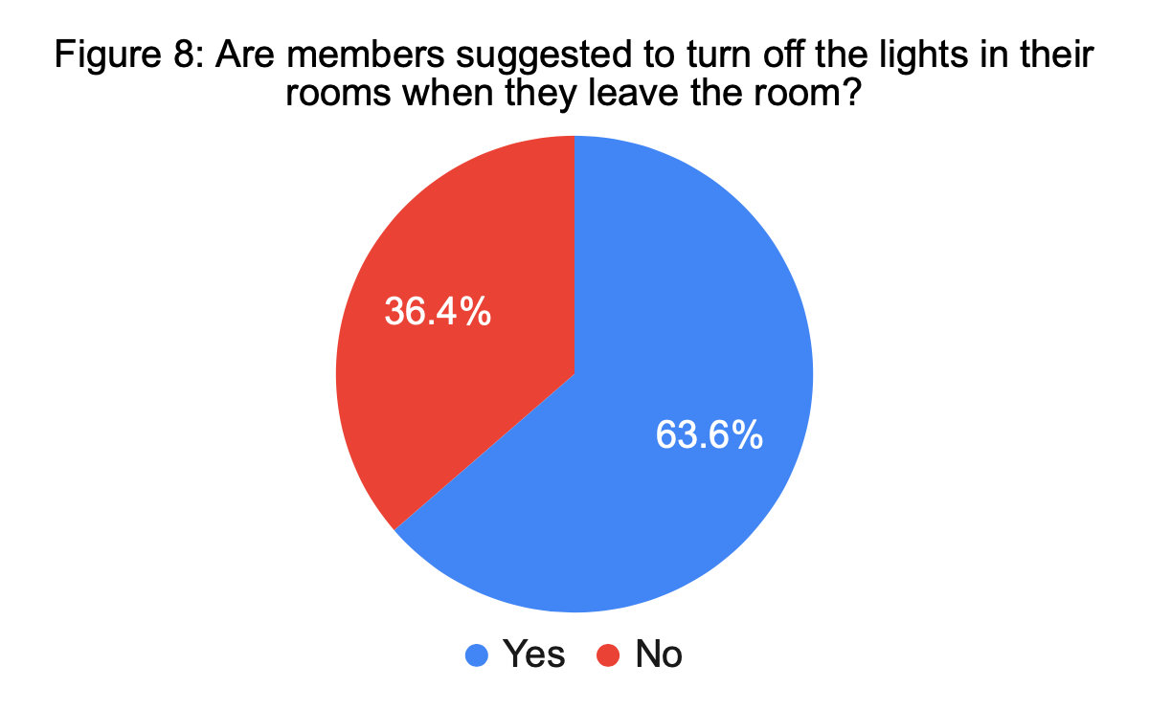
Survey Results Cont.
Figures 7 and 8 show that some houses set expectations for turning the lights off when rooms are not being used, while some do not.

Slide 12
Survey Results Cont.
Question: What temperature is your thermostat set at during an average day during the Winter?
Results: The temperatures ranged from 64-72 degrees Fahrenheit

Slide 13
Let’s Take Action!
The chapters can take simple steps toward sustainability with a few adjustments!

Slide 14
Improving Recycling Efforts
Request recycling bins for each of the houses
Chapter Houses can contact the URI Recycling Facilities Operations at 401-874-2840 or recycle@etal.uri.edu to request a bin.
Create an education program to ensure members recycle properly

Slide 15
Switch to Reusable Dishes and Other Items
Housing Directors can discuss purchasing reusable dishes and other items with the chapter’s national organization
Chapters can make these reusable items available to members at all times
Chapters can make an effort to stop ordering disposable dishware
If eliminating the use of disposable dishes is impossible, they should limit availability of the disposable resources to times when they are necessary

Slide 16
Implement Fraternity Circle Clean-ups
Since the majority of houses said they often see trash on the ground around fraternity circle, this is an important step for action
Monthly mandatory clean-ups around Fraternity Circle would eliminate the waste polluting the environment
Panhel and IFC could assign the clean-ups to one house per month

Slide 17
In House Sustainability
Expectations for members to turn off the lights after they leave a room can be set.
The temperature of the houses should be set at a neutral 68 degrees Fahrenheit to conserve energy

Slide 18
Why should Greek Life Take These Steps Toward Sustainability?
To further the positive impact URI Greek Life has on our campus
To ensure Greek Life is doing what they can to preserve energy and reduce waste production
To ensure that the future members of Greek Life have an environment that meets their needs

Slide 19
Thank You!

Slide 20
Works Cited
“UN World Commission on Environment and Development, Ed., Report of the World Commission on Environment and Development: Our Common Future.” UN World Commission on Environment and Development, Ed., Report of the World Commission on Environment and Development: Our Common Future | Environment & Society Portal, www.environmentandsociety.org/mml/un-world-commission-environment-and-development-ed-report-world-commission-environment-and.

