Slide 1
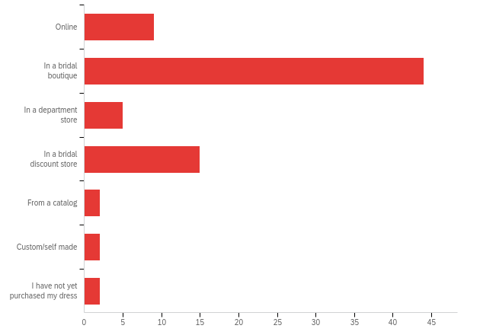
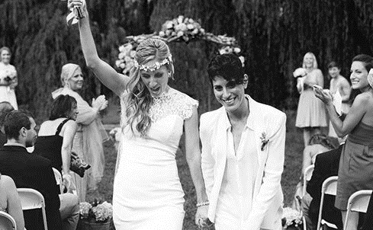
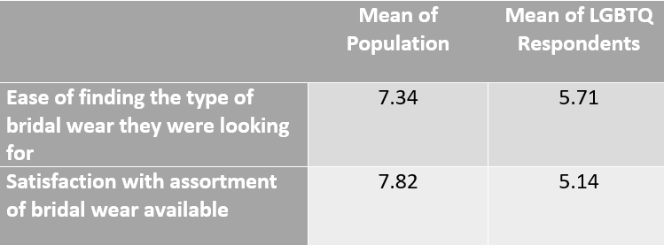
PURPOSE
To examine whether women who are part of the LGBTQ community consume more non-traditional bridal wear compared to their straight counterparts and to examine through which channel consumers of non-traditional bridal wear predominantly shop.
METHODS
Participant Profile
170 respondents (only 138 proceeded past first question)
130 females, 6 males, 1 non-binary, and 1 other
117 heterosexual, 9 bisexual, 8 gay/lesbian, 4 other
105 currently married, 33 not currently married
10 currently engaged, 22 not currently engaged
Procedure
Posted survey to relevant Facebook groups, including national LGBTQ groups and Our Town South Kingstown (RI only)
Performed a netnography to determine bridal designers’ perceptions of the non-traditional bridal wear market
Data Analysis
Quantitative data was analyzed using basic statistical methods like mean, median, and standard deviation. Qualitative data was analyzed by counting word frequency.
NON-TRADITIONAL BRIDAL WEAR AND ITS PRIMARY CONSUMER
Erica Thalmann and Kristina DiMaria
Advisor: Jessica Strübel, Ph.D.
University of Rhode Island
DISCUSSION
When LGBTQ respondents were asked to describe the assortment of bridal wear available to them, the responses were overwhelmingly “white standard gowns” and “long white gowns”, with silhouettes such as mermaid, A-line, and ball gown coming up frequently. When the same respondents were asked to describe what type of bridal wear they were seeking, responses were much more varied.
When the whole population was asked whether they considered their taste in bridal wear to be non-traditional, 21.5% responded yes and 78.5% responded no. When the LGBTQ respondents were asked the same question, 50% responded yes and 50% responded no
This confirms our hypothesis that members of the LGBTQ community are more likely to purchase non-traditional bridal wear compared to their straight counterparts
The decrease in satisfaction with the bridal wear assortment is most likely a result of a lack of assortment across bridal wear channels, and LGBTQ brides’ desire for something different. This desire to define their sexual orientation through dress is consistent with the Social Identity Theory.
The few respondents who wore bridal wear that would be considered non-traditional such as a pantsuit or a pink dress resorted to the internet to find exactly what they were looking for, confirming our hypothesis that shoppers seeking non-traditional bridal wear opt to shop online
INTRODUCTION
No studies have examined the correlation between sexual orientation and preference for bridal wear
Brands that implement targeted marketing have been found to have greater saliency and support from the gay community, which essentially means more sales (McNamara & Descubes, 2016; Oakenfull, 2012 )
The gay segment is created by marketers themselves through positive reinforcement between the brand and the consumer (Branchik, 2002 ; McNamara & Descubes, 2016)
America is experiencing a new downward shift in marriages known as a “marriage gap,” due to many couples wanting to be financially stable and settled before they tie the knot (“The Decline of Marriage”, 2010)
According to the Brides American Wedding Study, a wedding in 2017 cost a couple about $27,000 but increased to more than $44,000 just the following year (Brides Editors, 2019)
Bridal-wear stores began to carry collections of all types of wedding dresses so that any bride that came in would be able to find a unique dress to match each bride’s one-of-a-kind personality (Ketner, 2014)
RESULTS
25 went shopping more than four times, 21 went shopping once, 16 went shopping twice, 11 went shopping three times, and 6 went shopping four times
17 respondents said they would describe their taste in bridal wear as non-traditional, 62 respondents said they would describe their taste in bridal wear as traditional
Of the bridal designers that did mention non-traditional or “offbeat” brides, 2 (50%) of them only mentioned them in the context of colored dresses
BHLDN and Oscar de la Renta (50%) mention non-traditional bridal wear in the context of silhouette
Number of brides who purchased bridal wear, organized by channel
LITERATURE CITED
Begley, S. (2015, February 10). Wedding Dress History: Queen Victoria and Gown That Started it All. Retrieved from https://time.com/3698249/white-weddings/
Branchik, B. J. (2002). Out in the Market: A History of the Gay Market Segment in the United States. Journal of Macromarketing, 86–97. doi: 10.1177/027467022001008
Brides Editors. (2019, January 2). This is What American Weddings Look Like Today. Retrieved from https://www.brides.com/gallery/american-wedding-study
Crotty, N. (2013, June 11). Kleinfeld's Fashion Director Dishes on Dressing 10,000 Brides a Year. Retrieved from https://fashionista.com/2013/06/kleinfelds-fashion-director-dishes-on-dressing-10000-brides-a-year
De Klerk, A. (2020, January 22). Are brides turning away from the traditional wedding gown? Retrieved from https://www.harpersbazaar.com/uk/bazaar-brides/a30609690/are-brides-turning-away-from-the-traditional-wedding-gown/
Elllemers, N., & Haslam, S. A. (2012). Social Identity Theory. Retrieved from https://sakai.uri.edu/access/lessonbuilder/item/12708011/group/df806c31-ebc1-40ba-b6ec-1b60fcd68bb4/Course Resources/Social Identity Theory.pdf
Hogg, M. A., Terry, D. J., & White, K. M. (1995, December). A Tale of Two Theories: A Critical Comparison of Identity Theory with Social Identity Theory. Retrieved from https://www.ssc.wisc.edu/~jpiliavi/965/hoggterrywhite.pdf
Hogg, M. A., & Tindale, R. S. (2001). Blackwell Handbook of Social Psychology: Group Processes. Retrieved from https://www.researchgate.net/profile/Scott_Tindale/publication/227988590_Shared_Cognition_in_Small_Groups/links/5a45224f0f7e9ba868a92f3c/Shared-Cognition-in-Small-Groups.pdf#page=71
James, Erika Rasmusson. (2014, February 7). So you want two wedding dresses ... Here's how to make multiple looks work! , from http://www.brides.comlblogs/aisle-say/2014102/tips­buying-wearing-two-wedding-dresses.html
Ketner, D. L. (2012). Cardinal Scholar. Retrieved from http://cardinalscholar.bsu.edu/handle/123456789/199337
Leger, R. (2018, June 1). 12 Trends Your Groom Needs to Know. Retrieved from https://www.brides.com/gallery/groom-trends-wedding
McNamara, T., & Descubes, I. (2016, March 18). Targeted Marketing to the Gay, Lesbian, Bisexual, and Transgender Community. Retrieved from https://www.researchgate.net/profile/Tom_Mcnamara2/publication/299337107_Targeted_Marketing_to_the_Lesbian_Gay_Bisexual_and_Transgender_LGBT_Community_A_primer/links/56f1096f08ae70bdd6c97d16.pdf
O'Barr, W. M. (2012). Niche Markets: Gay Consumers. Project Muse, 12(4).
Oakenfull, G. (2012). Gay Consumers and Brand Usage: The Gender-Flexing Role of Gay Identity. Psychology and Marketing, 29(12), 968–979. doi: 10.1002/mar
Park, A. (2019, January 13). Here's How Much the Average Wedding in 2018 Cost-and Who Paid. Retrieved from https://www.brides.com/story/american-wedding-study-how-much-average-wedding-2018-cost
Raphael, T. J. (2015, July 1). How traditional couples changed the definition of marriage and opened the doors for same-sex weddings. Retrieved from https://www.pri.org/stories/2015-07-01/how-traditional-couples-changed-definition-marriage-and-opened-doors-same-sex
Stets, J. E., & Burke, P. J. (2000, September). Identity Theory and Social Identity Theory. Retrieved from https://s3.amazonaws.com/academia.edu.documents/46115881/identity_theory.pdf?response-content-disposition=inline;filename=Identity_Theory_and_Social_Identity_Theo.pdf&X-Amz-Algorithm=AWS4-HMAC-SHA256&X-Amz-Credential=AKIAIWOWYYGZ2Y53UL3A/20200226/us-east-1/s3/aws4_request&X-Amz-Date=20200226T171125Z&X-Amz-Expires=3600&X-Amz-SignedHeaders=host&X-Amz-Signature=a11bd0c08539ce327ad2ef945f442c39cd181fcfd1d82f5756a8cea8e1dca8f7
The Decline of Marriage And Rise of New Families. (2010, November 18). Retrieved from https://www.pewsocialtrends.org/2010/11/18/the-decline-of-marriage-and-rise-of-new-families/
Wardlow, D. L. (1996). Gays, Lesbians, and Consumer Behavior. Retrieved from file:///C:/Users/Erica/Downloads/9781315876788_googlepreview.pdf
Wells, J. (2018, July 18). The new same-sex marriage traditions. Retrieved from https://www.telegraph.co.uk/family/relationships/the-new-same-sex-marriage-traditions/
Mean responses, with 10 being very easy and very satisfied, respectively

