Slide 1
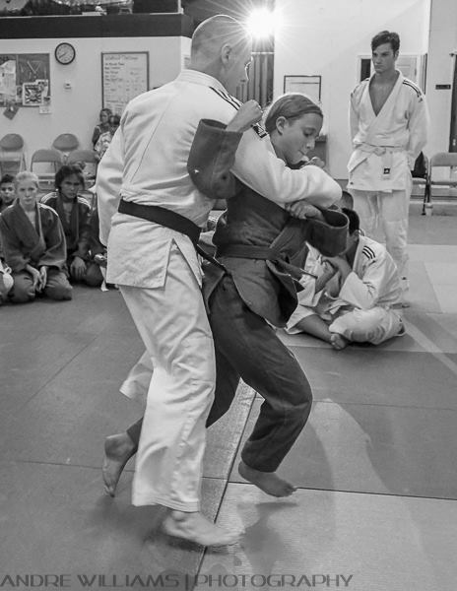
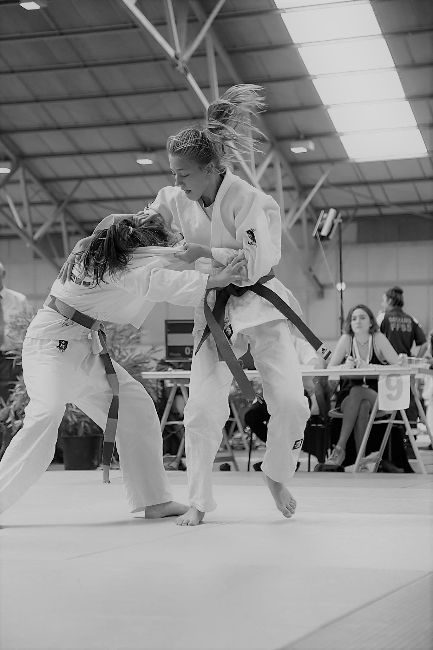
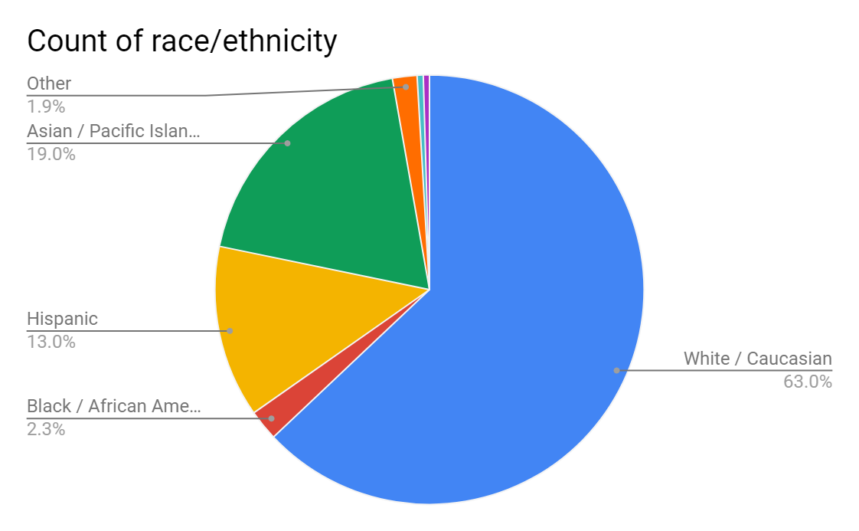
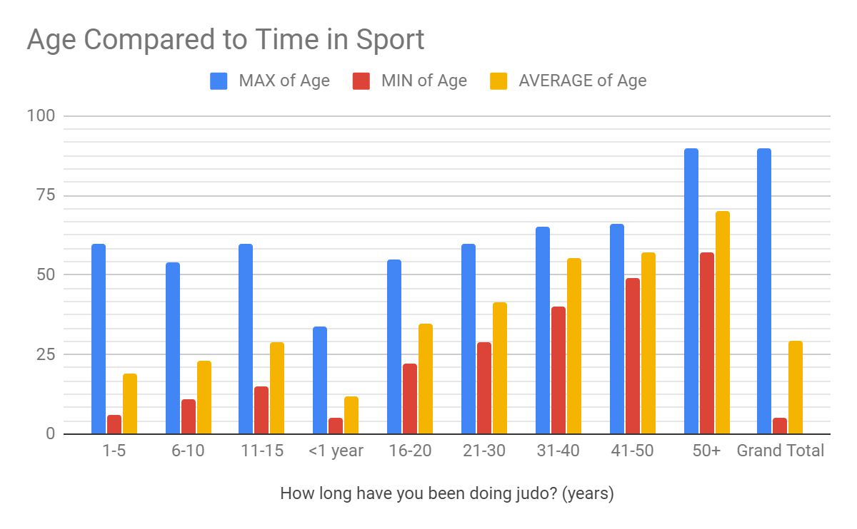
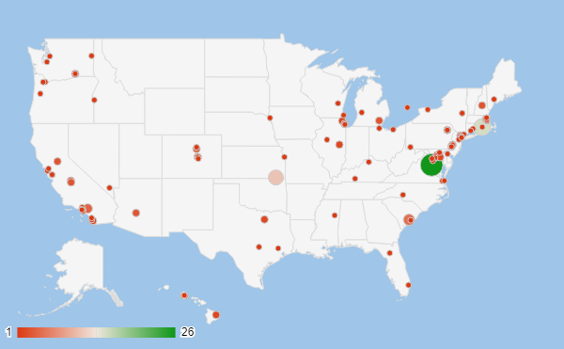
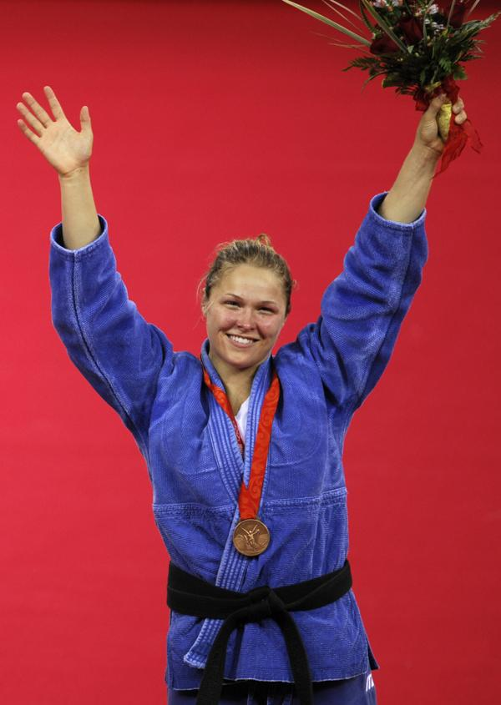
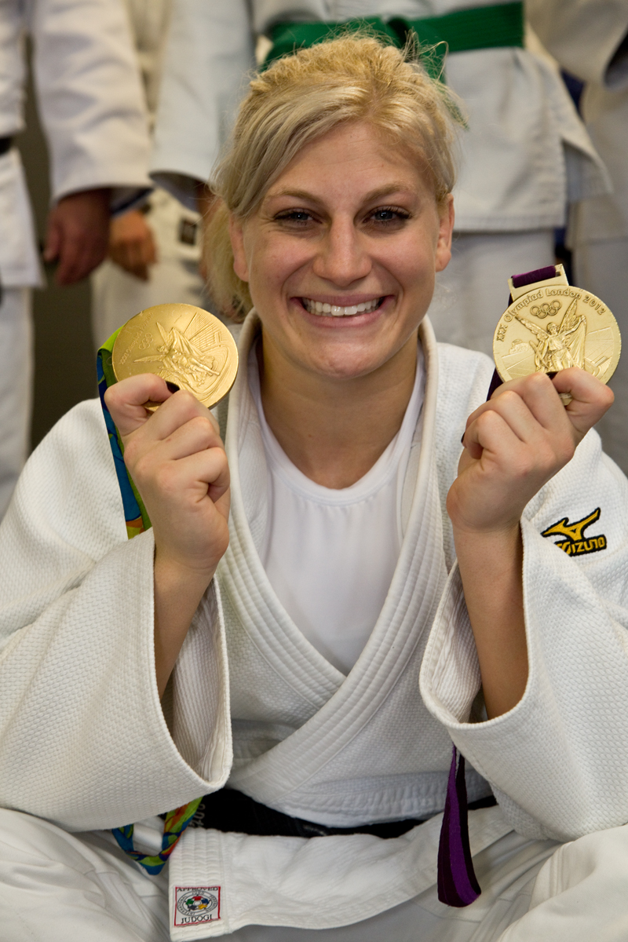
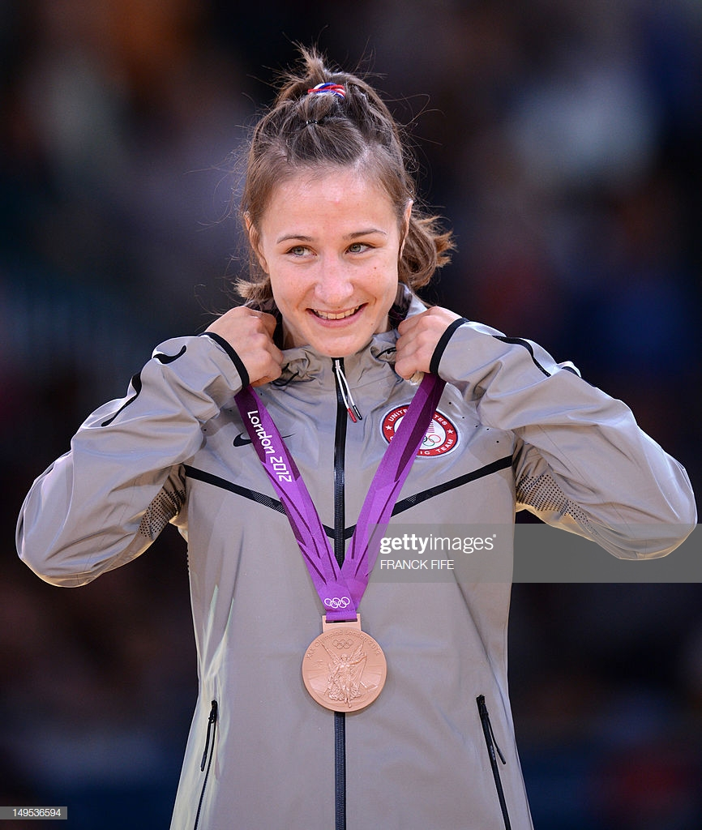
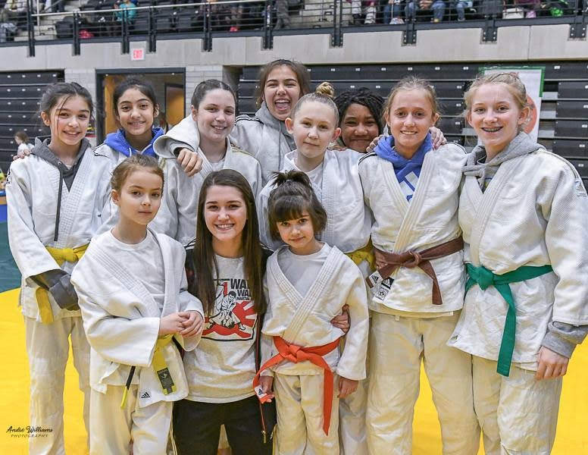
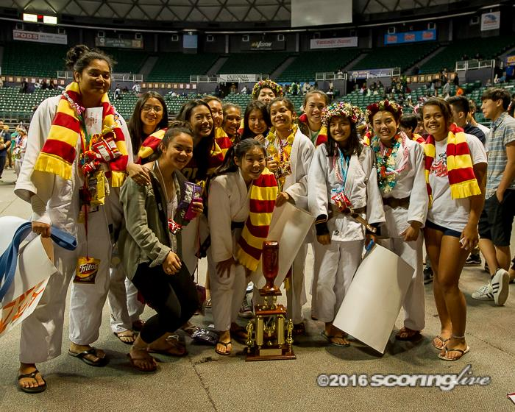
Morals and martial arts: a women's place of empowerment through judo Sydney Wall, Nursing Sponsor: Robert Widell, Department of History
Introduction
Although judo was founded as a sport in the 1880s, it would not be until 1992 that women’s judo became a part of the Olympic program. Despite almost thirty years of women’s participation at the highest level of the sport, this marginalization of women in the sport persists. These limitations on women’s participation have contributed to the association of judo with notions of masculinity. At the same time, though, a vibrant community of female judoka (judo athletes) has developed and women continue to thrive in the sport.
Through a series of interviews and questionnaires, this study collected stories from a broad swath of female judoka and explored how they view their experiences in judo and how their participation has affected their moral development. In so doing, I aimed to demonstrate the ways in which women have contested and reshaped traditional notions of masculinity and femininity through martial arts.
Demographic Results
Qualitative Results
Most Common Themes
Confidence
Respect for others
Physical and emotional strength
Bravery/overcoming fears
“It (judo) has taught me how to not fear judgement.”
-Barb Houston-Shimizu
“We may fight with each other on the mat but when it’s all said and done we respect each other and we have a good time, and that is the best part about judo.”
-Nicole Ward
“I think if I never started judo and never continued through the years and made it to where I did, I don't think I would be the person I am today. No way.”
-Kari Gabriel
“When I go out onto the mat, it forces me to overcome that fear with bravery, so then everything else that I do in life doesn’t seem so scary to me.”
-Katelyn Jarrell
“I like having girls to work with because girls are a lot stronger than other people see them as.”
-Corinne Blanche
Discussion
Results of this project supported that participation in judo affects the development of positive morals in women of all ages. Various responses demonstrated the ways in which women have reshaped traditional notions of masculinity in martial arts into a new format of powerful femininity that boasts confidence and courage through the inner self. Respect, confidence, self-defense, and improved quality of life socially and physically were all attributes women attested to their own character and attributed to their time in the sport. Little research is done about the benefits of female participation in martial arts, and even fewer have looked at judo specifically. The results of research that has been conducted are consistent with my own that involvement in martial arts is a positive motivator for the advancement of societally strong women mentally and physically. Application of this and other research will contribute to the growth and development of the sport of judo in female participants.
Classifications of Participation | Percent of Persons in Each Category
Actively Competitive | 35%
Coach | 1%
Recreational | 21%
Referee | 3%
Sensei (Teacher) | 5%
2 or more | 35%
Various Dojo Locations Across the United States based on participant identification.
Methods
This project used quantitative and qualitative research methods to describe and review female participation in the sport of judo and the benefits they derive from participation. 216 females were surveyed on demographic data including age, race, length of participation, belt rank, and dojo location. Of those persons, 50 were interviewed, either in person or self-recorded and sent in by the interviewee. The question set was developed based on age/skill level of interviewee and whether it was a one-to-one or group interview in order to allow each participant to answer the questions effectively. Qualitative data analysis consisted of reviewing recorded interviews to identify theme categories of responses. Emergent themes were noted and evaluated by the interviewer. The end product is a documentary style video that highlights parts of the interviews as a fun and uplifting way to show the importance and influence on judo in women’s lives.
Literature Cited
Philippa Velija, Mark Mierzwinski & Laura Fortune (2013) ‘It made me feel powerful’: women’s gendered embodiment and physical empowerment in the martial arts, Leisure Studies, 32:5, 524-541, DOI: 10.1080/02614367.2012.696128.
Charmaine Alsager, Janet Dewey, Constance H. Halporn, Scottie Johnson, Bonnie Korte (2002), The Women-Of-Judo Speak. Listen Well. 1st Report of the USJA Women’s Task Force.
Acknowledgements
Special thanks to my sponsor Robert Widell for his constant advisement and seeing me through these past 2 semesters. Thank you to my family for instilling the love of judo into my life. Biggest thank you to all of the great women in the judo community who participated in the project, without you, this was not possible!

