Slide 1
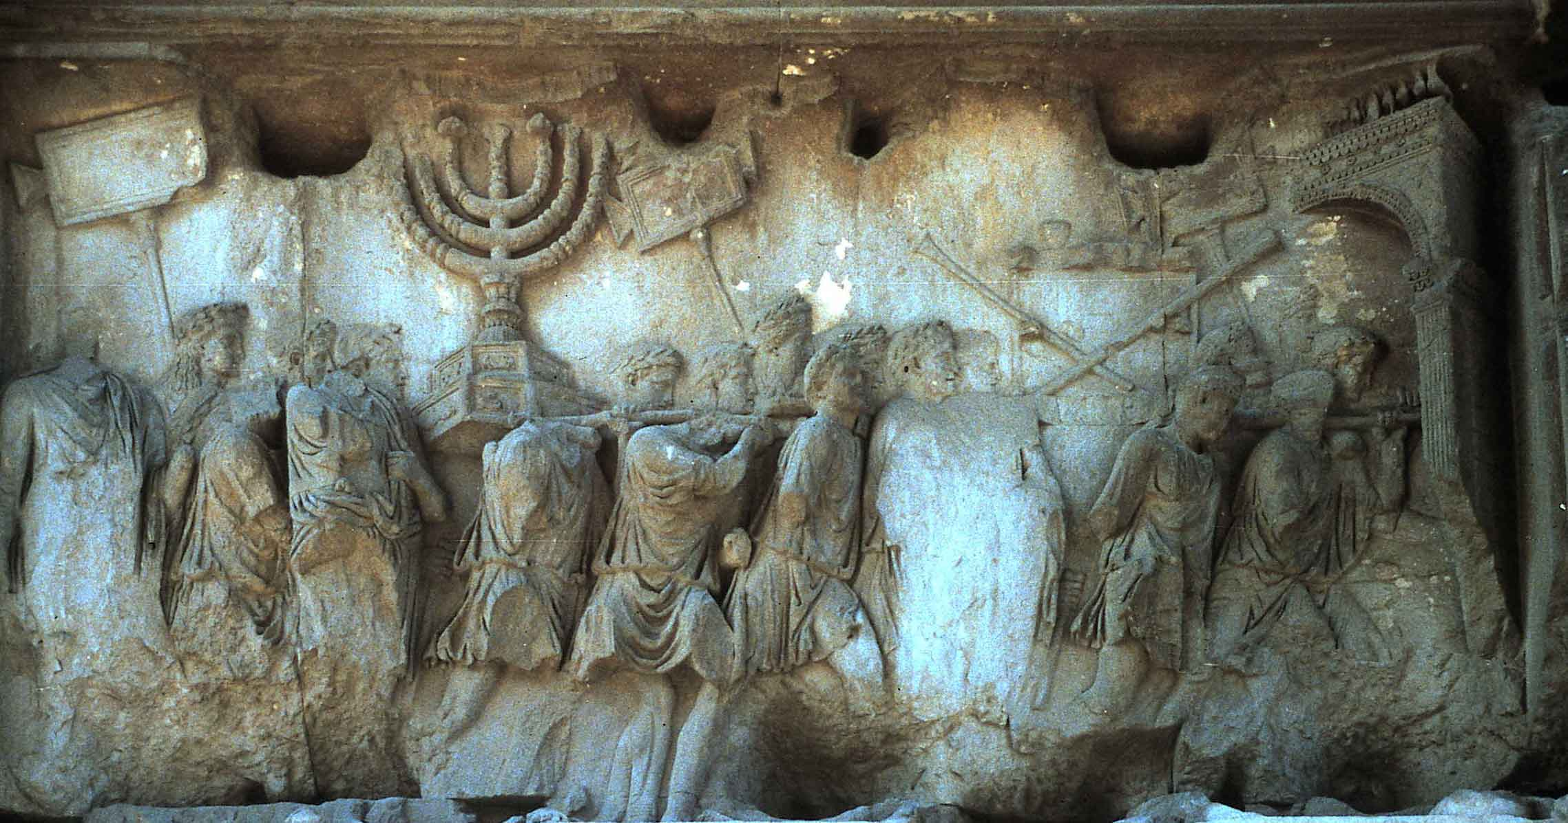
Freize on the Arch of Titus, 82 CE, White Marble, Rome, Italy
As a feature of political expression, examples of political art can be found in antiquity. In the 1st century CE we witness the construction of a triumphal arch in Rome, the Arch of Titus, depicting the Roman siege of Jerusalem, the destruction of the holy Temple, and the carting off of its spoils, most notably the sacred menorah which is featured prominently in the tableau. Created in the year 82, this piece of political art commissioned to exalt the victorious Titus and fix his place in the public imagination of Rome, still arouses deep feelings to this day. Titus’ triumph meant Judea’s humiliation, and Jewish people still maintain the defiant custom of not walking under the Arch when they visit the Forum.

Slide 2
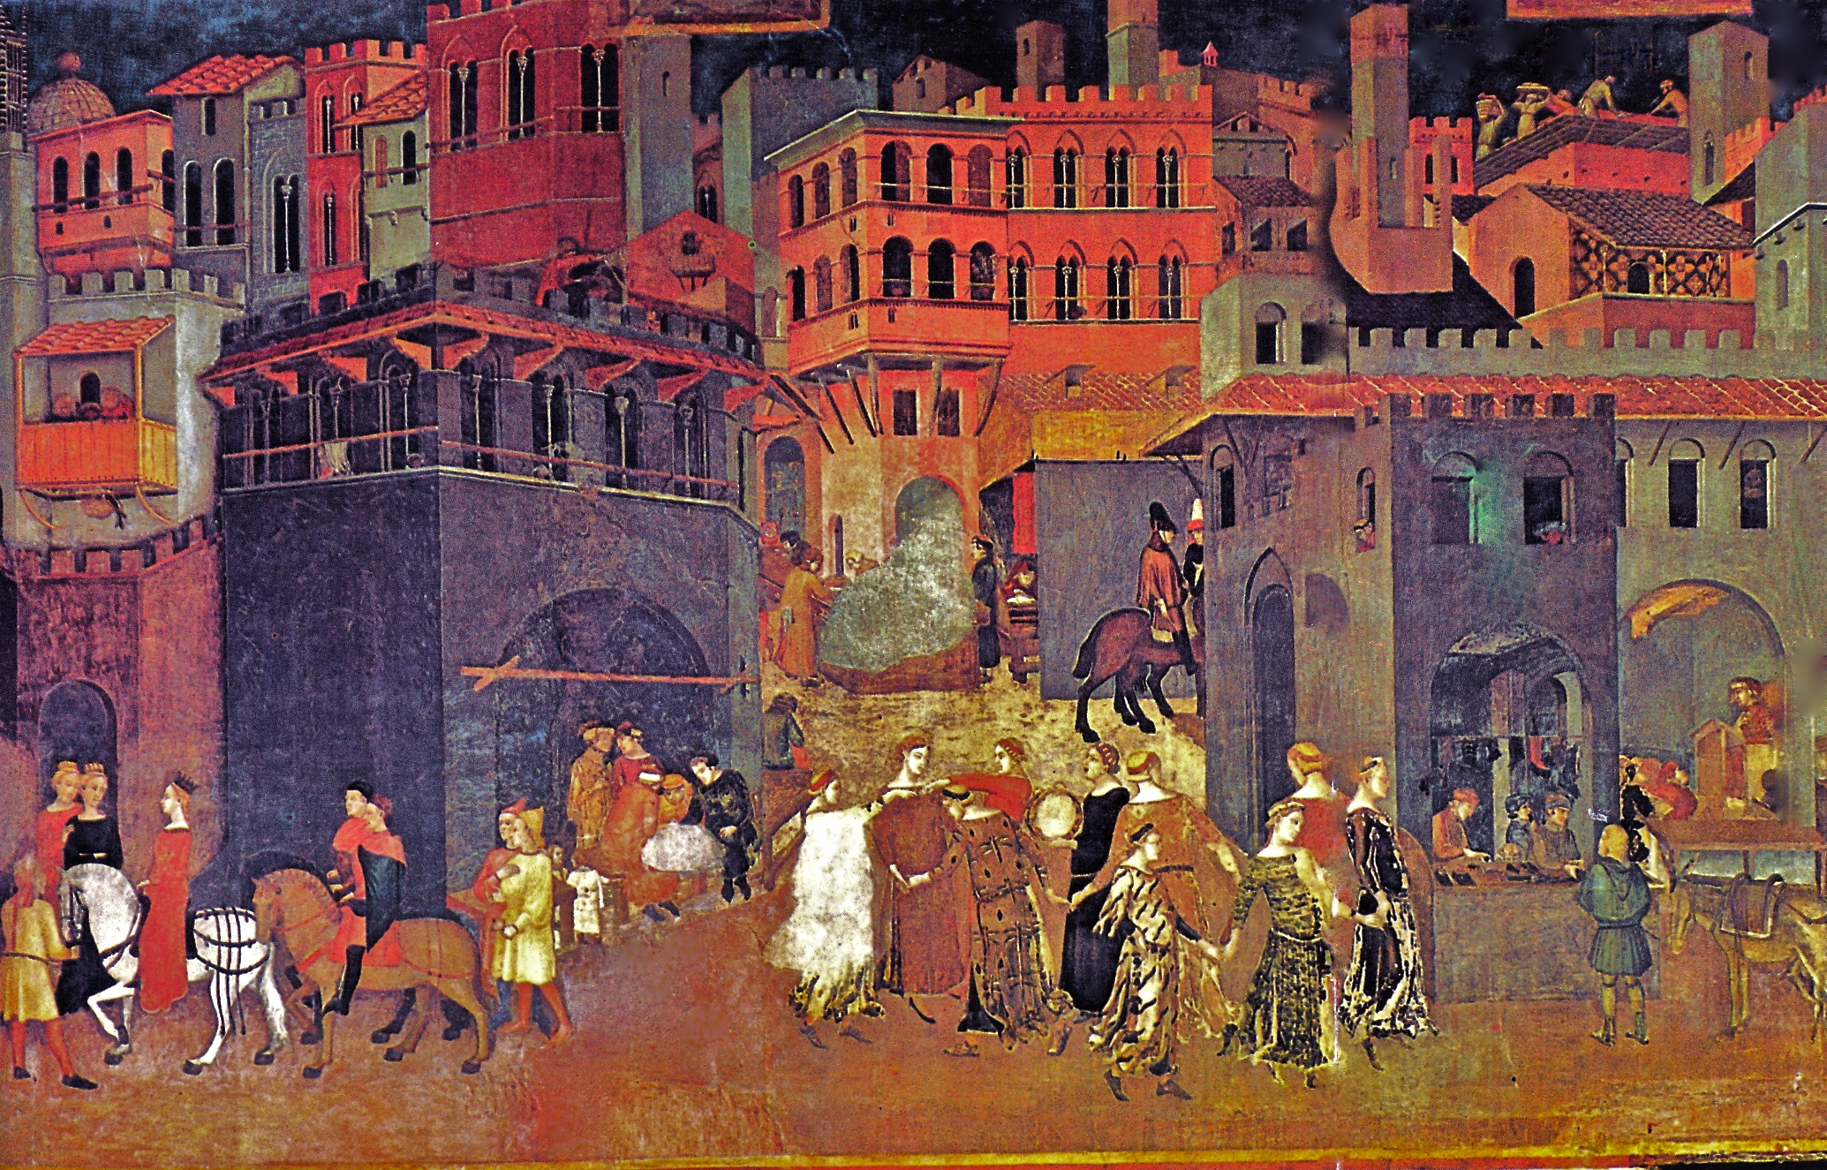
The Allegory of Good and Bad Government, 1339, Lorenzetti Brothers, Fresco
In the fourteenth century, the arts were utilized by the Italian city-republics to employ political virtues, in the room of frescos in the Sala dei Nove (Salon of Nine) of the Palazzo Publico in Siena. Entitled, The Allegory of Good and Bad Government, was painted by the Lorenzetti brothers and completed in 1339. This is a very important example of the portrayal of political virtues. Through many layers of narrative scenes, this fresco depicts the traits of a society under a good governing body, and how the city and its surrounding rural population in the countryside would be able to live and work together in peace and security without a division of classes. With good government, there would be a free flow of economic activity, as well as a strong bond between the city and the countryside. Seated at the council table in these chambers, The Council of Nine and all of their petitioners would have undoubtedly been inspired by this utopian vision. Its propagandistic and political influences are incredibly evident. And the list continues.

Slide 3
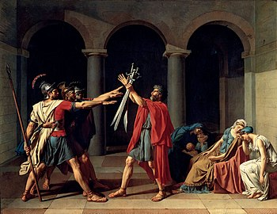
Oath of the Horatii, 1784, Jacques-Louis David, Oil on Canvas
The Renaissance period is replete with political art, with activist, academic painters like Jacques-Louis David, and Eugene Delcroix at the helm of this movement. Jacques-Louis David being an incredibly political artist of note. In his rendering Oath of the Horattii, he paints in a way that displays a complete exemplification of perspectival skill, and academic artistry but also the classical ideal of the depictions of historical legend. The story of the Horatii brothers is Roman legend of self-sacrifice and patriotism, the brothers drawing swords choosing who will end the war between their warring cities. To be sure, it is a painting with layered meanings depicting the legend of the brothers and also the onset French Revolution, but a tale nevertheless, that can be read from both sides of the revolutionary conflict. When this painting was exhibited at the Paris Salon of 1785 it captivated viewers with its implicit call for change and had tremendous influence in inspiring revolution.

Slide 4
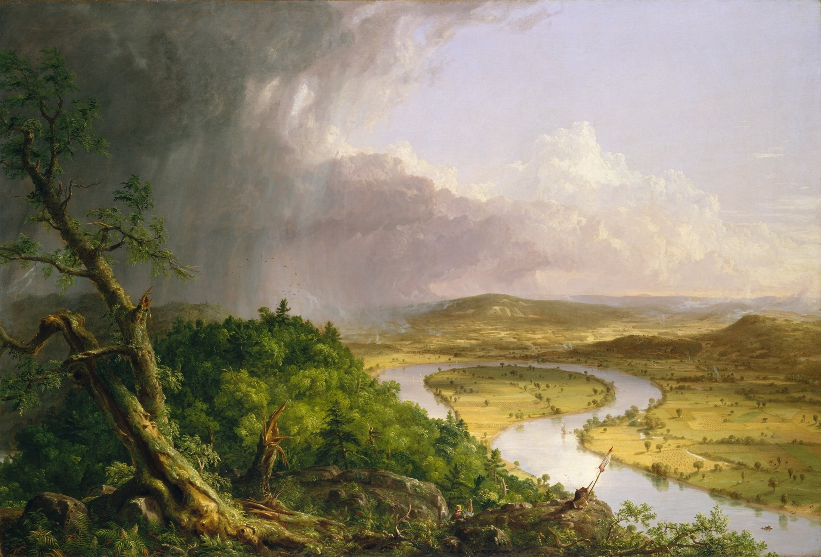
The Oxbow (View from Mount Holyoke, Northampton, Massachusetts, after a Thunderstorm), Thomas Cole, 1835, Oil on Canvas
As Western art expanded there were trends of political art moving across the sea from the European continent to the United States with the New York School. Thomas Cole’s 1836 painting, The Oxbow as well as his entire series entitled The Course of Empire, has its own political undertones. In The Oxbow specifically, The New York School painter masterfully exemplifies Kant’s definition of sublimity as “a rapid alternation of repulsion from, and attraction to, one and the same object” in his depictions of a passing storm on Mount Holyoke. The painting displays the way in which a storm can create so much destruction and beauty in simultaneity, a theme analogous to the painter’s political ideologies as a dissident of the Jacksonian democracy of his time. The painting also depicts the figure of a painter hiding amongst the fauna of this landscape creating a sense of vastness with the undertones of Christian religiosity.

Slide 5
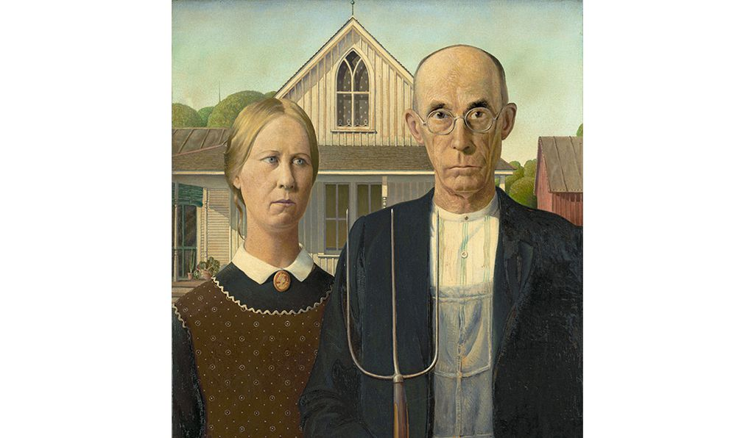
American Gothic, Grant Wood, 1930, Oil on Beaverboard
The turn of the century witnessed the Great Depression, the roaring 20’s and the developments that lead to World War I, all of which provided a vast amount of material and inspiration for artists. Seen within the context of political art, subtle as it may be, in his iconic American Gothic (1930), Grant Wood offers his comments on the onset of industrialization by focusing on the narrow mindedness of rural society100 years after Thomas Cole. His painting captures his desire to display the essence of Midwestern society, its history, and the challenges that it faces with the beginning changes of modernization and industrialization. Grant Wood blends many historical sources into his entire body of work, dispelling the importance for the simplicity of aesthetics and representation of Midwestern history. This was in keeping with the zeitgeist of post-WWI America, which was marked by a surge in enthusiasm for national myth and history which in turn, was a reflection of growing American confidence as an emerging world power.

Slide 6
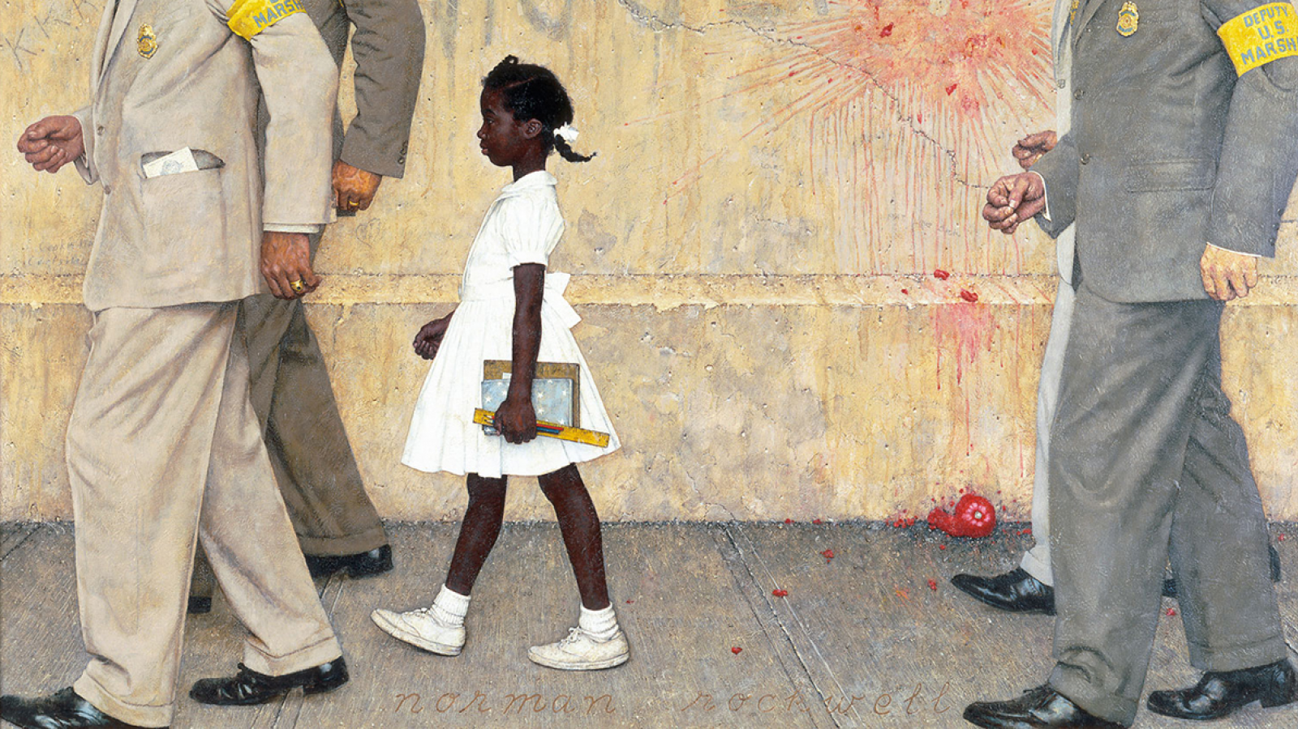
The Problem we all Live With, Norman Rockwell, 1964, Oil on Canvas
The Civil Rights Movement, whose roots can be traced to the end of WWII, through the 50’s and reached is climax in the marches and protests of the 60’s, elicited tremendous activity from American artists. Among the most famous and most accessible artists and visual commentators, Norman Rockwell was able to expose issues through his art and transmit messages for his viewers to see issues through a new light. Rockwell’s 1964 painting The Problem We All Live With became an icon of the civil rights movement. This painting directly confronts the issues of race in America and tells the story of a very humanized, 6-year old, Ruby Bridges being escorted to school by faceless by US Marshalls. She walks along a wall that has the letters “KKK” scratched into and a trace of the n-word painted on it, painted 10 years after the Brown vs. Board of Education ruling, and created with the perspective of a young child, she walks confidently into school with determination in moving forward to her new school and to a new America.

Slide 7
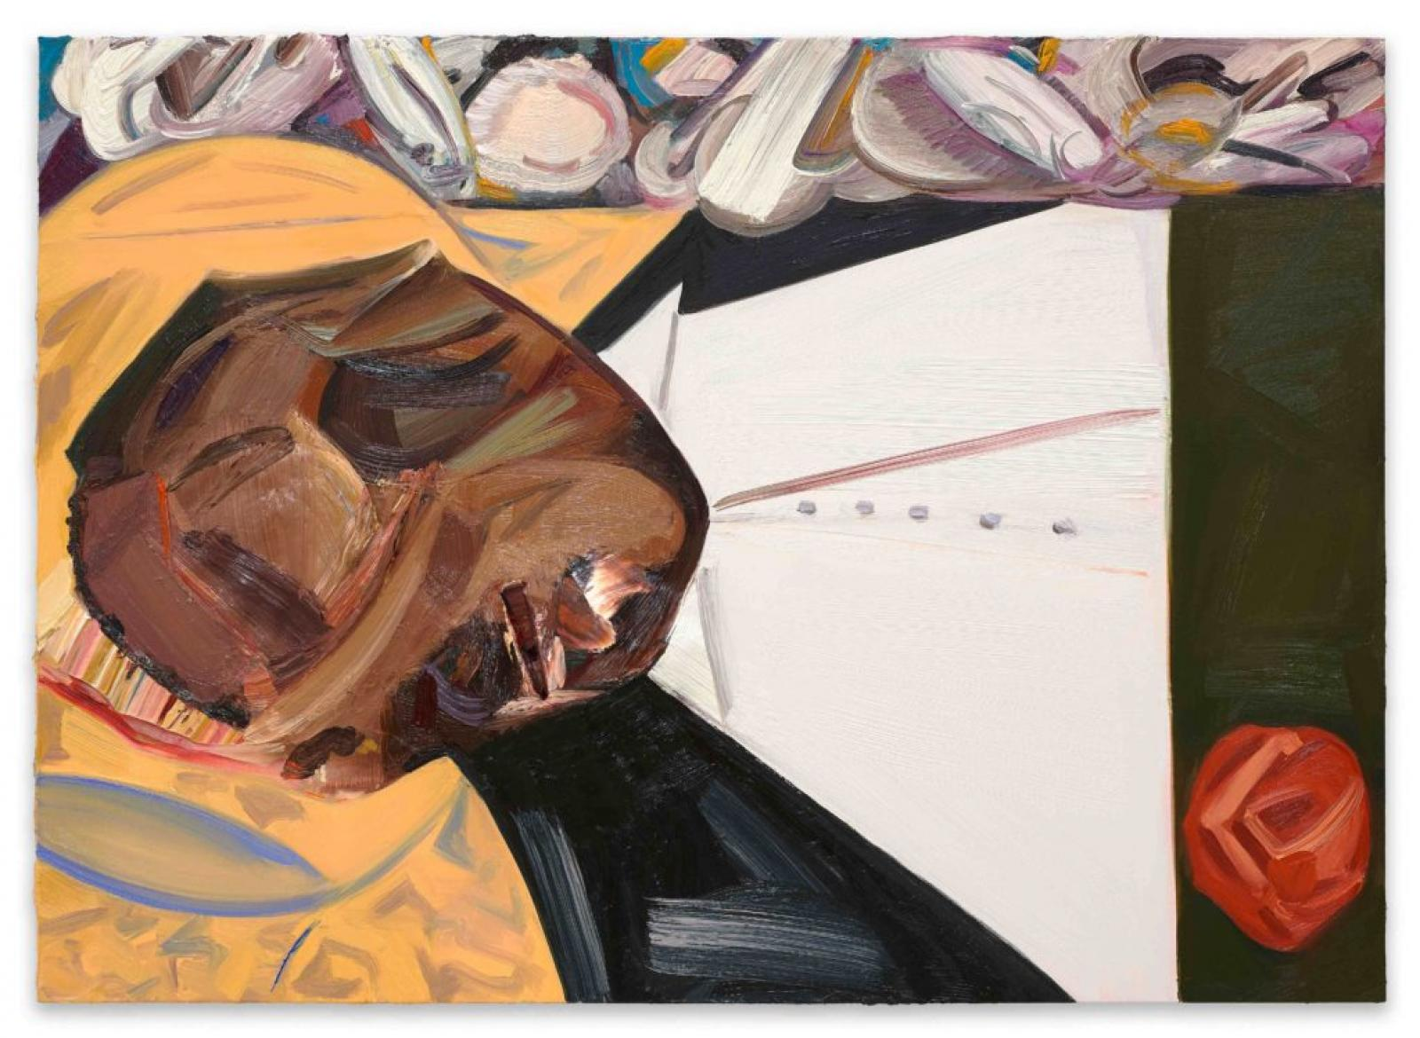
Open Casket, Dana Schutz, 2016, Oil on Canvas
Open Casket, is a painting by the white, American artist Dana Schutz which is a central piece of national notoriety, which debuted at the Whitney Spring 2017 Biennial. Her painting depicts an abstracted, impasto or thickly painted version of its main subject, Emmett Till, a 14 year-old black Mississippi teenager who was murdered in 1955 by a lynching that horrified the public, the story continues as Emmett Till’s mother opted to have an open casket at the funeral to show the brutality of racism. Schutz’s painting of this tragedy has been exceedingly controversial, stirring black and white artists alike, in protest. Hannah Black, a notable British artist of mixed racial heritage, publicly spoke out against her piece saying: “It is not acceptable for a white person to transmute black suffering into profit and fun…The painting must go.” Schutz created the painting as a response to the Black Lives Matter movement and as a shared history of America, as did Rockwell in his commentary on racial segregation, her piece also instigated a movement of questioning who can create black art and, who can tell these stories.

Slide 8
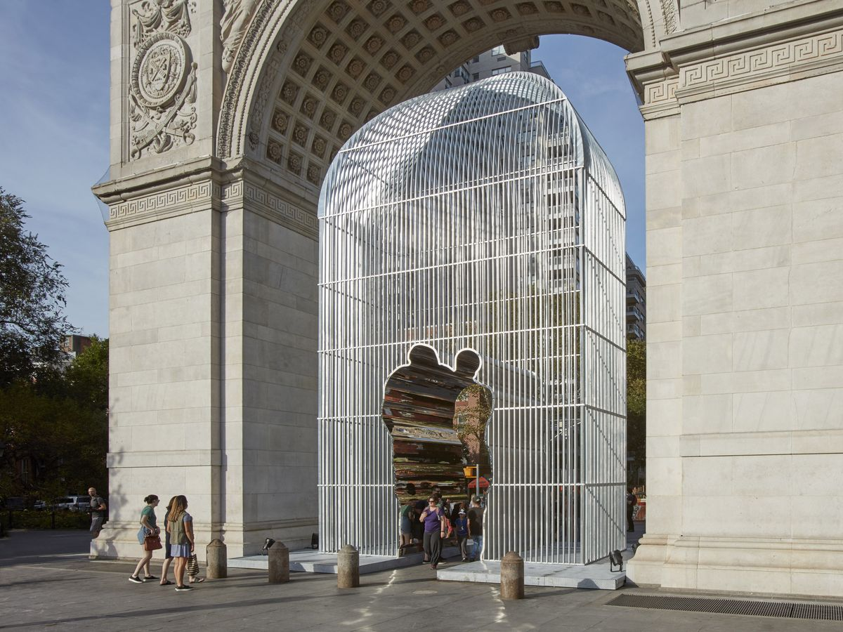
Good Fences Make Good Neighbors, Ai Wei Wei, 2017-18
Ai Wei Wei’s art is notorious for publicizing and exposing volatility and sometimes even exposing unrecognized socio-political issues of human rights and oppression all around the world. All of his exhibits aim to pose questions and make his viewers think about the dark world that surrounds them. Wei Wei finds that in this period his art has never been more important, inspired by the refugee crisis Wei Wei has over 300 works spread across all five boroughs of New York city, in an outdoor exhibition titled Good Fences Make Good Neighbors. Referencing the poem “Mending Wall” by Robert Frost, Wei Wei’s exhibition portrays the role of “fences and neighbors”, in a time when propositions of government funding for a border wall between the United States and Mexico is being suggested. This piece also plays on the Art Historical meaning of the triumphal arch as a symbol of conquest as we saw in the Arch of Titus, but with this particular arch symbolizing freedom. Ai Wei Wei was silenced for speaking out against civil liberties in China and here, in America he wants his viewers to be thinking about the worldwide crisis of refugees and the human rights issues of censorship.

Slide 9
Cabinet of Horrors, Judith Bernstein, 2017, Acrylic and Oil on Paper
Judith Bernstein is known for her outspoken and often times crude, feminist work was asked to debut a collection of anti-Trump artwork at the Paul Kasmin Gallery in New York City for a show called “Money Pieces” in specific her work Cabinet of Horrors, 2017, uses fluorescent colors, globed figures, one of which has a mouth shaped as a vagina, swastikas, dollar signs, and the words “TRUMP CABINET OF HORRORS.” This painting clearly is depictive of Trump’s unfavorable cabinet as well as a greater commentary of him as a person and his speculated associations with the Alt-Right and neo-Nazi and, his persona as a rich big shot. This piece like the others in the exhibit uses this visual language of protest and harks on Trump’s unconventional demeanor and presidency.

Slide 10
The Burial of Liberty, Aaron Johnson, 2016, Acrylic on Polyester Knit Mesh
Aaron Johnson’s The Burial of Liberty was also displayed in an exhibit at a Joshua Liner Gallery exhibit. The Burial of Liberty uses the visual language of political cartoons and depicts Trump and other characters in caricatured versions of themselves with bright comic strip colors. This busy painting depicts Trump garbed in a suit emblazoned with swastikas, beside the figures of Uncle Sam, Marilyn Monroe, John F. Kennedy and other recognizable icons of American history, all participating in the burial of the Statue of Liberty. The painting is replete with motifs that reflect American society and history and a condensation of the many different elements that comprise our society. The overarching message of the piece is abundantly clear. These individuals are engaged in burying the ultimate American symbol of freedom and hope, precisely at the end of the Obama era; the era which had been marketed as an era of “hope” and “change” has now been terminated. The symbolism of JFK with his hands in between the legs of Marilyn Monroe standing alongside Trump is intended as a graphical depiction of Trump’s Access Hollywood remark on “grabbing women,” and also depicts the sexualization and commodification of the presidency that can be traced back to JFK. Uncle Sam’s face is the only face in the image that expresses fear of what is to come in the Trump era.

Slide 11
Bloody Trump (Whatever), September, 2015, Sarah Levy, Menstrual Blood
Sarah Levy is a Portland based artist who, not formally trained in art, is interested in both the storytelling and therapeutic benefits that art provides. Levy mainly creates portraits focusing on radical history, change-makers, and people who are often ignored by the media giving them a face in her art provides a narrative for people that the media cannot. She is inspired by the intersection of politics and art, along with the influence that art has on the movements of today.
She painted Bloody Trump (Whatever), (2015), in which she depicts the face of Donald Trump using her own menstrual blood. The impetus for this was the infamous comment that Trump made in September of 2015, when recounting his performance in one of the Republican primary debates, when he said that during the debate Fox News host, Megyn Kelly looked like she had "blood coming out of her eyes, coming out of her whatever.", By using her own menstrual blood as a medium for the painting, Levy was making a shocking indictment of Trump’s disparagement of women’s intelligence due to the cycles of the female body. Levy also conflates the overarching theme of her piece with Trump’s vulgarity and his constant tendency to remark upon the deficiencies of women’s bodies, especially the bodies of women who he finds particularly unattractive. The portrait reflects of her rage against Donald Trump and is an expression of her feminist artistic activism, it depicts Donald Trump’s face with a furrowed brow, in mid-speech with pursed lips. The red pigment adds to the fury of the piece. The blood used as the medium in Levy’s piece has much more significance than just simply feminism and rage. The larger significance is in the meaning of blood itself as the medium.

Slide 12
Rise Up Thy Young Blood, January, 2017, Illma Gore and Indecline, 10ft X 15ft, Human Blood
Gore and Indecline made their connection when Indecline approached Gore to do a post-election project, resulting in the creation of Rise Up Thy Young Blood. The title of the mural paraphrases Shakespeare’s, King Richard in a call to action. The entirety of the 10x15 foot mural is painted in human blood. The mural references Henry Mosler’s, academic style, oil painting, from 1911, The Birth of the Flag. For Gore and Indecline, this particular Mosler painting not only signifies the beginning of the United States, and the importance and sacredness of the American flag, but it also signifies the “American Dream”. Mosler’s painting is a significant comment on the ideal that America was built on the contributions of all of its immigrant populations. Gore and Indecline’s painting uses the exact room that functions as the setting of Mosler’s piece, but the characters and flag are different. The artists chose to feature eight characters: a Native American woman holding up the flag, a blue-collar Trump supporter donning a hat that reads “Make America Great Again”, a black man in business clothes, a police officer, and a Muslim couple with a young child being coddled in the mother’s lap. Each of these characters symbolizes a different part of a vastly different American society from Mosler’s. Yet, also recognizes the melting pot of acceptance and tolerance that is the American Society for which Mosler immigrated to America, and is still an ideal of our society today. Assembling in the same representation of the room that Mosler depicted in The Birth of the Flag, the characters of Gore’s piece symbolize the coming together of the disparate elements of an America currently divided by numerous cultural fissures. It depicts the togetherness and unity that America needs.
The artist’s intention in this painting was “to be something that was peaceful and unifying and involved everyone.” But, it was also “a statement about 'giving all we have got' for our country after the Trump Inauguration.” And, in a rather personal and direct way, it does exactly that, as it was painted with the blood of over 50 anonymous and, apparently, high-profile donors who are themselves quite prolific in the art and music worlds. Gore and Indecline, literally “spill the blood” of other artists onto her paper unifying artists from all over in her piece. Bringing these people together in this way, united them for a cause that was unknown to them.

Slide 13
Birth of the Flag, Henry Mosler, 1911, Oil on Canvas
Mosler’s painting shows Betsy Ross and her seamstresses sewing the first American Flag. The use of this specific painting as a source of Illma Gore and Indecline’s painting is also of importance to the piece because of Mosler’s personal background. Mosler was a Jewish immigrant who came to the United States from Poland. Mosler was one of the leading figures of his era who was heavily involved in socio-political art. During the Civil War, he was a soldier for the Union army as well as an artistic correspondent for Harper’s Weekly. During his service in the Civil War he wrote letters and sent sketches that were then published in Harper’s Weekly detailing the events of the war. His accounts of the war are recorded in his journal which can be found at the Archives of American Art. As a soldier for the Union he exemplified his patriotism. After the war, he spent a significant amount of time in Paris studying and learning from other artists. He was the first American artist to have a work purchased by the French government and won an honorable mention in the Salon of 1879 for a painting of his. Upon his return from Paris, he took up the themes of patriotism in his art and was heavily involved in the rising New York City art scene. His painting, Birth of the Flag, depicting his Union patriotism and also demonstrating his classical art training, was completed seven years before his death.

