Slide 1
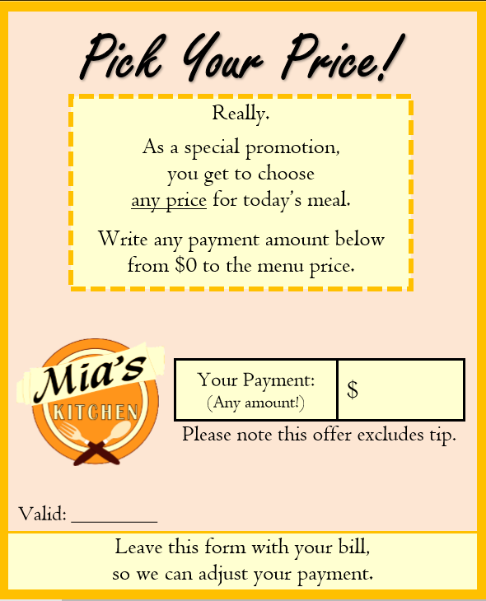
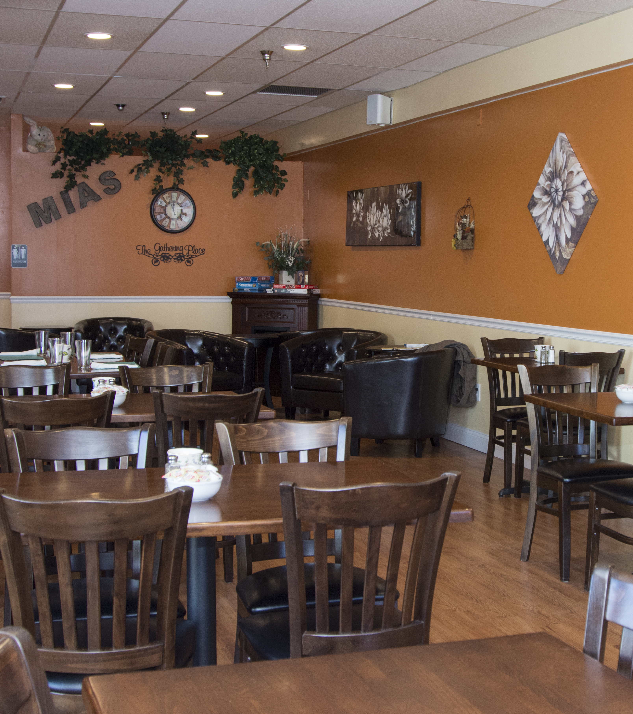
A Process for Field Studies in Behavioral Economics Victoria Ferraro – Economics, Political Science Faculty Sponsor: Dr. Stephen Atlas, College of Business Administration University of Rhode Island
Motivation
Approach
How can I develop and execute a natural field study in behavioral economics?
Phase | Objectives | Key Challenges
Building the Partnership Aug. 15- Sept. 7 | Attain commitment of owner and workers to be affected by study’s implementation | Incentivizing commitment and maintaining the partnership for the longevity of study
Learning the Partner’s Process Sept. 7 – Sept. 27 | Understand the final procedure will come from a series of trials, errors, and adjustments | Managing the “chaos” as to not hurt business, and explicitly recording errors to learn from
Streamlining a Process Sept. 28 – Oct. 31 | Apply experiment to initial understanding of business; develop in response to challenges that arise between business and research process | Lack of precedent to work with, everyday anomalies within business’s procedure, and need to maintain order and organization for clientele
Collecting the Data Nov. 1 – Dec. 20 | Maintain a procedure that will resist the strain of all major problems that have been identified over time | Adjusting what is required of the business’s normal procedure with what the experiment demands
Aftermath | Provide proper closure with the business staff and management | Ensuring our absence does not affect the establishment’s normal functions.
Background
Experimental design mechanisms such as randomization, originating in the hard sciences, have long since migrated to that the social sciences¹.
Bridges the gap between the issues economists aim to address, and the real world in which these issues exist
Particularly salient in behavioral economics (i.e. Tversky & Kahneman)
The need to externally validate lab experiments and economic theory has since brought field experiments to the realms of economic research
The purpose of collecting such data parallels that of any science: construct theory, test theoretical predictions, measure key parameters².
Today
Major challenge: A breakdown of how natural field experiments in economics are developed and implemented does not exist in academic literature
Natural field experiments are the newest, and least developed within the field
Existing guidelines: keep theory in mind, have a proper control group, build a strong relationship with the firm(s), communicate effectively⁴
Absent from existing literature are examples how to execute this advice, and what the execution of this advice looks like.
Experiment Categorization³:
Conventional lab experiments | Frame field experiments
Artefactual field experiments | Natural field experiments
Streamlining the Experimental Procedure
KEY: C: Customer R: Researcher S: Server T1: Main Tablet T2: Spare Tablet
Initial Collaboration
Final Collaboration
Step
Perceived
Restaurant Procedure
Preliminary Experimental Process
Challenges to
Experimental Procedure
Inferred
Restaurant Procedure
Final
Experimental Process
Customer
Served
If C seated at eligible table, R creates entry and assigns condition
Limited data as Cs sit at ineligible tables
C seats self or S seats C, S takes drink order
R creates entry and assigns condition for every seated C
1a.
C seats self
1b.
S takes and
records order
R waits “out of the way”
Limited visibility creates missing and erroneous data
S takes order, records order at T1
R is mobile, uses T2 to match orders to tables, record info. to log
1c.
S prepares and
serves food
R waits
R has unused bandwidth
S prepares and serves food, and takes/records additional orders
R prints bill from T2; labels table number on card
Customer Billed
R waits
R dependent on S for bill; lost data when C pays at T1; S ignores card
C appears to be ready for bill
R leaves prepared bill at front counter for S
2a.
C requests bill
2b.
S prints bill
R intercepts, records in log, fills in card; staples together, gives to S
R creates bottleneck by delaying bill for S to bring to C
S prints bill if not already printed
R waits
2c.
S delivers bill
R waits
Customers ask wait staff about cards.
S trained to deliver bill with script about cards
R waits
Customer Pays
S collects payment
R intercepts paid bill; R records, calculates discount for S to adjust
C ignores card; S ignores R
R intercepts paid bill; records, adjusts discount choice on T2
3a.
S collects payment
3b.
S returns change/card/receipt
R waits. R records tip when S brings it to front counter.
More bottlenecks: R waits for S to return; T in use by other S
S returns change/card/receipt
R waits for C to leave. R collects tip from table or asks S to do so
Main Takeaways
Conclusion
Experimental design development requires an approach of layering adjustments onto an original, blanket approach. The final experimental design should fit into the normal, every-day business procedure ‘like a glove’.
Recording, in detail, all conflicts that occur between experimental design and business procedure is necessary to develop final fitting experiment
Design should not affect regular business flow; to have the experimental design effect the flow of the businesses design too strongly, will spoil the credibility of the data you are collecting.
Researcher-organization partnership is vital; maintaining a presence and involvement with the staff at all times will prevent slip-ups and missed steps from occurring.
Maintain open dialogue with management and staff
“Run the field experiment yesterday rather than tomorrow” (3)
Natural field experiments with private businesses must:
Coincide smoothly with the business's regular operational structure
Not compromise efficient and effective data collection for researcher
Future research:
Once a final procedure for a natural field experiment is established and refined, many different variables can be further manipulated and tested within the environment, on both the business and consumer side of the experimental design.
Work Cited:
List, John A. "Why economists should conduct field experiments and 14 tips for pulling one off." The Journal of Economic Perspectives 25, no. 3 (2011): 3-15.
Reiley, David H., and John A. List. "Field experiments in economics." The New Palgrave Dictionary of Economics (2007).
Harrison, Glenn W., and John A. List. "Field experiments." Journal of Economic literature 42, no. 4 (2004): 1009-1055.
List, John A. Field experiments: A bridge between lab and naturally-occurring data. No. w12992. National Bureau of Economic Research, 2007.
Work Cited:
1. Harrison, Glenn W., and John A. List. "Field experiments." Journal of Economic literature 42, no. 4 (2004): 1009-1055.
2. List, John A. "Why economists should conduct field experiments and 14 tips for pulling one off." The Journal of Economic Perspectives 25, no. 3 (2011): 3-15.
3. List, John A. Field experiments: A bridge between lab and naturally-occurring data. No. w12992. National Bureau of Economic Research, 2007.
Acknowledgements: URI Mental Accounting and Pricing Lab, & Carrie Gill for her contributions to diagram design. URI Honors Department, & Caroline Hames.

