Slide 1
Sometimes Laughter is the Best Medicine: Stand Up Comedy, Humor, and Healthcare
Haran Mennillo

Slide 2
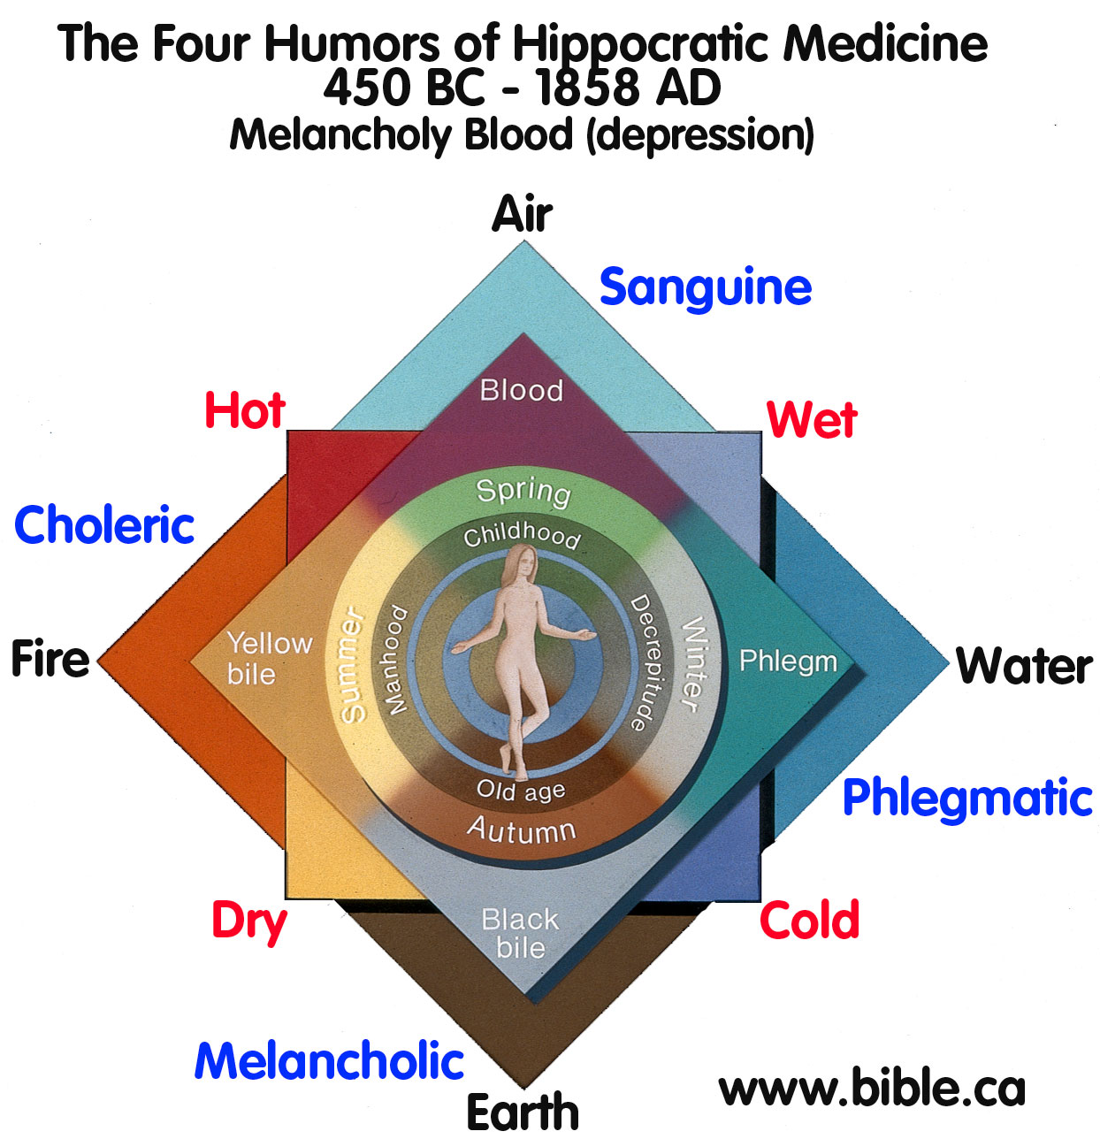
Why did I do this?/ Learning outcomes
Learn about the role of Humor in the field of Healthcare
Put humor into practice in order to develop my own skills.
Notes:
Describe learning objectives and reasons why project was done. What did I get out of it?

Slide 3
What is my Project
Literature Review
Humor and Medicine
Communication
Coping Mechanism
Physiological health benefits
Stand-up comedy
Performed 4 stand up acts in total
Culminated in competing in Last Ram Standing
Notes:
Describe the process of the literature review, sources drawn from pubmed, proquest, ebscohost, and other URI library databases.
Focus on several aspects of humor, the use of humor as a method of communication, as a coping mechanism, and also any possible health benefits of humor.
Second, the practical aspect, developing and performing stand up routines throughout the semester in order to practice humor in a public setting.

Slide 4
Stand up Sample
Notes:
What you are about to hear is a modified version of an excerpt from my last stand-up act,

Slide 5
Literature Review
Notes:
So now it’s time to get serious about being funny.

Slide 6
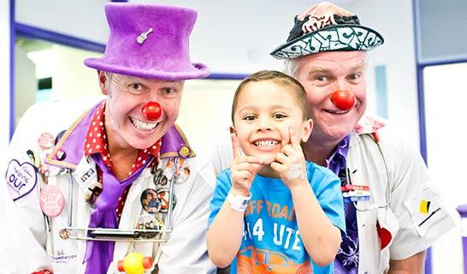
Clown Doctors
Notes:
When people think of humor and medicine, often the first thing that comes to mind is medical clowning, and figures such as Patch Adams. An Italian study has shown that compared to the general physician population, doctors that practice clowning are more agreeable, open, and extraverted, and are less neurotic. Clowning is also looked on favorably by parents in a pediatric setting, almost 85% viewing it as helpful not only to their children, but to themselves and other medical staff. If something as overt as clown care can provide favorable outcomes, imagine the benefits of more subtle uses of humor in the healthcare setting. (Dionigi 2016) (Mortamet et al 2017)

Slide 7
Why can Healthcare be a laughing matter
Communication
Provider-Patient
Provider-Provider
Patient-Patient
Coping (Stress/Loss)
Patient Coping
Provider Coping
Health
Notes:
Humor can be beneficial in several aspects of healthcare. First and foremost is the role of communication, as it can assist not only in communication between healthcare providers and patients, but also among providers and among patients. Second, medicine can be a very stressful field, being in proximity to illness, morbidity, and mortality. Humor is, and can be used as a coping mechanism, both for patients suffering illness, and for the providers that treat them. Finally, when humor is used as a coping mechanism, it is linked to several health benefits.

Slide 8
Communication
Patient-Provider
Relationship Maintenance
Boundary management
Patient-patient
Comradery
Provider-Provider
Coping
Peer Support
Notes:
The provider-patient relationship is critical for effective practice of medicine, and physicians that can not only utilize, but also acknowledge and respond to humor initiated by their patients, can break down barriers and better provide care (Beach 2016). Studies reviewing transcripts of interactions between doctors and cancer patients show that the vast majority of them incorporate some use of humor, with the same being true for diabetic patients as well (Schopf 2015). This humor is not only a tool through which physicians can connect with their patients, but also use it to determine if a patient is subtly expressing a desire. For example in the qualitative transcript study mentioned earlier, when asked about weight loss, a patient responded humorously “I wish”. Physicians with experience with humor could pick up on this, and better inform the patient about their concerns, and how they can best make a healthy change.
Humor can also be a tool with which to manage a patient’s boundaries. In the case of adolescent patients, physicians can utilize humor to bring up topics, such as sex and drugs, that a patient might not otherwise wish to discuss in the presence of their parents (Ebersole 2016). Additionally, adolescents will use humor to signal topics that they are not yet comfortable discussing.
Among patient support groups, humor can be used to instill a sense of comradery and inclusiveness. For example, in Men’s support groups for prostate cancer, humor is used to get new members comfortable talking with the group. In addiction and substance abuse support groups (12-step programs), former members use humor to both connect with new members seeking help, and also to reach out to populations resistant to legal and factual motivations for seeking treatment (Canha 2016).
With regards to humor used among healthcare providers, the primary purpose of that humor is for coping and peer support, which I will get to later.

Slide 9
Provider Coping
High Stress Occupation
Mental Health Professionals
Surgeons
Vicarious Traumatic Stress
Posttraumatic growth
Notes:
Medicine can be an extremely high stress field, and as such it is essential that physicians find a way to cope with this stress. Healthcare providers can be subject to secondary trauma as a result of providing care, and often must seek out self-care in some form (Dorocial 2017). Humor can be a very effective form of self-care and coping. Therapists and other mental health professionals often use humor as a way to combat secondary traumatic stress (Breen 2014), and among surgeons in Australia, humor is deemed one of the most essential non-professional skills when in a disaster setting, as it not only helps relax stress, but also promote teamwork among surgical groups (Willems 2013). Disaster surgery training programs are encouraged to utilize humor during the training process, as trainees would then deem humor to be acceptable to use in the field.
In addition to combating stress, humor also positively predicts vicarious posttraumatic growth, so that providers can better be able to handle secondary traumatic stress in the future (Manning-Jones 2016).

Slide 10
Patient Coping
Humor as a Coping Strategy
Alternative to Harmful Coping Methods
Patient Initiation of Humor
Cancer
Hospice/Palliative Care
Notes:
In addition to the providers who work in stressful environments, the patients that they serve are also under a lot of stress regarding their personal health, or the health of their loved ones. Many patients, having to deal with the stress of illness, turn to various methods of coping, some healthy, others not so much. Opposed to negative coping mechanisms, such as denial, or substance abuse, humor can help patients deal with stress in a positive way. In a Japanese analysis of how coping strategies are related to patient demographics and health conditions, the type of illness was not correlated to the type of coping mechanism, however, younger patients were more likely to use humor to cope than older patients (Ito 2017).
Patients in a variety of settings, including oncology (Cancer), hospice and palliative care utilize humor to cope. In both, it is often the patient that initiates humor, with providers taking that as a cue as to the acceptability of their own humor use. While using humor to cope with stress, the humor is often used to hide a concern that the patient is having. For example, a cancer patient making a joke about how they are suddenly losing more weight now than they ever have dieting, could be signaling that they are concerned about the rate of their weight loss. Coping with the stress of this rapid change in health, providers with an understanding of the reasoning behind a patient’s humor can best respond to their concerns.

Slide 11
Physiological Health Benefits
Notes:
Patients that practice humor as a coping mechanism had lower systolic blood pressure (Ito 2017).

Slide 12
Humor Practice: Stand-up Comedy

Slide 13
My Stand Up
Fieldwork
Comedy Connection
Internet Research
Performances
URI Open Mic (X3)
Last Ram Standing
Notes:
The practical portion of my project consisted of two parts, fieldwork, and performance. For fieldwork, I went to a comedy exhibition at Comedy Connection in East Providence, featuring several local comics, both amauture and professional. From observing the styles of these local comics, and also professional comics on the internet, I was then able to create my own comedy routines.
The URI Coffeehouse, right here in the Memorial Union, was the proving ground for my stand-up acts. My first act started slow, with a story about losing to a group of 5th graders in soccer.
After this act, and further fieldwork, I realized that what separated successful comics from the less than funny ones was that they had crafted a persona for themselves. That, and they also made fun of their families and significant others. So, much to the dismay of my lovely sisters, mother, and girlfriend, I decided to incorporate both of these qualities into my second act, in which I was the scatterbrained geek with ADHD, using logic to prove that a messy room is more efficient than a clean one.
My third act, was regarding the great clown scare of 2016, which was successful at first, but in preparation for my final performance at Last Ram Standing, I rewrote and refined, adding new jokes, and removing those that fell flat.
While it may have seemed that these acts were spontaneous and off the cuff, their scripts were actually the product of many hours of work and practice, running jokes by different people to see what worked and what did not. Additionally, I had to tailor each of my performances to my expected audience. For example, while at the coffeehouse i often made fun of the government, which was well received by the crowd. However, at Last Ram Standing, I received a tip that much of the audience would consist of Fraternity brothers, so I ensured that I incorporated fart-jokes and similar humor.

Slide 14
Notes:
And I’m happy to say that this work paid off, and I won second place!

Slide 15
Why did I do this?/ Learning outcomes (Reflection)
Learn about the role of Humor in the field of Healthcare
Communication and Coping
Put humor into practice in order to develop my own skills.
Public Speaking
Audience Awareness
Adaptability
Notes:
Describe learning objectives and reasons why project was done. What did I get out of it?
From the literature review, I’ve learned just how important humor can be in a healthcare setting.
From my practice of stand-up, I’ve learned that it isn’t enough to know what makes something funny, but also to be able to adapt to your audience.
I hope that what I’ve learned from this project will not only help me to be a better physician in the future, but also give me a tool with which to cope with the stressful, yet necessary field that I hope to be a part of.

Slide 16
Thank You!
Notes:
Works cited
Ariff, F., A. Suthahar, and M. Ramli. "Coping styles and lifestyle factors among hypertensive and non-hypertensive subjects." Singapore medical journal 52.1 (2011): 29-34.
Beach, Wayne A., and Erin Prickett. "Laughter, Humor, and Cancer: Delicate Moments and Poignant Interactional Circumstances." Health Communication (2016): 1-12.
Breen, Lauren J., et al. "The “specter” of cancer: Exploring secondary trauma for health professionals providing cancer support and counseling." Psychological services 11.1 (2014): 60.
Canha, Benjamin. "Suppl 1: M2: Using Humor in Treatment of Substance Use Disorders: Worthy of Further Investigation." The Open Nursing Journal 10 (2016): 37.
Claxton-Oldfield, Stephen, and Anamika Bhatt. "Is there a place for humor in hospice palliative care? Volunteers say “Yes”!." American Journal of Hospice and Palliative Medicine® (2015): 1049909116632214.
Corrigan, Patrick W., et al. "Does humor influence the stigma of mental illnesses?." The Journal of nervous and mental disease 202.5 (2014): 397.
Dionigi, Alberto. "Personality of Clown Doctors." Journal of Individual Differences (2016).
Dorociak, Katherine E., et al. "Development of the Professional Self-Care Scale." Journal of counseling psychology 64.3 (2017): 325.
Ebersole, Diana S., and Rachael A. Hernandez. "“Taking Good Care of Our Health”: Parent-Adolescent Perceptions of Boundary Management About Health Information." Communication Quarterly 64.5 (2016): 573-595.
Ito, Miho, and Eisuke Matsushima. "Presentation of coping strategies associated with physical and mental health during health check-ups." Community mental health journal (2016): 1-9.
Manning-Jones, Shekinah, Ian de Terte, and Christine Stephens. "Secondary traumatic stress, vicarious posttraumatic growth, and coping among health professionals; A comparison study." New Zealand Journal of Psychology 45.1 (2016): 20.
Mortamet, Guillaume, et al. "Parental perceptions of clown care in paediatric intensive care units." Journal of Paediatrics and Child Health (2017).
Oliffe, John L., et al. "Connecting humor, health, and masculinities at prostate cancer support groups." Psycho‐Oncology 18.9 (2009): 916-926.
Schöpf, Andrea C., Gillian S. Martin, and Mary A. Keating. "Humor as a Communication Strategy in Provider–Patient Communication in a Chronic Care Setting." Qualitative health research (2015): 1049732315620773.
Stewart, Simon, et al. "Is the last “man” standing in comedy the least funny? A retrospective cohort study of elite stand-up comedians versus other entertainers." International Journal of Cardiology 220 (2016): 789-793.
Willems, Anneliese, et al. "Interprofessional non-technical skills for surgeons in disaster response: A qualitative study of the Australian perspective." Journal of interprofessional care 27.2 (2013): 177-183.

