Slide 1
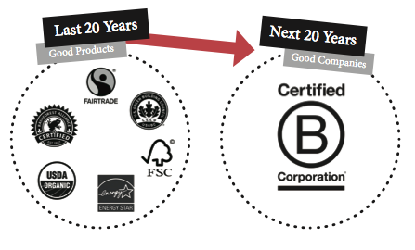
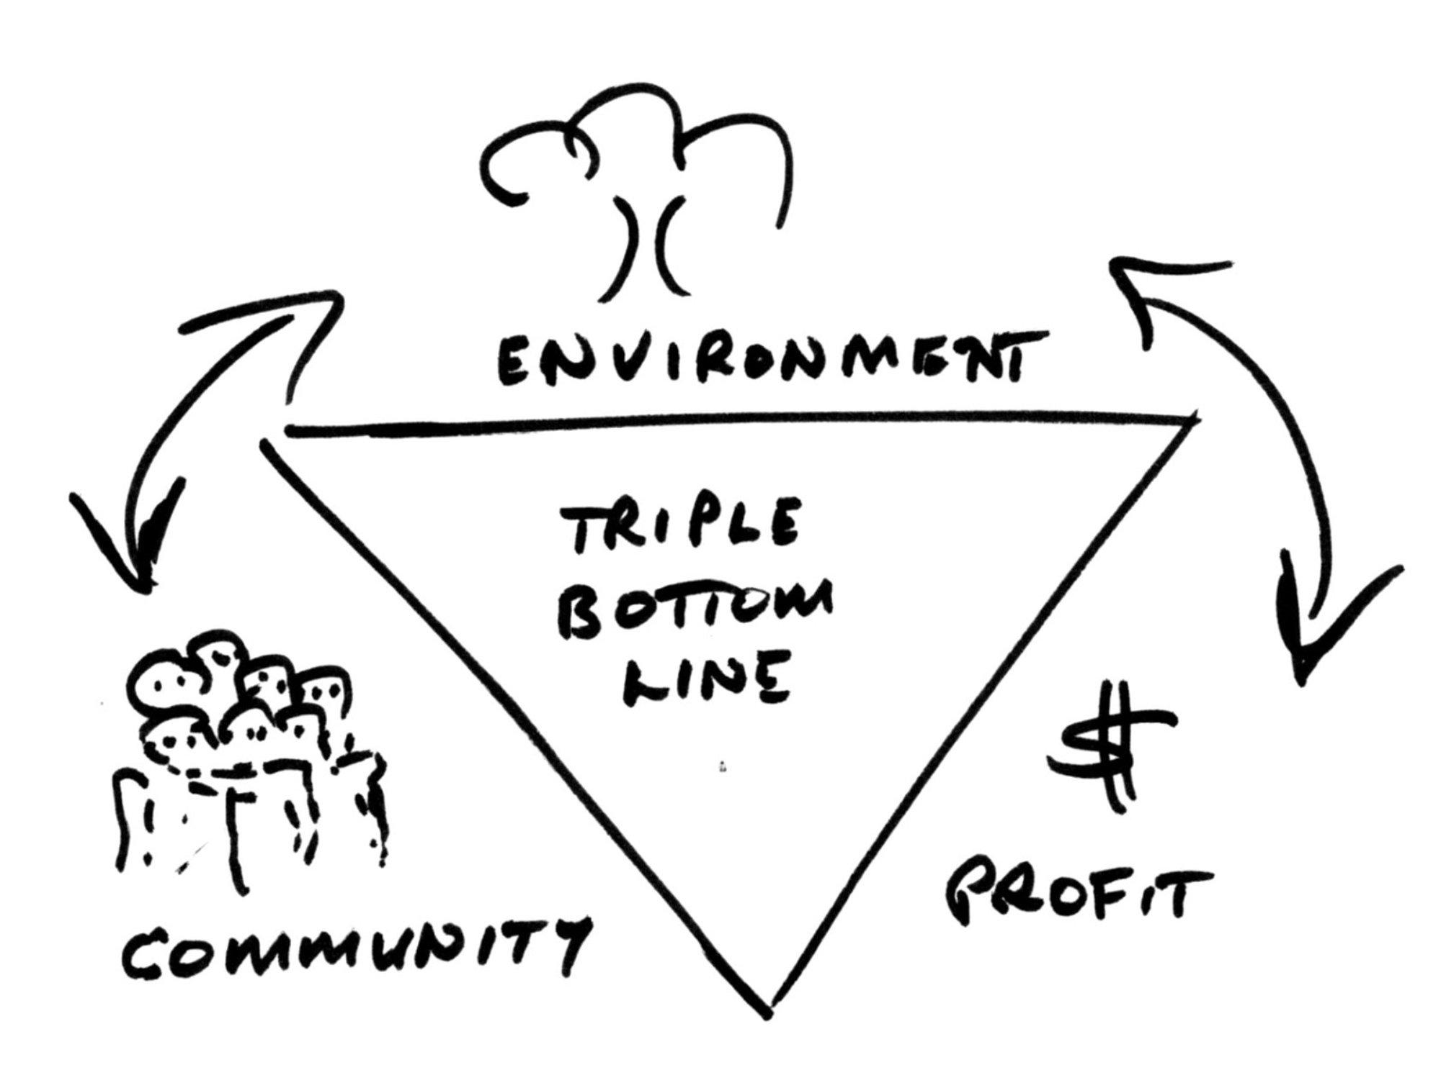
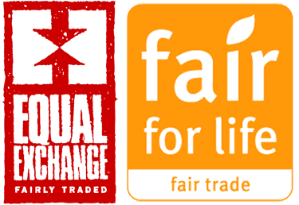
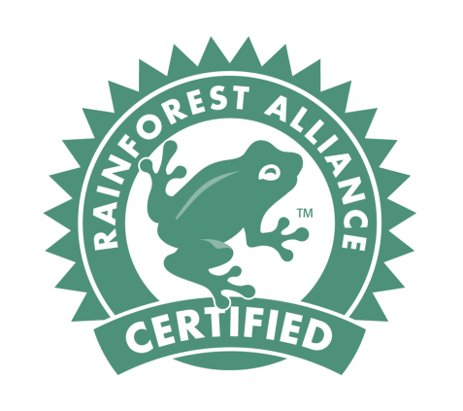
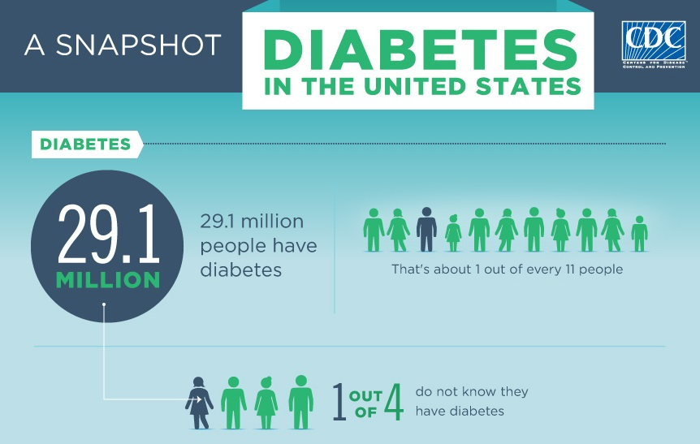
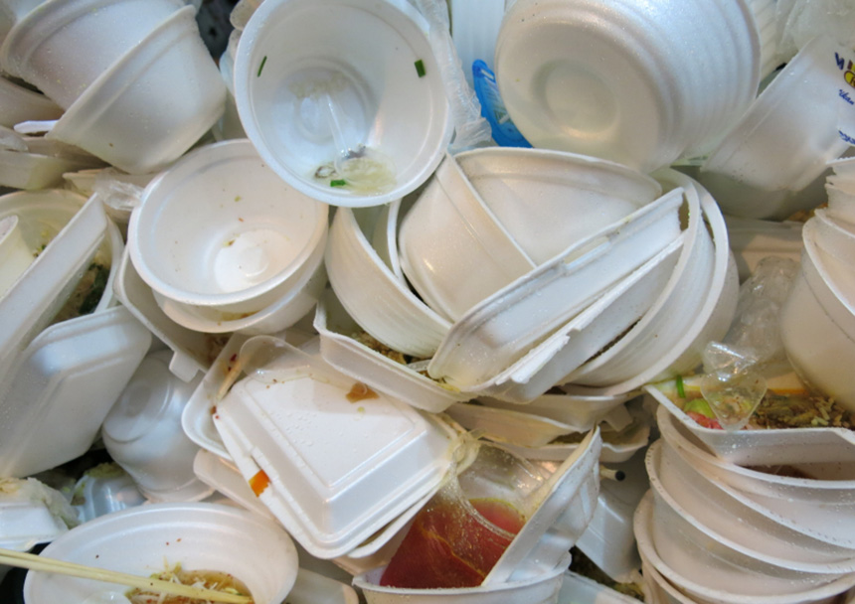
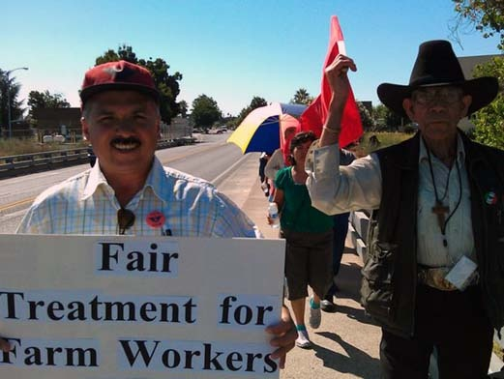
Redefining “Success” : Toward a community minded restaurant industry Molly Bennett, Supply Chain Management
The project was originally intended to be a cost/benefit analysis of the feasibility of operating a profitable food service company that was centered around a positive impact on the community and the planet. After beginning my research I found that many restaurants in my local area were already following these practices. I decided to learn from them by identifying what was working, what wasn’t and how much the consumer valued these practices. Through conversations with local restaurant owners, farmers, and consumers I was able to gain a perspective of the community minded industry that I wanted to be a part of. “As business owners we should focus on the little things that we can do to build a better community.”
–Tilly’s Cheesesteaks Owner
.
Companies with Similar Goals
Certified B Corporation has one unified goal to redefine success in business. They are a certification for for-profit companies to meet rigorous standards of social and environmental performance, accountability, and transparency. Founded in 2006 they envision a global economy that uses businesses as a force of good. They provide conferences for its members and help companies continually develop a business that impacts more than just its shareholders.
Price Comparison
Whether motivated by benefits for their own health, or the health of the environment, an educated consumer tends to buy organic whenever possible. I sought to analyze the common perception that organic food is too expensive. I scavenged a local grocery store called Belmont Market that sells organic and nonorganic food and found some similar prices of organic certified products compared to conventionally produced food. The market also provides wholesale products for businesses at comparable prices as well. Local coffee shop owner, Dave Turchetta, says “If customers are willing to pay and the profit margin is the same then I want to sell the best product.”
The Need
Ways restaurants are making a difference
If not buying organic food then trying to keep food sourced within 50 miles
Using certified products, like Rainforest Alliance
Providing meals for employees when working long shifts and training employees so they can have the skills to become more marketable
Continuously researching the suppliers, watching the news
Encouraging customers to recycle and buying biodegradable containers
Healthy Choices
Most consumers are somewhat concerned about healthy food choices when they dine out. However, my survey shows that convenience and price are just as important. This means many consumers turn to fast food. Studies have shown that Fast-food consumption has strong positive associations with weight gain and type 2 diabetes. Fortunately there are healthy alternatives. Crazy Burger in Narragansett tries to make everything from scratch, even condiments, so they know what ingredients are going into their food. This is just one example of many establishments that strive to provide fresh healthier options.
Mini Success
The concept of sustainable restaurants is steadily growing. My research has found several establishments that are taking steps toward their own viable identities. The real obstacle is the consumer. Rightfully so, they expect a dining establishment that offers choice, value, taste and convenience. Must any of these expectations be sacrificed due to sustainability? One of my goals has been to open a sustainable fast food restaurant. This project has allowed me to understand the realities of making this dream happen, as well as to be a more conscientious restaurant consumer.
Environmental
Now, more than ever, reducing waste and recycling are smart tactics to incorporate into a business. Restaurants are faced with the decision to negatively impact the environment or take steps to implement sustainable practices. According to a local coffee shop owner in Rhode Island, the process of waste management is not adequately managed, nor is it cost effective to adopt eco-friendly containers. Managers are not willing to buy eco friendly products if they are going to be sitting in trash bags in a landfill. Unfortunately some of the managers felt limited in the ways they can be eco friendly and hoped future regulations and better systems are put into effect. Just as alarming, only 10 out of 132 consumers surveyed said they won’t use styrofoam cups.
Fair Treatment of Workers
Some restaurants turn a blind eye on their food suppliers and purchase food that was harvested or prepared from workers that were mistreated. A sustainable restaurant will follow ethical labor practices. This includes fair treatment to those people who grow, distribute and serve the food. Most local restaurant owners that were not associated with a chain boasted about their higher than average employee wages. According to my survey, 90 out of 120 consumers did not know where restaurants sourced their food nor if they followed ethical labor practices.
Websites Cited
Marcario, Rose. "B Corporation." Why B Corps Matter | B Corporation. N.p., n.d. Web.
"US Labor Law for Farmworkers." US Labor Law for Farmworkers | Farmworker Justice. N.p., n.d. Web.
“Triple bottom line.” The Economist. The Economist newspaper,17 Nov. 2009. Web
Acknowledgements
Special thanks to Robert Widell, History
Thank you to the following people and companies, TLC owner Dave Turchetta, Casey Farm site manager Jane Henndy, Tilly’s Manager John, Belmont Market, Crazy Burger, Professor Dara Schniederjans and Dan Levinson.
Logos should go here if you have to use logos
Notes:
Survey
When looking at graph it portrays that the majority of people agree that they would like to make better choices when it comes to treatment of the workers, environmental impact or health implications. The sample survey shows that only 37% of people believe it is the restaurant industry that does not provide enough. To my surprise the majority of people agree that they are content with the ways things are. The results of this survey baffle me and my conclusion is that people overall would like to make the world a better place but the effort to educate oneself and make the choice to go only go to restaurants that fit with your values is too much work.

