Slide 1
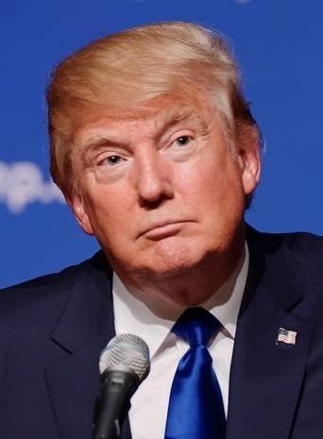
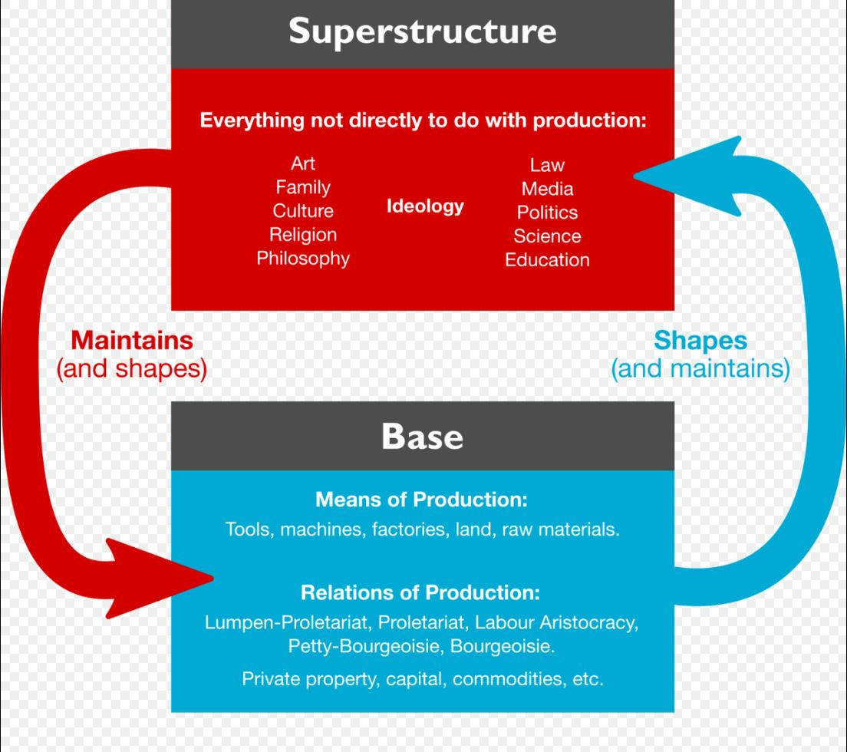
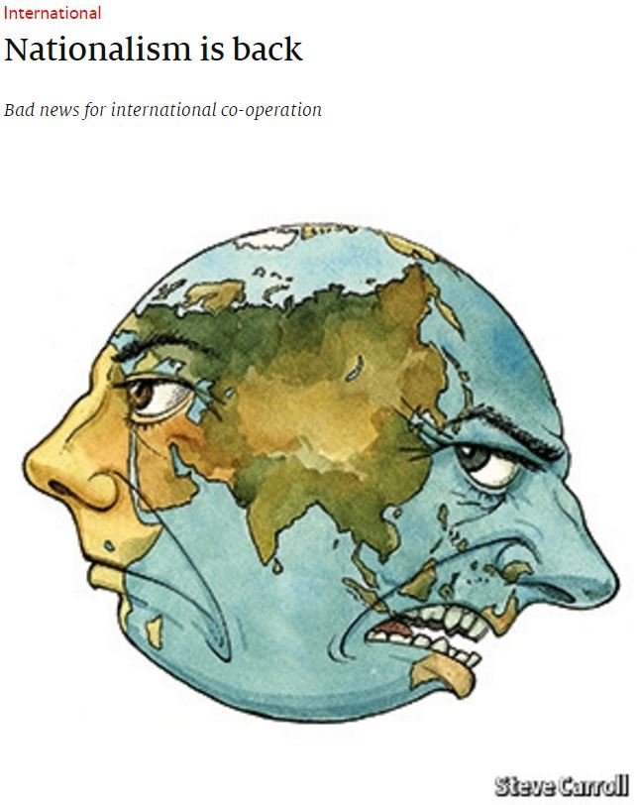
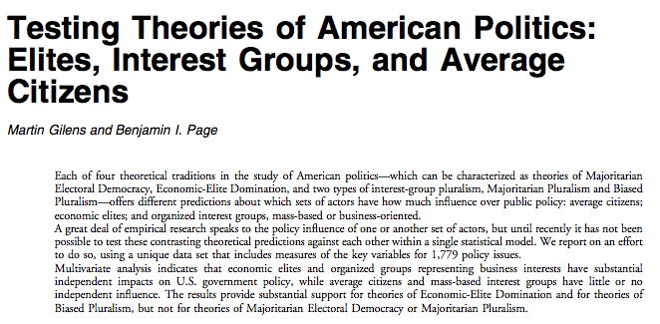
Cultural Hegemony In American Democracy, Mark Bocchini Media, Elites, and the rise of Trump
?
Backgroud/Learning Outcomes
Findings
Discussion
Background:
Election 2016
Occupy wall street
Brexit and the dissolution of the EU
Iraq War
Civil and Legal society form the state
Base and superstructure
Outcomes:
Understand why the media was manipulating us this election
What is our relationship to the media?
What factors came together to lead to Trump’s rise to power?
What role do the elites play?
Trump is the product of a system.
The rise of populism and authoritarianism across the globe is a backlash against the global and intrastate systems which have disenfranchised the working people for decades.
The American people are living in a oligarchy. The media manipulated the masses, and the polls are skewed by those interests.
Trump came along and (said he) wanted to destroy the establishment.
The media manipulated the masses on behalf of its corporate and bureaucratic owners in order to stoke organic crises which would allow the state to legitimize its use of force.
In order to prevent further Trumps, do we need to revive civics and do our best to undo the creation of the “naïve and complacent citizenry” that has gotten to us?
What do you think caused this?
What is the role of partisanship and divisiveness, how much does that contribute to achieving consensus on policy matters?
What is the role of race?
What is the role of increased apathy towards politics?
To what extent does our creation of online echo chambers hinder our ability to talk to one another about serious policy matters and political beliefs?
Is this the end or are people finally starting to wake up to what is around them?
How much can we blame those who wish to manipulate us, as opposed to ourselves?
References
Chomsky, Noam. "What Makes Mainstream Media Mainstream." What Makes Mainstream Media Mainstream. Z Magazine, Oct. 1997. Web. 15 Feb. 2017.
Gramsci, Antonio, and Joseph A. Buttigieg. Prison Notebooks. New York, NY: Columbia U, 1992. Print.
Marx, Karl. "The German Ideology." Works of Marx and Engels 1845. Progress Publishers, n.d. Web. 15 Feb. 2017.
Rorty, Richard. Achieving Our Country: Leftist Thought in Twentieth-century America. Cambridge, Mass: Harvard UP, 1999. Print.
Riley, Dylan J. "Hegemony, Democracy, and Passive Revolution in Gramsci's Prison Notebooks." EScholarship. California Italian Studies, 24 Feb. 2011. Web. 22 Mar. 2017.
T.J., Lears Jackson. "The Concept of Cultural Hegemony: Problems and Possibilities." The American Historical Review 90.3 (1985): 567-93. JSTOR [JSTOR]. Web. 15 Feb. 2017.
.
Acknowledgements
Steve Williamson, Political Science
The University of Rhode Island

