Slide 1
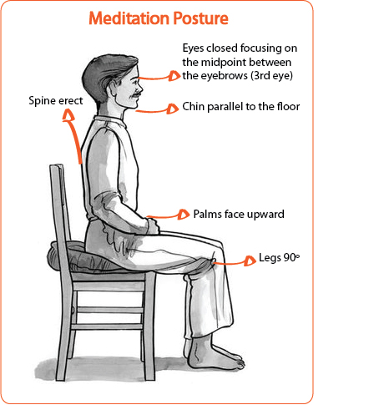
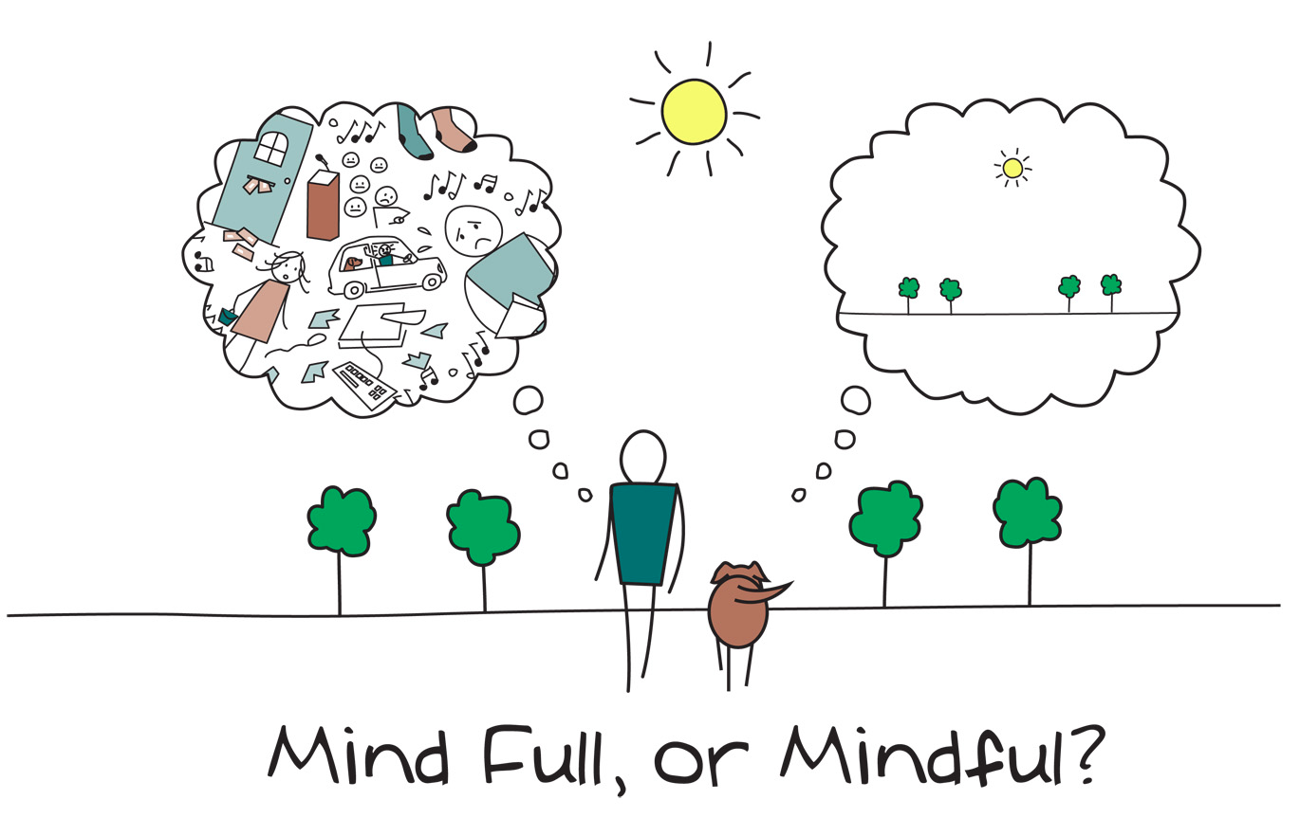
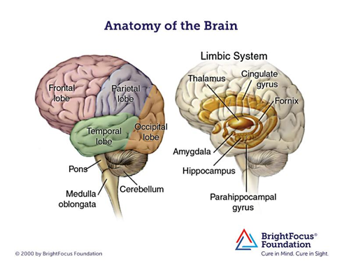
Mindfulness meditation: effects on stress management and public speaking ability
Maggie Buell
URI Undergraduate, College of Nursing
Introduction
Stress and anxiety are emotions that many individuals experience in their lifetime.
These feelings can occur suddenly or develop on a gradual and consistent basis.
Mindfulness meditation helps to decrease negative emotions by bringing awareness to the present moment in a natural way.
By maintaining awareness moment by moment, without judgment, a greater sense of emotional balance and well - being is developed.
Approach
A meditation group was designed to support teachers and breathing
techniques were implemented with a 6th grade chorus class.
Breathing in, I calm my body. Breathing out, I smile.
Dwelling in the present moment,
I know this is a wonderful moment.
The development of three PowerPoints took place in order to describe the basics of mindfulness meditation:
Session 1: Introduced meditation with deep breathing and a body scan practice,
Session 2: Described the power of pause and mantra meditation,
Session 3: Acknowledged fear and doubt and established the goal of meditation
The goal of meditation is:
Gently returning, without judgment, over and over again to the object of meditation.
The key to success: Practice, Practice, Practice!
It was important to address proper meditation posture when introducing meditation to the teachers and students.
Two breathing techniques taught to 6th grade chorus students:
Breathing Technique #1: High Five Meditation: Students were instructed to trace each finger up with inhalation and down with exhalation, tracing all 10 fingers producing 10 deep breaths.
Breathing Technique #2: The Balloon Meditation: Students were instructed to imagine their belly like a balloon, inflating deeply with a long inhale and deflating deeply with a long exhale.
Evaluation
Goal I: The benefits of having a daily meditation practice
Determined through literature review as well as experience with personal practice.
Goal II: Introduce mindfulness
The teachers and students actively participated in each meditation practice and gave positive feedback on stress management tools provided.
The mindfulness techniques introduced to the teachers and students helped to decrease personal public speaking anxiety.
The ability to become aware of anxious thoughts got stronger and stronger with each presentation.
Project Goals
Determine if a consistent mindfulness meditation practice will help decrease personal public speaking anxiety.
Introduce mindfulness meditation to the local middle school and provide the students and teachers tools to decrease stress and performance anxiety.
Discussion
Oral presentations can produce anxiety in many individuals.
It is easy for the mind to take over and automatically think of the worst possible scenarios.
Instead of letting these emotions take control, there are tools that can be used to address them.
With a consistent meditation practice, negative thoughts come into awareness almost instantly. As a result, a choice can be made on how to respond rather than reacting automatically in a negative way.
This approach can be used in any stressful situation that an individual encounters.
Key Findings:
Stress and anxiety will never go away. A consistent meditation practice will not make stressful thoughts and emotions disappear. These emotions can become more noticeable because of increased awareness. When emotions are clearer they can be supported appropriately.
Calm the monkey mind down: The monkey constantly swings from branch to branch; similar to how our mind constantly goes from one thought to another. Meditation helps to directly calm this monkey down.
Consistency is key: The gym analogy can be applied to this finding: building muscle physically only occurs when someone goes to the gym on a regular basis. A consistent meditation practice is essential in fostering resilience.
Background
Mindfulness meditation transforms the brain just as exercise transforms the body. Meditation directly affects two regions of the brain: the limbic system and the prefrontal cortex.
Limbic system: the area of the brain that controls emotions.
The amygdala is in charge of controlling stress levels as well as triggering the fear response.
By meditating on a consistent basis there is a decrease in neuronal activity and a decrease in the size of the amygdala.
The mind is then better able to respond to stressful or fearful situations in a calm and collective way (Holzel et al., 2009).
Prefrontal cortex: the area of the brain that is in charge of higher executive functioning.
Responsible for decision-making, planning, abstract thinking, and regulating emotions.
There is an increase in neuronal activity to this area of the brain due to meditation, increasing the attention span and the ability to control emotions (Chiesa & Serretti, 2010).
Literature Cited
Holzel, B. K., Carmody, J., Evans, K. C., Hoge, E. A., Dusek, J. A., Morgan, L., ... Lazar, S. W. (2009, September 23). Stress reduction correlates with structural changes in the amygdala [Journal]. Social Cognitive and Affective
Neuroscience, 5(1). http://dx.doi.org/10.1093/scan/nsp034
Chiesa, A., & Serretti, A. (2010, August). A systematic review of neurobiological and clinical features of mindfulness meditations [Journal]. Psychological Medicine, 40(8), 1239-1252. https://doi.org/10.1017/S0033291709991747
Acknowledgements
Sponsor: Ginette Ferszt, College of Nursing

