Slide 1
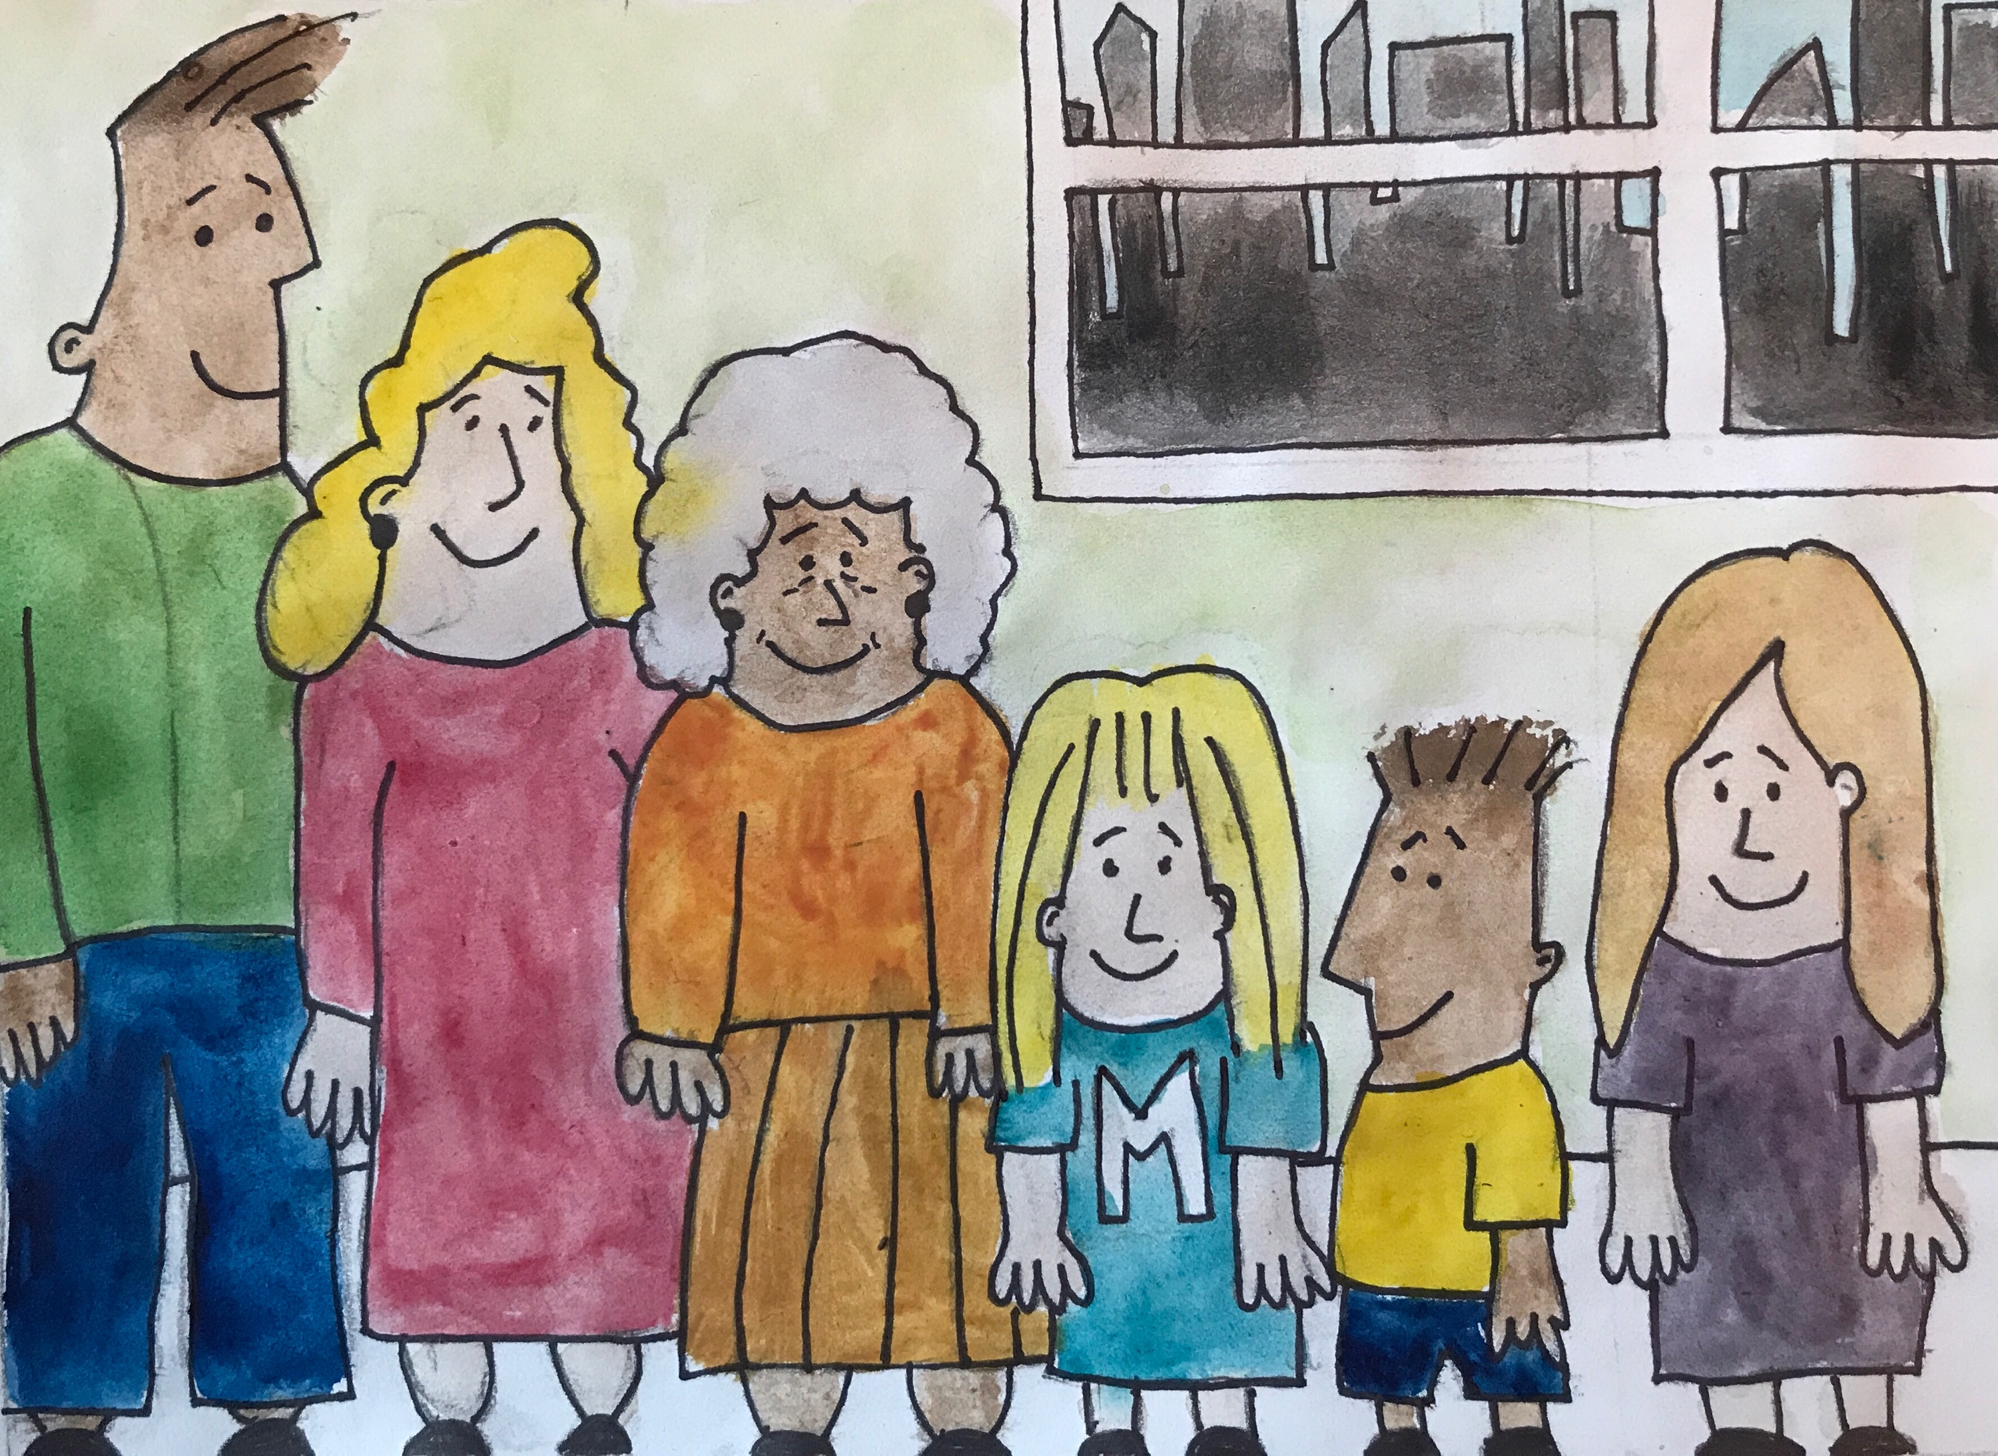
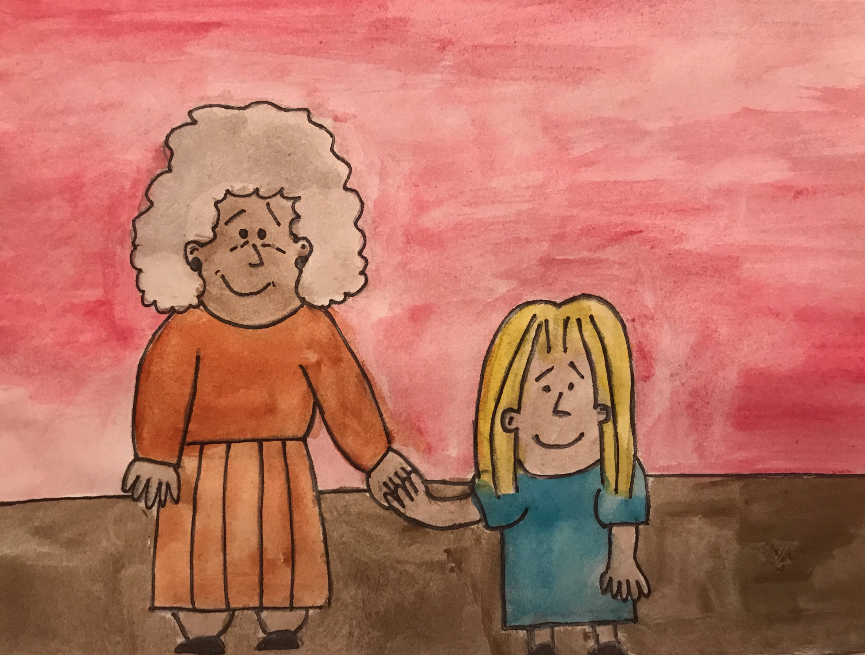
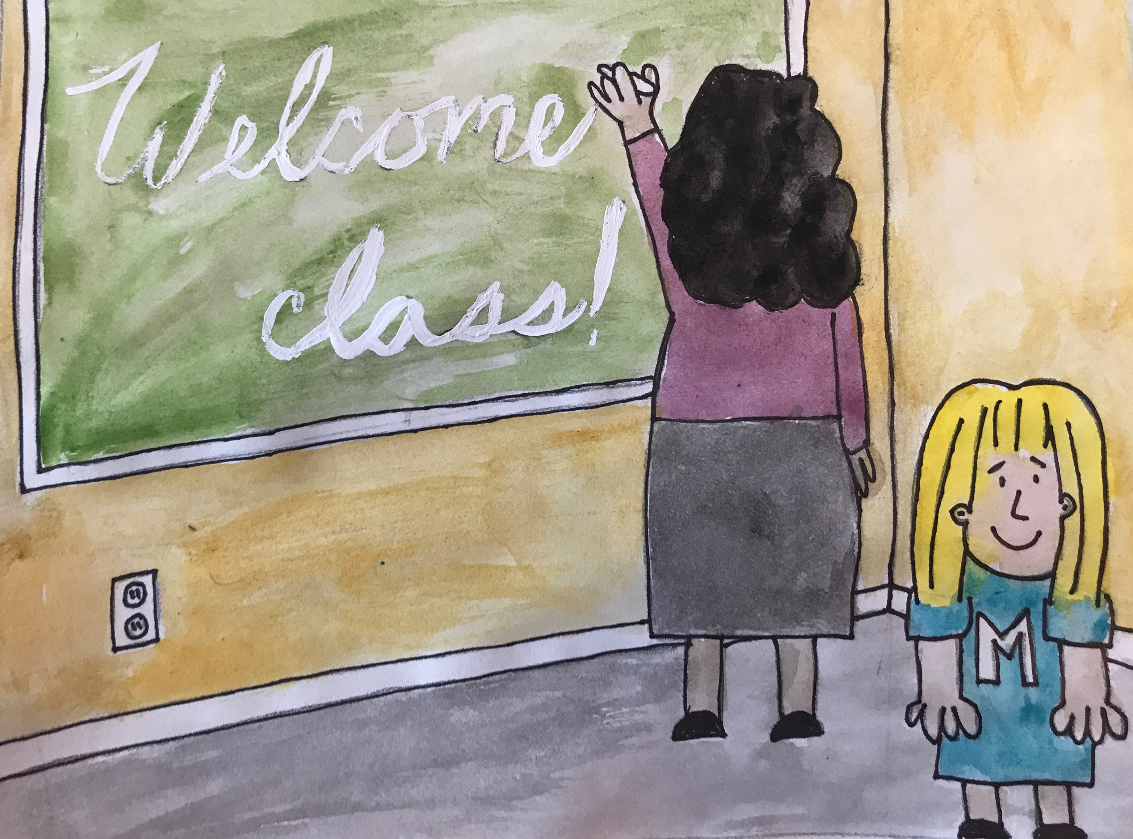
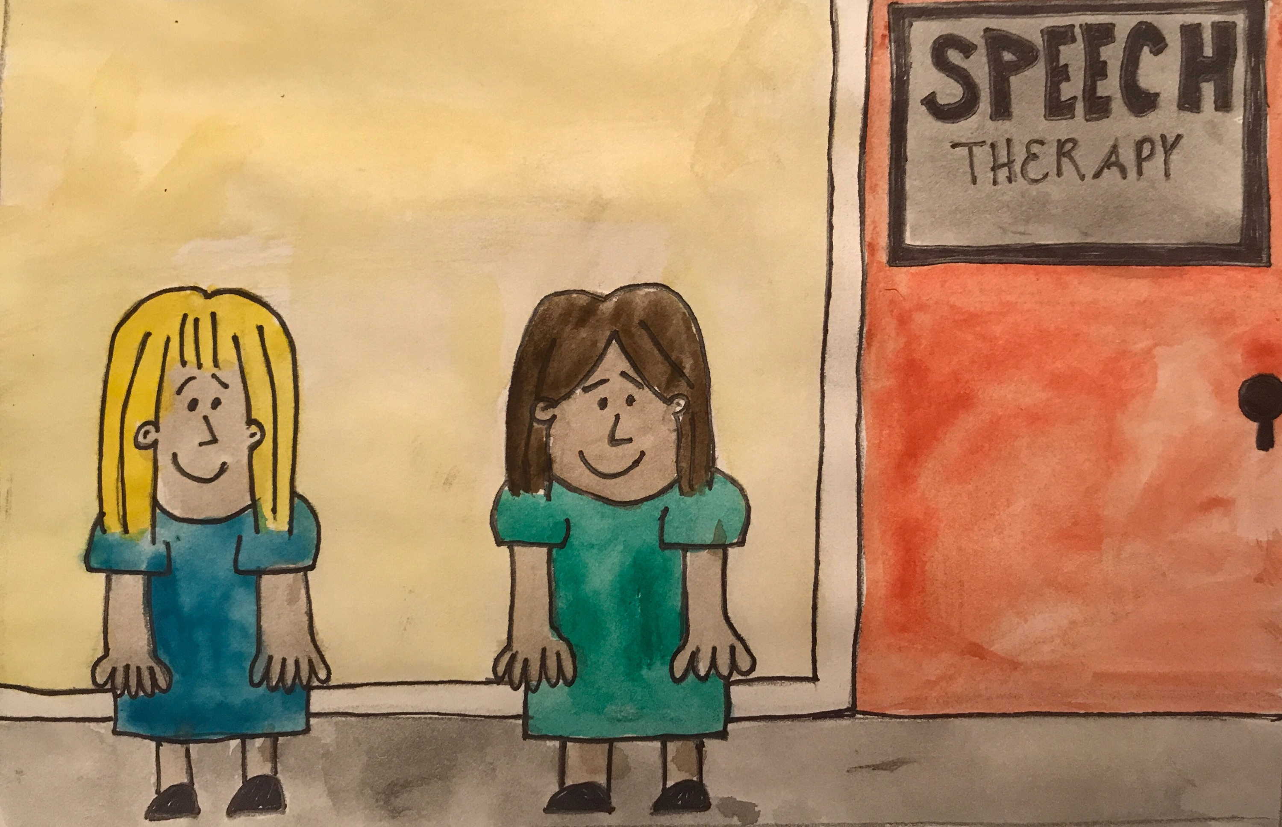
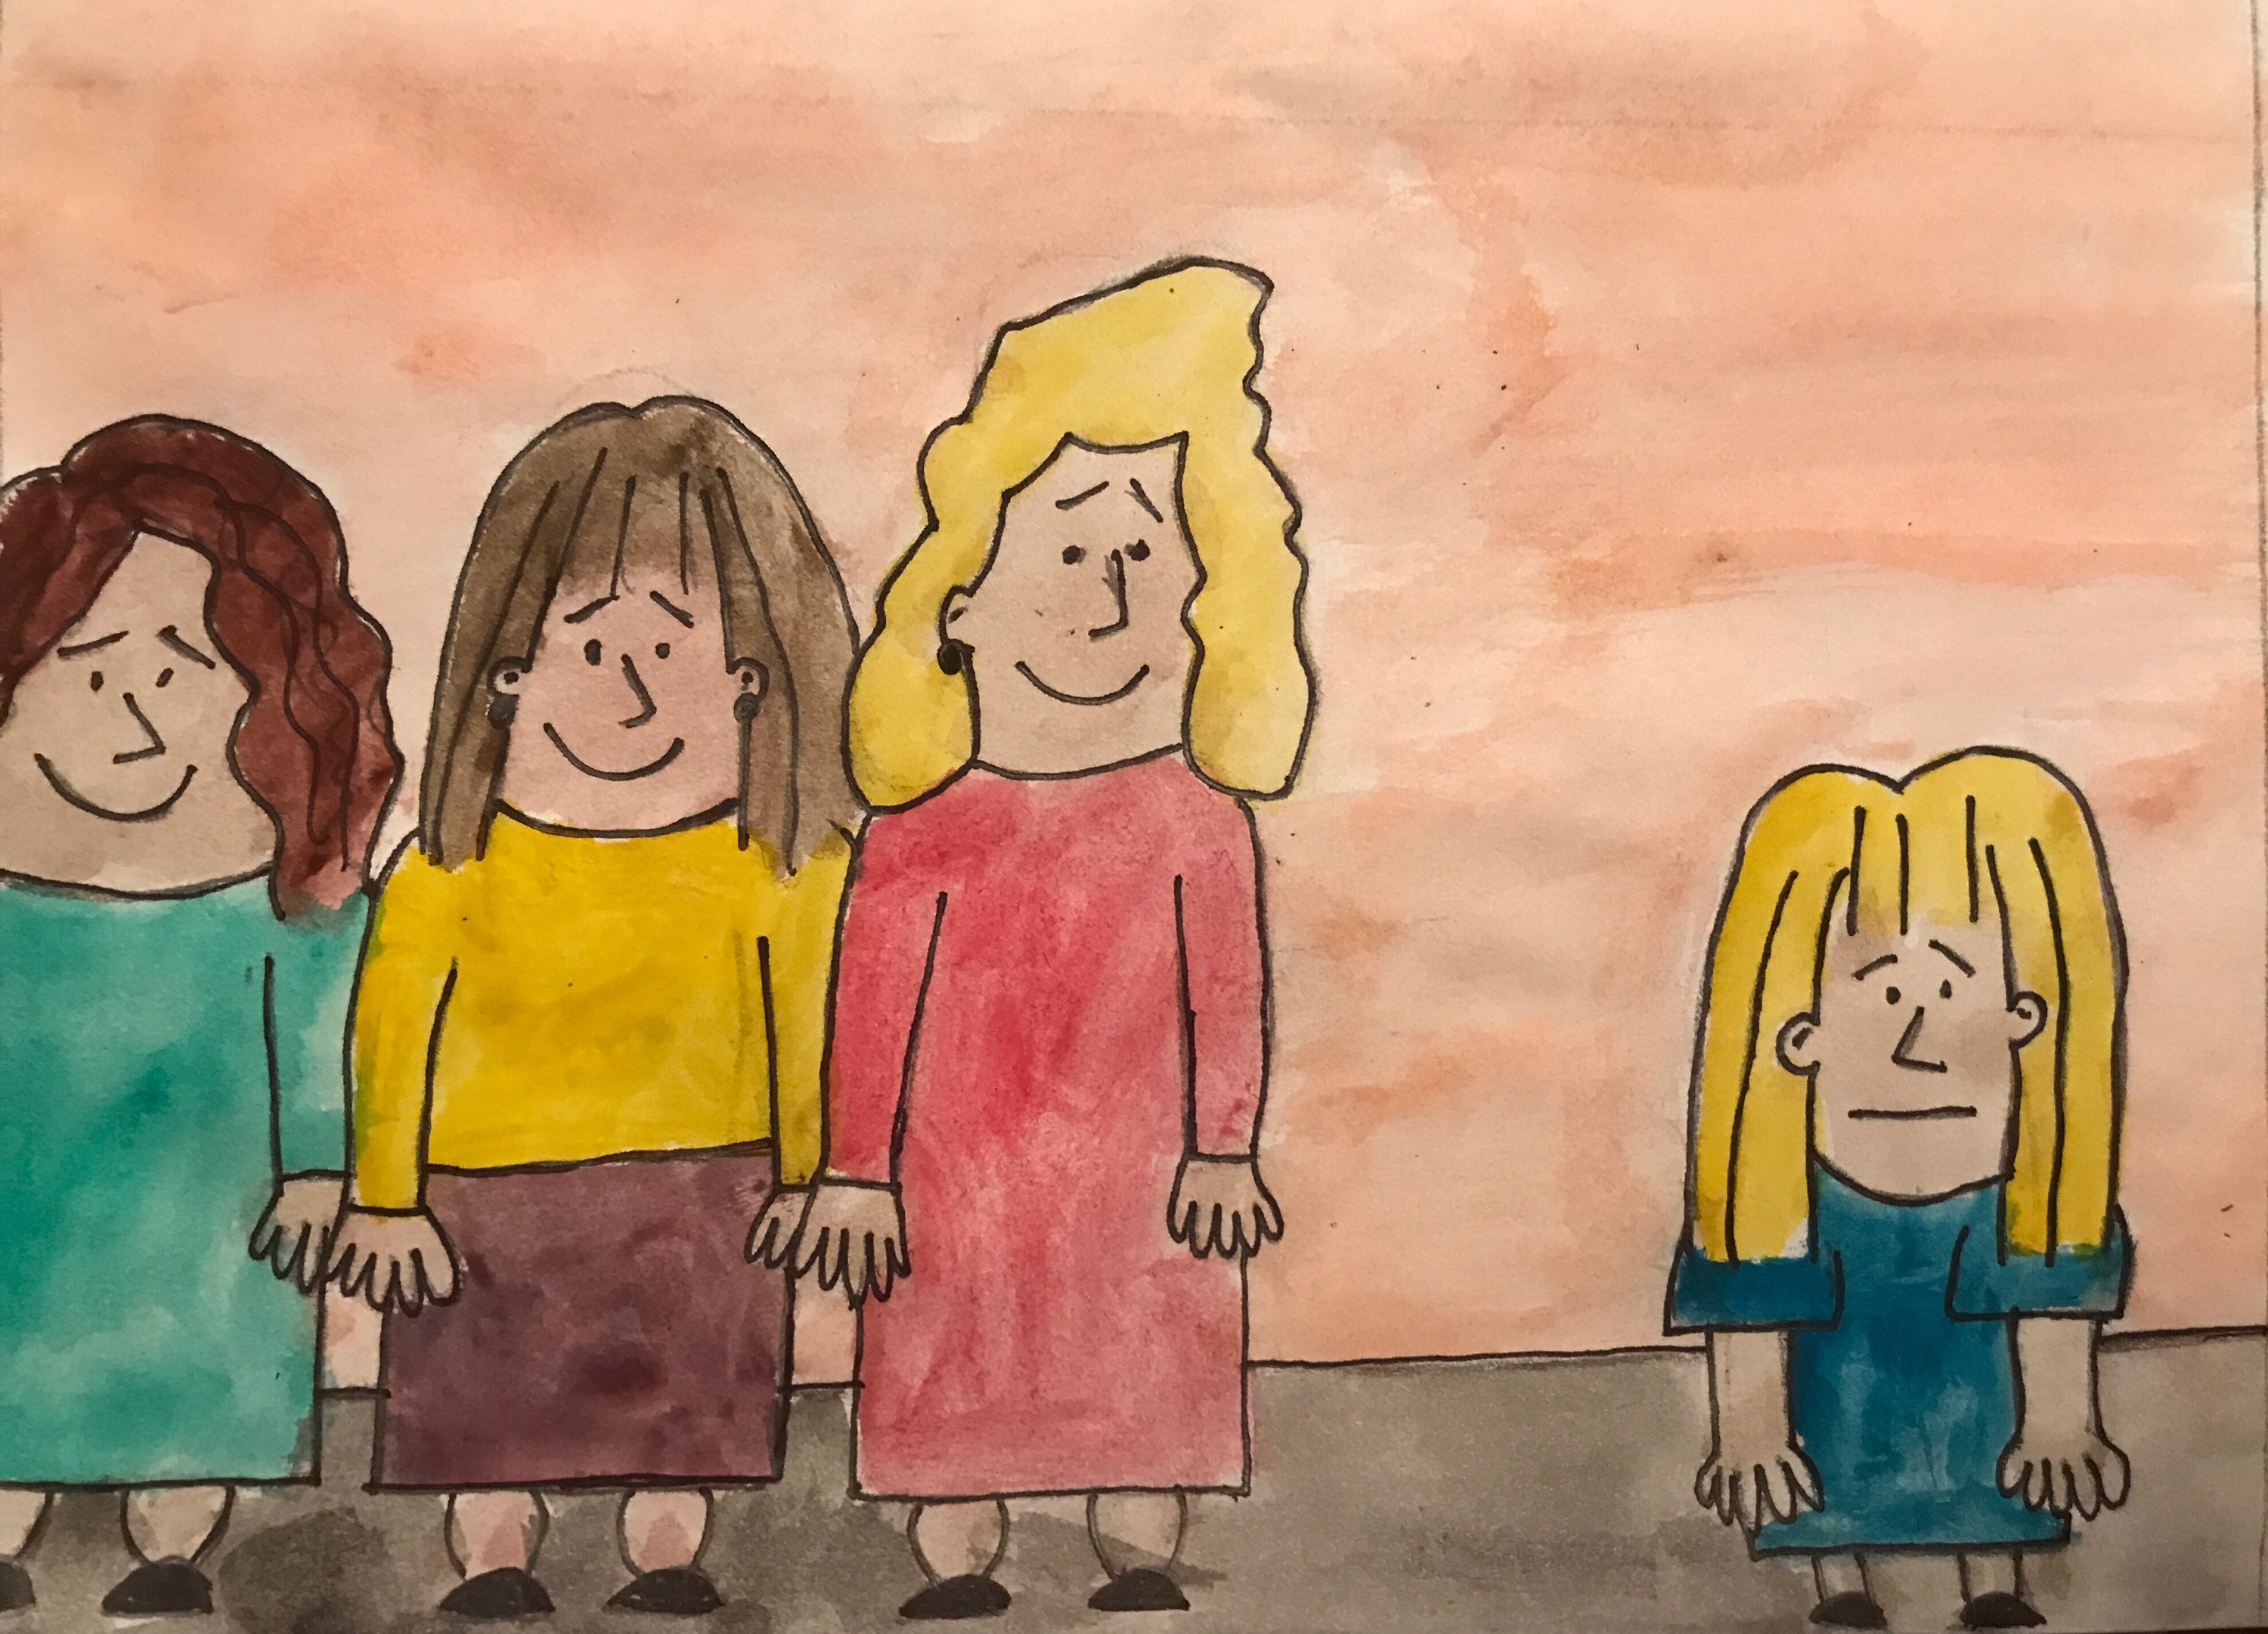
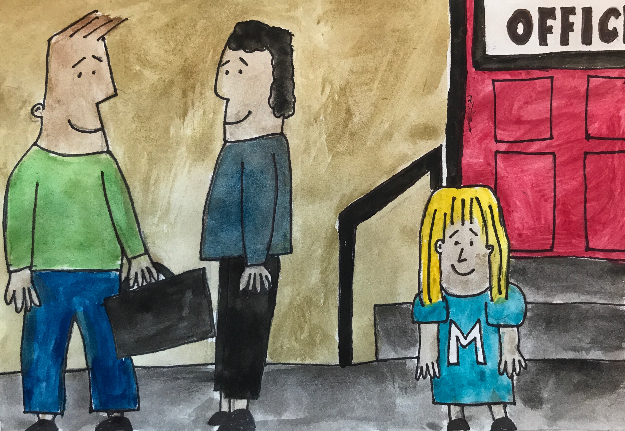
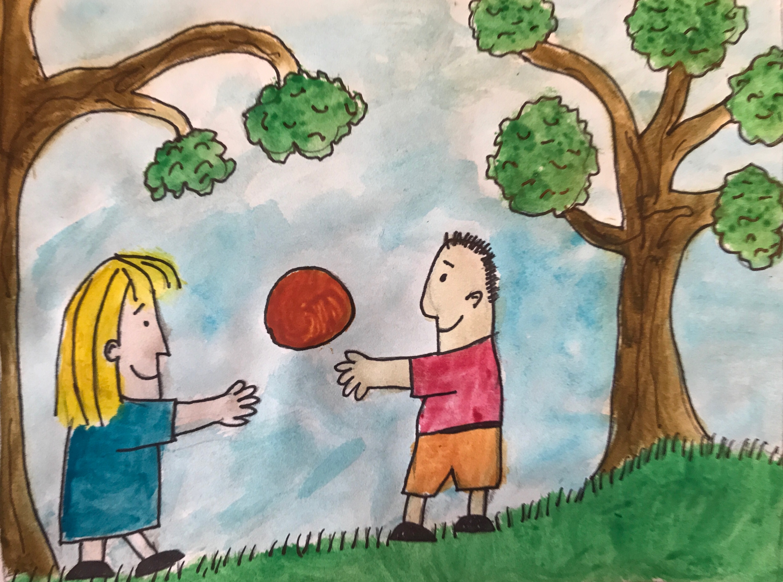
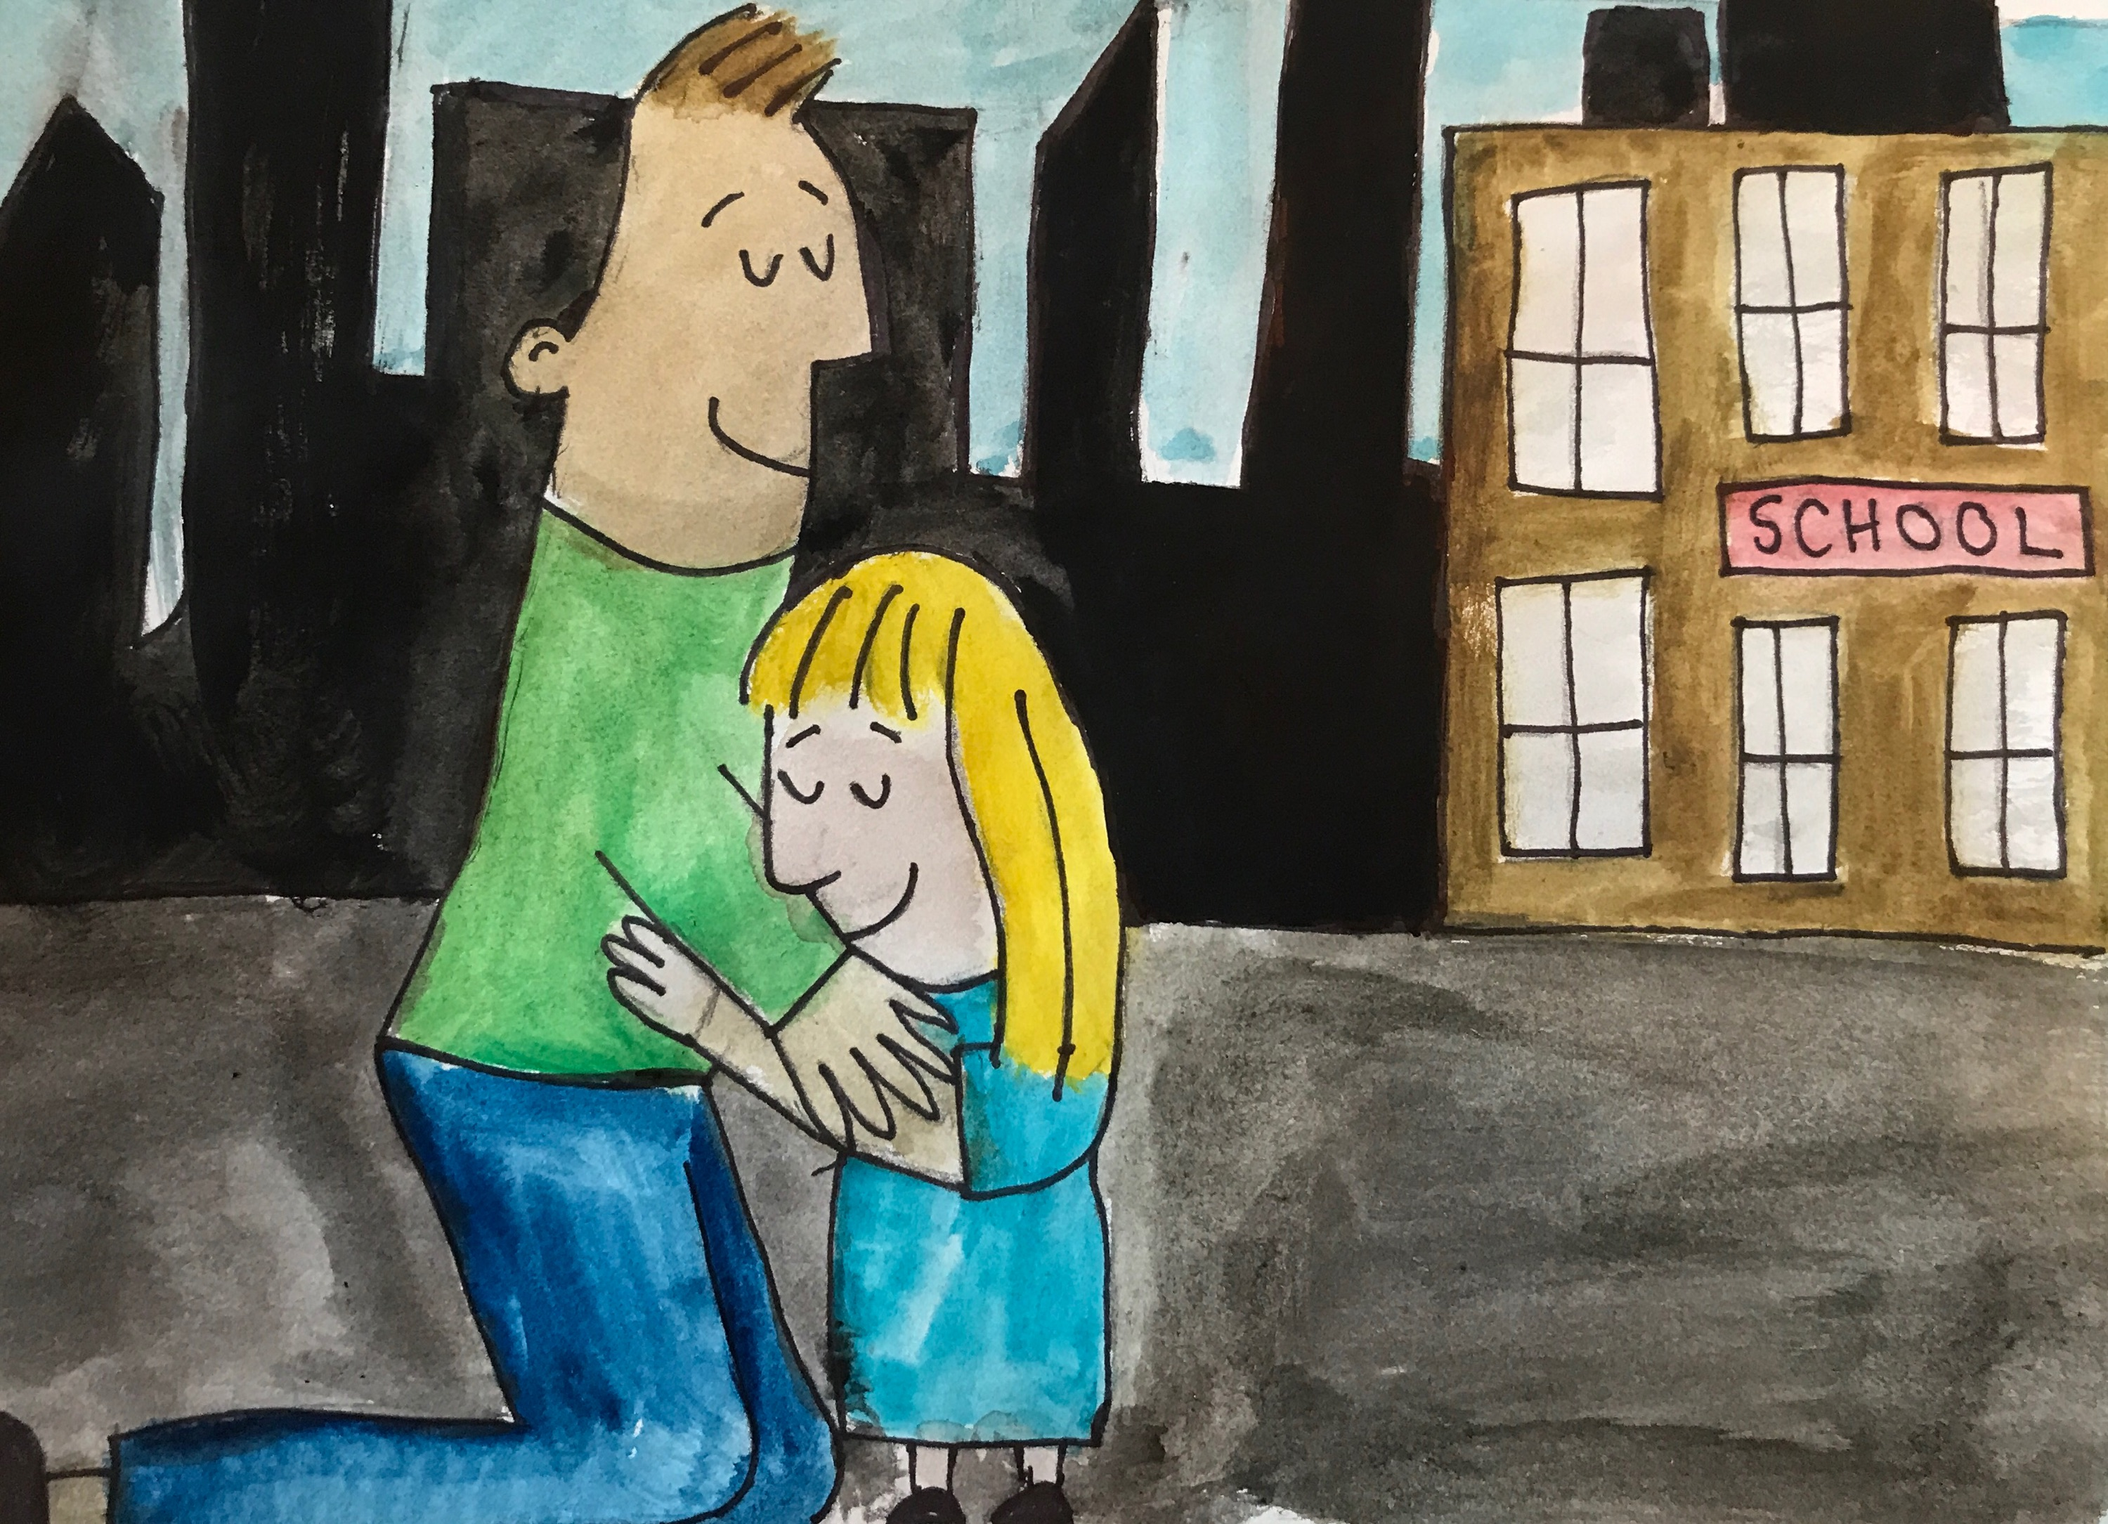
Bilingualism and the American family Caitlin Nickerson
Introduction
Bilingualism is the ability to speak more than one language fluently. People of all ages may aspire to learn a second or third language in order to fulfill both personal goals and communicate with a variety of people in different contexts. Although English is the language of power in the United States, there are hundreds of other languages spoken in this country. I proposed a two-part book about children in bilingual families. Part one is meant for parents to read with their children. It chronicles the life of an 8-year-old girl named Marta who speaks both English and Spanish. Part two provides parents with information about raising children to be bilingual.
When I am at home / Cuando yo estoy en la casa
Marta is an 8-year-old bilingual English and Spanish speaker with two siblings. She has a 6-year-old brother, Eddy, and a 10-year-old sister, Rachael. She started speaking Castilian Spanish when she was 3-years-old and her paternal grandmother moved from Spain to live with her family in New York. Marta’s mother only speaks English and her father speaks both English and Spanish. Marta and her brother are simultaneous bilinguals because they learned English and Spanish before age 5. Her sister is a successive bilingual because she started learning Spanish at age 5 after mastering English.
When I am at school / Cuando yo estoy en la escuela
Marta is in the 3rd grade. She likes to participate in school but sometimes gets nervous speaking in front of the class. Although other classmates are Spanish speakers, her teacher makes all of the students speak in English. Marta’s friend Carla, who is also a bilingual English/Spanish speaker, goes to speech therapy at school to correct a lisp. This lisp is not related to her bilingualism, nor is it related to the Spanish seseo, an intentional regional lisp employed by many Spaniards. In her mandatory Spanish class, Marta is learning to read and write standard Castilian Spanish. She is more proficient in speaking than literacy.
Rationale
Age of acquisition: Simultaneous versus successive acquisition: learning more than one language at the same time versus learning a second language after mastering native language (Battle, 2002).
Methods: There are many different “types” of child bilingualism that are categorized according to a family’s bilingual situation: parents who speak the same or different native languages, who may or may not be bilingual themselves (Romaine, 1995).
Disfluencies: Many children go through a period of disfluency. If they anxious or self-conscious while speaking, they may use more effort to articulate and appear to have a harder time speaking (Harding-Esch and Riley, 2003).
Code switching: The alternating use of more than one language. Bilinguals code switch according to the conversational situation that includes the setting, partner, topic, and context (Fletcher and MacWhinney, 2004).
Extrinsic factors: The attitudes of extended family and community can greatly affect how children acquire a second language (Romaine, 1995).
When I am with grown ups / Cuando yo estoy con adultos
Many of Marta’s mothers’ friends who only speak English think that she and her siblings are very smart because they speak 2 languages. These friends make a big fuss when any of the children speak Spanish. It makes Marta nervous when asked to showcase her speaking abilities because all of the attention is on her. Her father works with a Guatemalan man who speaks a different dialect of Spanish. He uses some different words and phrases to say things, and speaks with a different accent. Marta does not always understand what he says.
When I am with friends / Cuando yo estoy con amigos
Marta does not get nervous when talking with her friends. However, sometimes she fumbles over her words when she gets excited. Her friend Juan is from Mexico and speaks better Spanish than English, so they speak Spanish to each other when they play together. Their friend Hannah only speaks English. She gets frustrated when Marta or Juan speak Spanish because she can’t understand what they are saying. Some of Marta’s friends who only speak English think that it is weird that she speaks Spanish at home. She asked her dad not to speak Spanish to her when he picks her up from school because she wants to seem like a ”regular” American kid. Her dad told her that being bilingual is nothing to be ashamed of and that she should be proud to speak two languages.
Works Cited
Romaine, Suzanne. Bilingualism. Malden, Mass.: Blackwell, 1995. Print.
Battle, Dolores E. Communication disorders in multicultural populations. Boston: Butterworth-Heinemann, 2002. Print.
Fletcher, Paul, and Brian MacWhinney. The handbook of child language. Malden (MA): Blackwell, 2004. Print.
Harding-Esch, Edith, and Philip Riley. The bilingual family: a handbook for parents. Cambridge: Cambridge U Press, 2003. Print.
Acknowledgements
University of Rhode Island Honors Program
Dr. Dana Kovarsky, Department Chair, Communicative Disorders, URI

