Slide 1
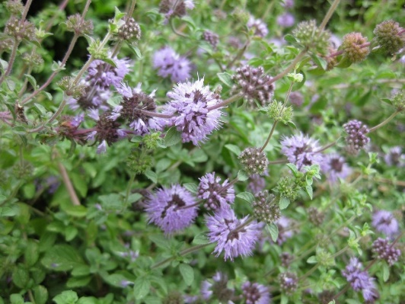
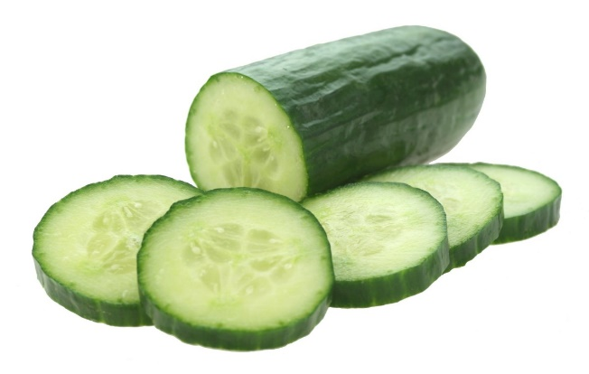
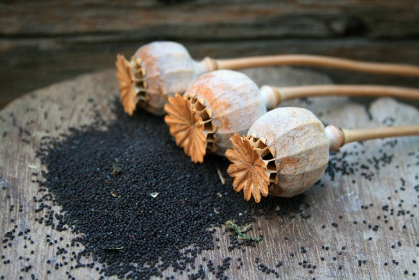
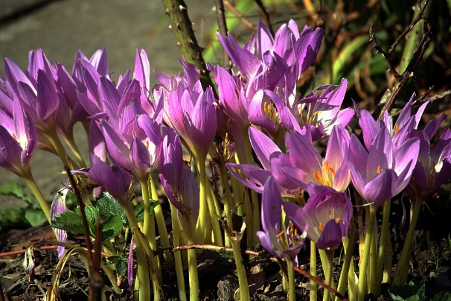
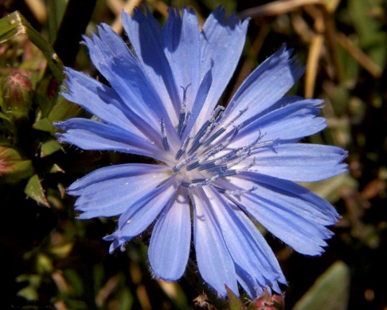
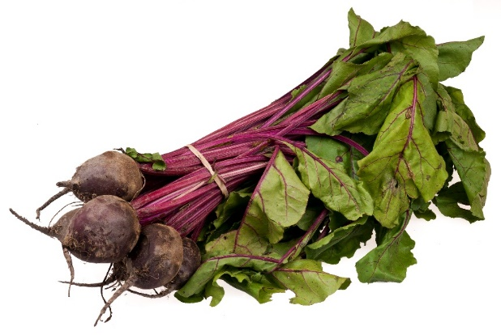
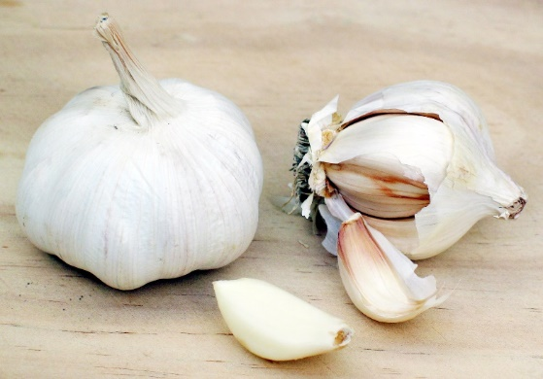
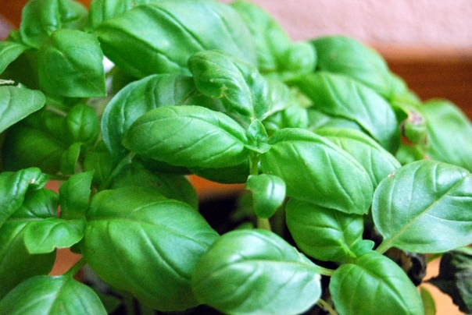
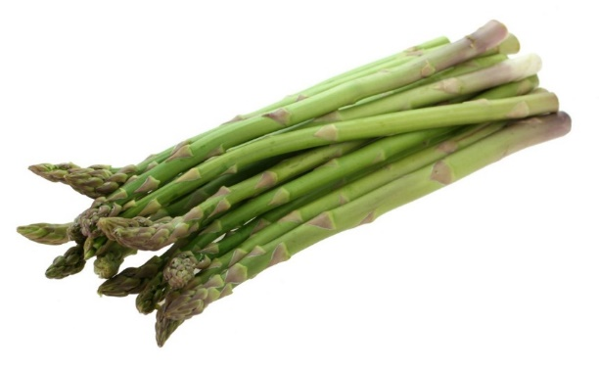
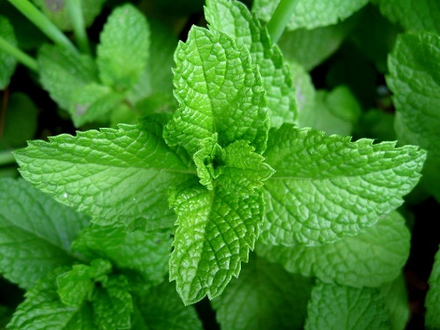
Evaluating the Safety and Efficacy of Classical Greek and Roman Treatments Compared to Modern Treatment Morgan Wynes PharmD/MBA Candidate Class of 2018¹ ¹The University of Rhode Island, College of Pharmacy
Introduction
Results²⁴
Classical Greek and Roman society made many medical advances. Hippocrates was the most important contributor to Greek medicine. During his life he shifted Greek medicine away from spiritual medicine toward practical medicine.¹ Galen was the most important contributor to Roman medicine and was considered to be the father of medicine for the next 1400 years. Galen theorized that the circulatory system was used to carry more than just blood and his work led to the discovery of capillaries.²
Gout ^{3,4}
90% of patients have under-excretion of uric acid.
Symptoms are painful, red, swollen lower extremities.
Flare Treatment:
NSAIDs, COX-2 Inhibitors, Systemic corticosteroids, colchicine
Prevention:
Xanthine oxidase inhibitors
Pennyroyal^{5,6}
Cucumber⁷
Poppy^{8,9}
Autumn Crocus^{10,11}
Active ingredient is pulegone
Pulegone has not been studied in gout.
Pulegone is hepatotoxic in concentrations of greater than 10 mL.
Active ingredients are apigenin and quercetin.
Both have anti-inflammatory properties similar to NSAIDs.
No reports of human toxicity
Absorbs morphine inside the seed pod
Morphine alleviates the pain of a gout flare.
Morphine does not treat the cause of gout.
Active ingredient is colchicine
Colchicine is toxic in doses > 1.2 mg per day.
Deaths have occurred from accidental ingestion.
Purpose
Assess the treatments of disease used in classical Greece and Rome and compare them to the treatment methods currently used
Gain knowledge of disease states not covered in pharmacy curriculum
Develop understanding of Classical Greek and Roman culture beyond what is covered in traditional Classics courses
Improve drug information skills
Jaundice^{12,13}
Skin and mucous membranes are visibly yellow
Caused by hyper-bilirubinemia which results from many factors such as alcoholic hepatitis.
Treatment of alcoholic hepatitis: Systemic corticosteroids
Chicory¹⁴
Beet Juice¹⁵
Garlic^{5,16}
Basil^{5,17}
Methodology
Tested in mice given CCl₄
Inhibited toxic effects of CCl₄ and minimized rise in AST and ALT.
Active ingredient is betaine
No significant change in AST and ALT
⬇ in steatosis grade
Decreased AST and ALT in mice with hepatic steatosis though not to normal.
Can cause GI upset and increased risk of bleeding.
Decreased AST and ALT in goats.
Not tested in humans.
Potentially safe if taken in medicinal doses.
Ancient texts were analyzed for diseases with tell tale symptoms and associated treatments.
The main resource consulted was Natural History by Pliny.
Tertiary resources were consulted to provide background on diseases.
Primary sources were consulted using mainly PubMed and Embase.
Those primary sources were used to assess the efficacy of the classical treatment in the disease state as well as to assess the safety and potential toxicities of those treatments.
Finally tertiary resources were consulted to assess the safety, efficacy and mechanism of action of the modern treatments for the same disease.
Elephantiasis^{18,19}
Enlargement of lower limbs
Caused by a blockage of the lymphatic system.
Caused by S. pyogenes or S. aureus
Treatment: Penicillin G then Penicillin VK
Asparagus²⁰
Mint^{5,21}
References
Marketos Spyros G. History of Medicine. Athens University Medical School Web site. http://asclepieion.mpl.uoa.gr/parko/marketos2.htm. Published May 28 1997. Accessed March 9, 2016.
Galen. Internet Encyclopedia of Philosophy Web site. http://www.iep.utm.edu/galen/. Accessed March 4, 2016.
Khanna D, Fitzgerald J, Khanna P, Bae S, Singh M, Neogi T, et al. 2012 American College of Rheumatology guidelines for management of gout. Part 1: systematic nonpharmacologic and pharmacologic therapeutic approaches to hyperuricemia. Arthritis Care Res. 2012; 64: 1431-46.
Khanna D, Khanna P, Fitzgerald J, Singh M, Bae S, Neogi T, et al. 2012 American College of Rheumatology guidelines for management of gout. Part 2: therapy and anti-inflammatory prophylaxis of acute gouty arthritis. Arthritis Care Res. 2012; 64: 1447-61.
Jellin JM, Gregory PJ, Batz F, Bonakdar R, et al. Natural Medicines Comprehensive Database. www.naturaldatabase.com. Stockton CA: Therapeutic Research Faculty; Accessed January 2, 2017.
Anderson IB, Mullen WH, Meeker JE, Khojasteh-Bakht SC, Oishi S, Nelson SD, et. al. Pennyroyal toxicity: measurement of toxic metabolite levels in two cases and review of the literature. Ann Intern Med. 1996; 124: 726-734.
Cucumbers. The world’s healthiest foods Web site. http://www.whfoods.com/genpage.php?tname=foodspice&dbid=42. Published 2001. Updated 2017. Accessed January 27, 2017.
Can Poppy Seeds Cause A Positive Drug Test? U.S. Anti-Doping Agency Web site. http://www.usada.org/can-poppyseeds-cause-a-positive-drug-test/. Published February 9, 2014. Updated December 2015. Accessed January 28, 2017.
Gold Standard, Inc. Morphine. Clinical Pharmacology [database online]. Available at: http://www.clinicalpharmacology.com.uri.idm.oclc. Accessed January 28, 2017.
Gold Standard, Inc. Colchicine. Clinical Pharmacology [database online]. Available at: http://www.clinicalpharmacology.com.uri.idm.oclc. Accessed January 30, 2017.
36th International Congress of the European Association of Poisons Centres and Clinical Toxicologists (EAPCCT) 24-27 May, 2016, Madrid, Spain, Clin Toxicol (Phila). 54:4, 344-519.
Herrine S. Jaundice. Merck Manual Professional Version Web site. http://www.merckmanuals.com/professional/hepatic-and-biliary-disorders/approach-to-the-patient-with-liver-disease/jaundice. Published May 2016. Accessed February 24, 2017.
O’Shea RS, Dasarathy S, McCullough AJ, Shuhart M, Davis G, Franco J. et al. Alcoholic liver disease. Hepatology. 2009; 51: 307-28.
Elgengaihi S, Mossa AH, Refaie A, Aboubaker D. Hepatoprotective efficacy of cichorium intybus L. extract against carbon tetrachloride-induced liver damage in rats. J Diet Suppl. 2016; 13: 570-84.
Abdelmalek MF, Sanderson SO, Angulo P, Soldevila-Pico C, Chen L, Peter J, et. al. Betaine for nonalcoholic fatty liver disease: Results of a randomized placebo-controlled trial. Hepatology. 2009; 50: 1818-1826.
Shin JH, Lee CW, Oh SJ, Yun J, Kang MR, Han SB. Hepatoprotective effect of aged black garlic extract in rodents. Toxicol Res. 2014; 1: 49-54.
Meera R, Devi P, Kameswari B, Madhumitha B, Merlin NJ. Antioxidant and hepatoprotective activities of Ocimum basilicum Linn. And Trigonella foenum-graecum Linn. against H₂O₂ and CCl₄ induced hepatotoxicity in goat liver. Indian J Exp Biol. 2009; 47: 584-90.
Gold Standard, Inc. Naloxone. Clinical Pharmacology [database online]. Available at: http://www.clinicalpharmacology.com.uri.idm.oclc. Accessed January 28, 2017.
Elephantiasis. National Organization for Rare Disorders. Web site. https://rarediseases.org/rare-diseases/elephantiasis/. Published 2009. Accessed March 9, 2017.
Teka A, Rondevaldova J, Asfaw Z, Demissew S, Van Damme P, Kokoska L, et al. In vitro antimicrobial activity of plants used in traditional medicine in Gurage and Silti Zones, south central Ethiopia. BMC Complement Altern Med. 2015; 15: 286-92.
Iscan G, Kirimer N, Kurkcuoglu M, Husnu K, Baser C, Demirci F. Antimicrobial screening of menthe piperita essential oils. J. Agric. Food Chem. 2002; 50: 3943-6.
Empyema. MedlinePlus Web site. https://medlineplus.gov/ency/article/000123.htm. Published February 4, 2015. Updated March 9, 2017. Accessed March 25, 2017.
Wessels MR. Streptococcal Infections. In: Kasper D, Fauci A, Hauser S, Longo D, Jameson J, Loscalzo J. eds. Harrison’s Principles of Internal Medicine, 19e New York, NY: McGraw-Hill; 2014.
24. Pliny, Jones WHS. Natural History VI. Books XX-XXIII. Cambridge, MA: Harvard University Press; 1969.
Did not inhibit S. aureus or S. pyogenes
Antibacterial effect against S. aureus
Not tested against S. pyogenes
Safe for use < 8 weeks
Conclusion
Some treatments such as colchicine and pleural drainage are still used in practice today though they have been refined to be safer for the patient. Other products such as cucumber, chicory and garlic show promise and could be approved for use with further study. The remaining treatments; pennyroyal, poppy, mint, asparagus, beets and basil, either lack the necessary evidence of effectiveness or their therapeutic benefit does not exceed their toxic potential when taken at medicinal dosages.
Pleural Empyema ^{1,22,23}
Buildup of infected pus in the pleural space
Symptoms are fever, chills, shortness of breath and cough.
Treatment: Clindamycin and Penicillin G
Secondary Treatment: Surgical drainage
Surgical drainage was practiced by Hippocrates.
Improper sanitation made this procedure dangerous.
Sponsored by Dr. Kristina Ward¹ and Dr. Daniel Carpenter²
¹The University of Rhode Island, College of Pharmacy, ²The University of Rhode Island, College of Arts and Sciences, Department of Modern and Classical Languages and Literatures, Classics Section Head

