Slide 1
Designing Towards a Dream
Collection: Exposure
Danielle Williams

Slide 2
Artist Statement

Slide 3
The inspiration to my collection is the ability that women have to express themselves freely. We live in a world where women are suppressed and men are said to have the upper hand, which has been a ‘tradition’ since the 1800’s. Studies done by Letty Cottin Pogrebin, an American author, journalist, lecturer, and social activist, show that “when men are oppressed it's a tragedy, when women are oppressed it's tradition” (Cotton). Although, over time, we have progressed, there is still much progress to be made. Therefore my collection is going to express the freedom that women should embody.
Feminism also plays a role in my line: “feminism’s overarching credo is that women must be allowed the right to be who or what they want to be and to do whatever they want to do, as long as they are not breaking any laws or infringing anybody else’s rights” (Sika). The statement, ‘who or what they want’ reflects the idea that women have the same rights and abilities as men and should be able to express themselves not only freely, but completely. Overall, this is what this line expresses; therefore feminism and freedom of women go hand in hand.
Clothing can be an expression of many things: power, age, gender, job position, interests, etc. Clothing can also express feelings, such as freedom and edgy-ness. My clothing line is inspired by the idea of dreams and freedom. It captures the essence of a women’s rights and this quote: “if there is one message that echoes forth from this conference, let it be that human rights are women rights and women rights are human rights, once and for all” (Clinton). The clothing is simple, yet has a hint of the expression that each woman should have the right to; women can wear what they want, show their bodies however they want and look good while doing it.
My mood board captures the essence of subtle colors, trapped figures and freedom. It shows that women are breaking out of a shell to be themselves. The colors include violet purple and black with a hint of mustard gold. The colors compliment the free-flowing line.
Literature Cited
1. Cottin Pogrebin, Letty. (1991 January 1). Deborah, Golda, and Me:
Being Female and Jewish in America. Crown Publishers, Inc.
2. Sika, Varyanne. (2014). Fashion for Feminists: How Fashion and Dress
Shape Women’s Identities. Open Society Initiative for Southern
Africa. Retrieved from https://www.osisa.org/buwa/regional/fashion-
feminists-how-fashion-and-dress-shape-women’s-identities
3. Clinton, Hillary. (1995 September 5). U.N. Fourth World Conference:
Women Plenary Session.

Slide 4
Mood Board

Slide 5
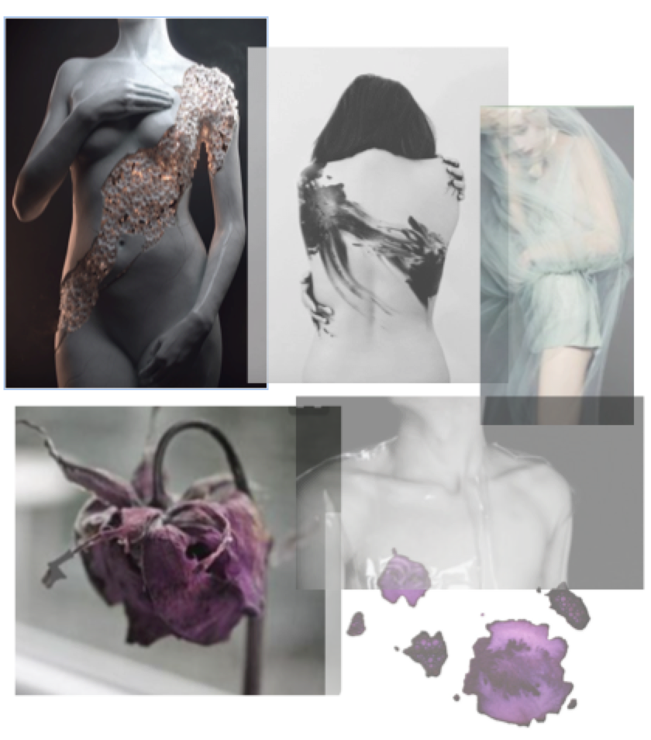

Slide 6
Color Swatches

Slide 7
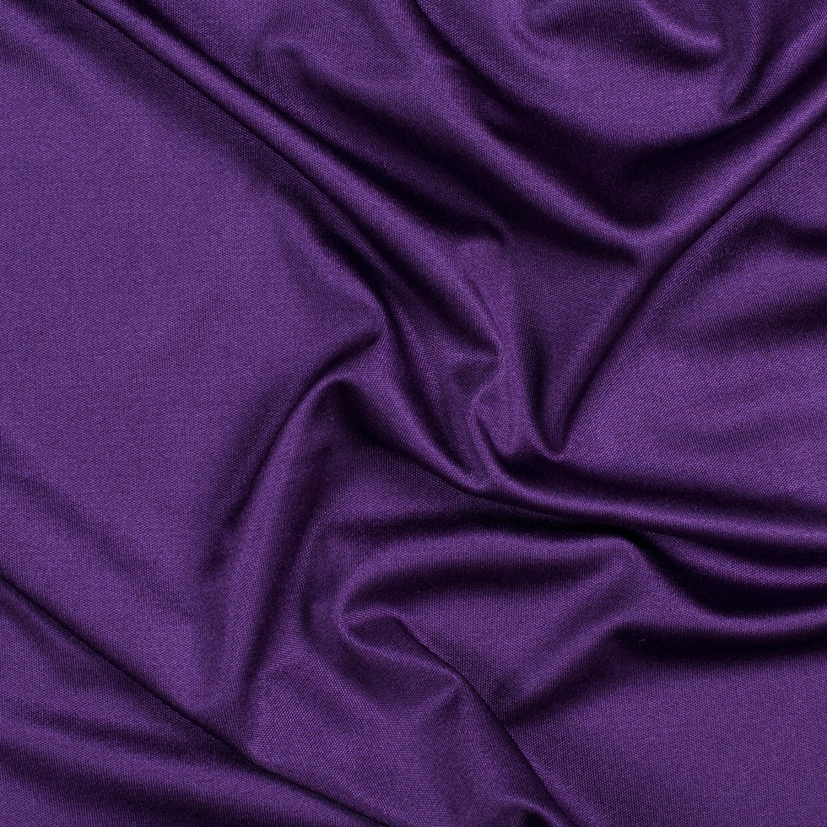
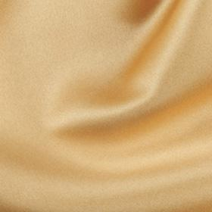

Slide 8
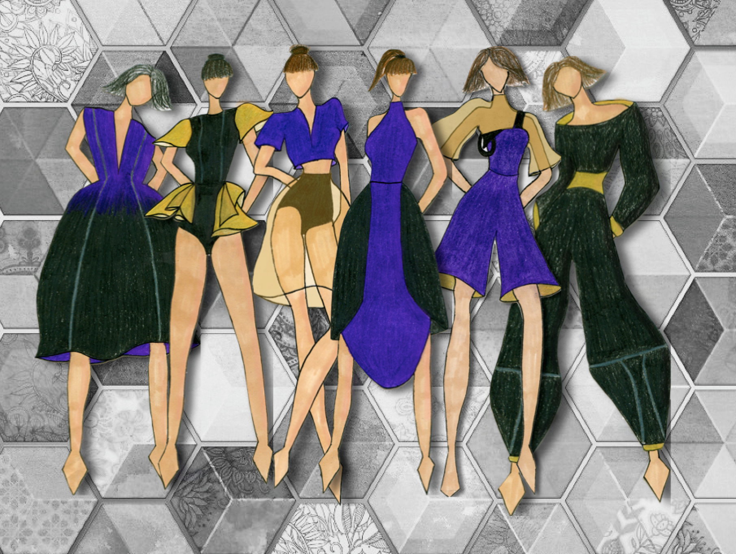

Slide 9
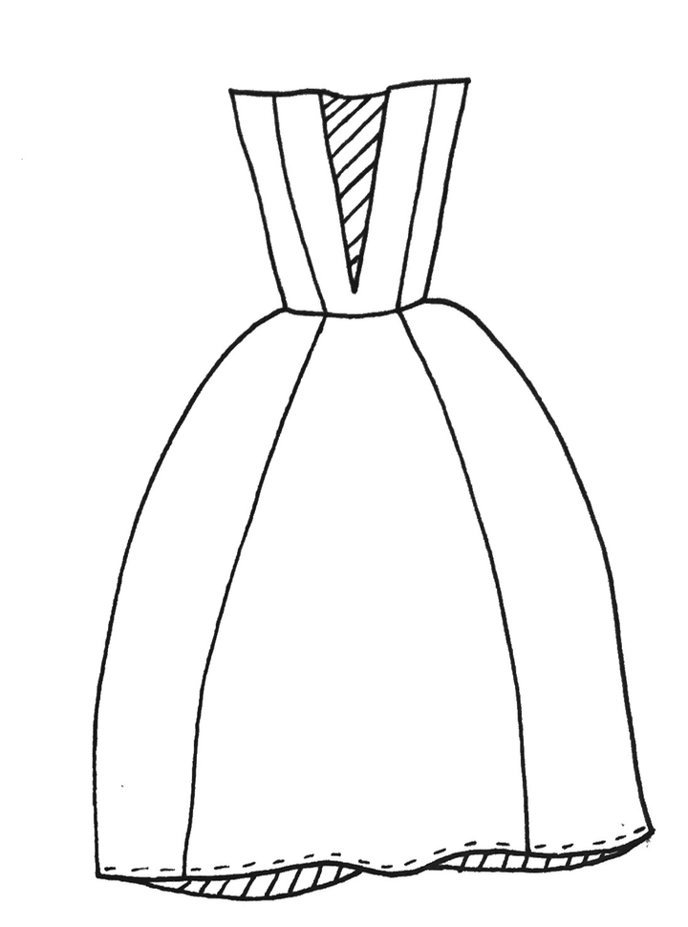
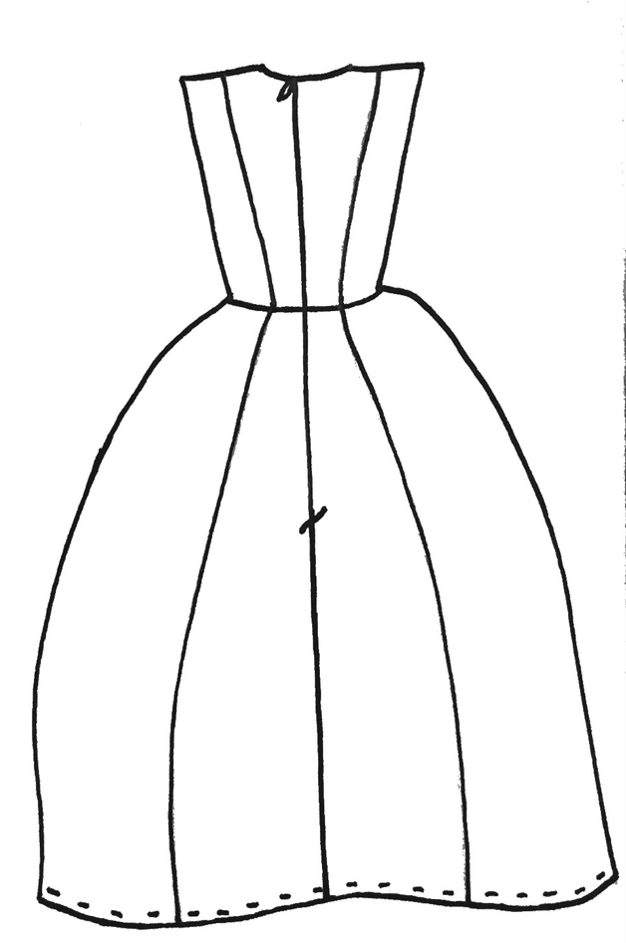

Slide 10
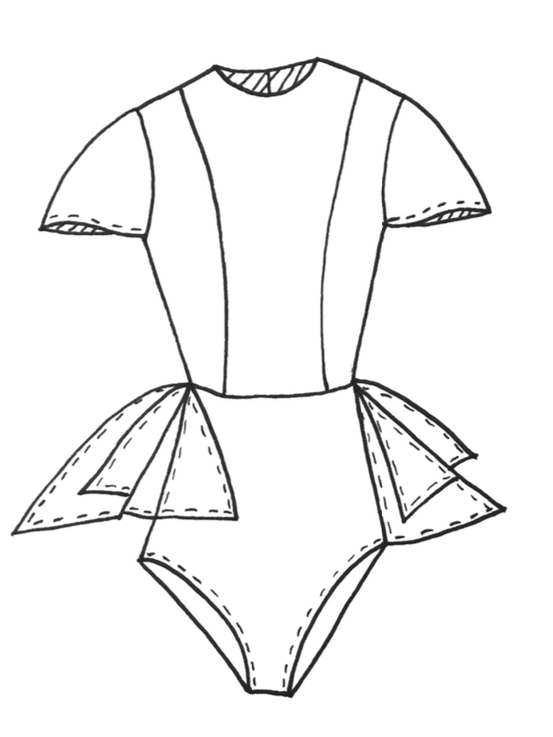
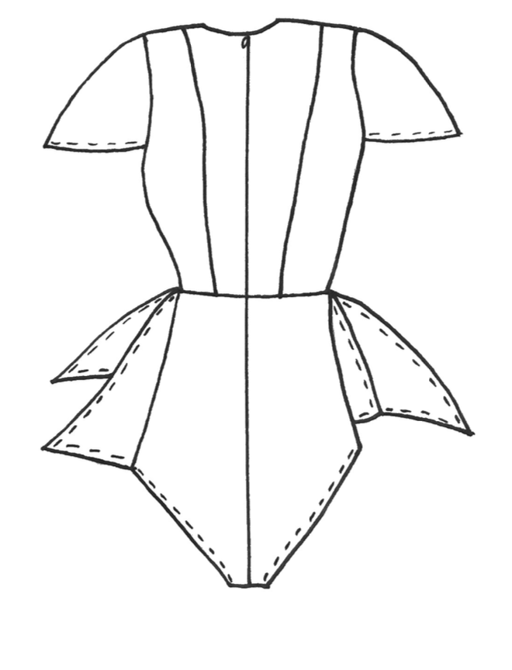

Slide 11
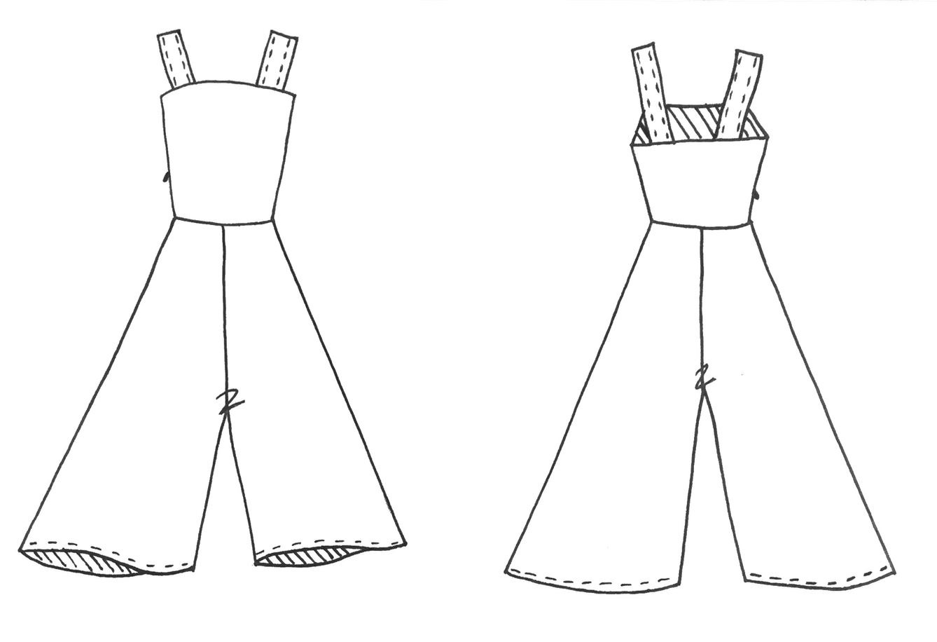
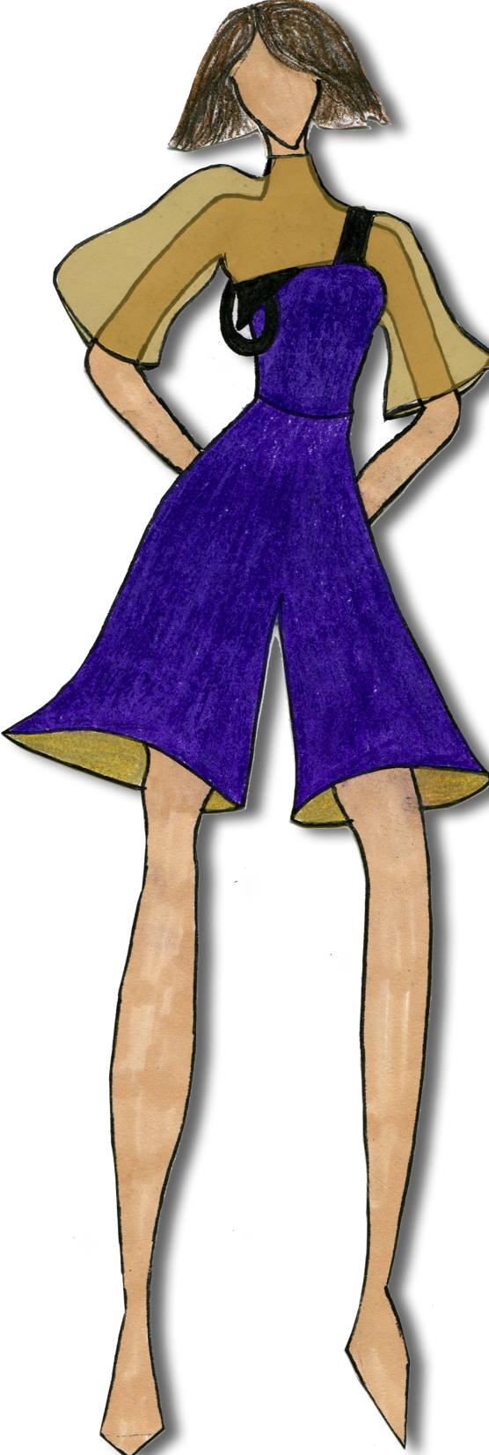
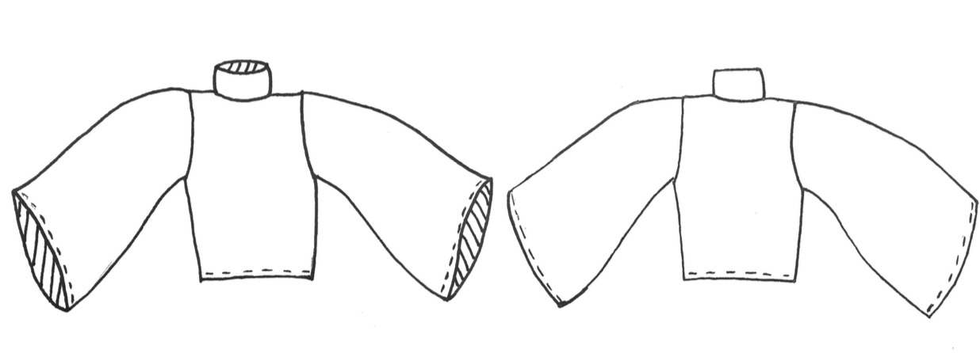

Slide 12
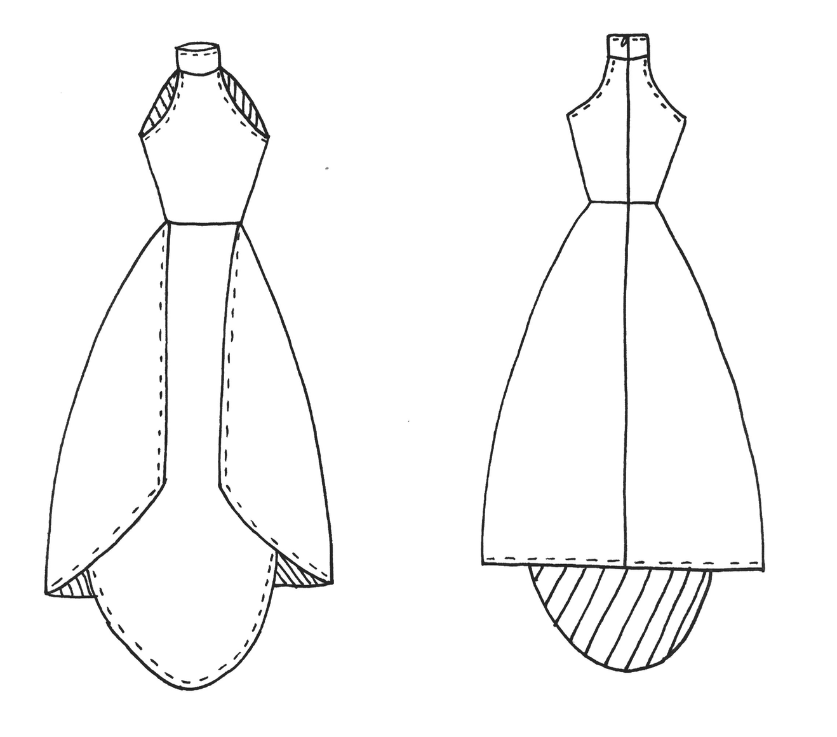

Slide 13
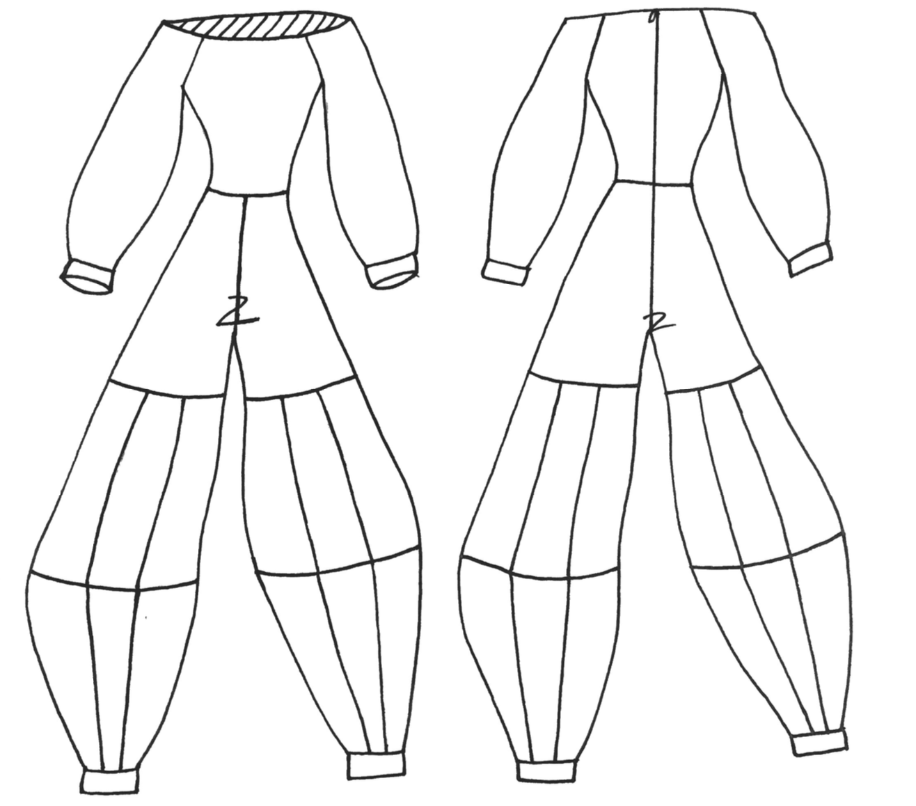

Slide 14
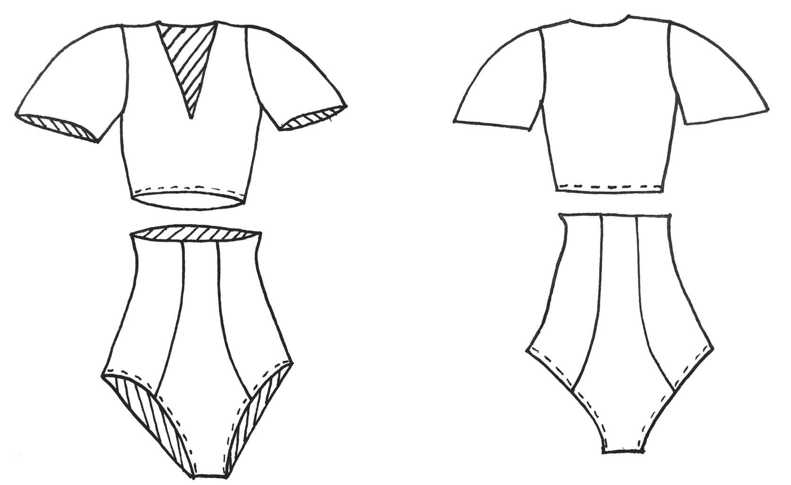
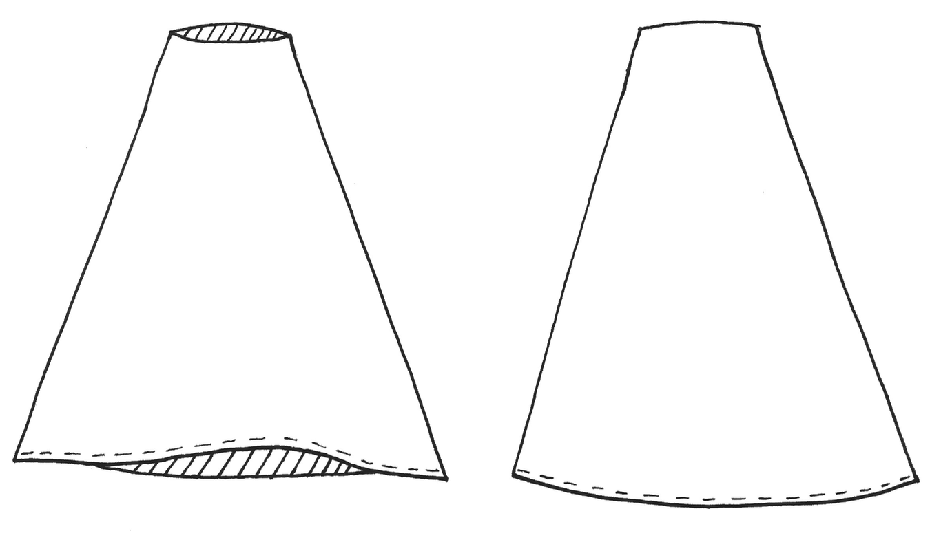

Slide 16
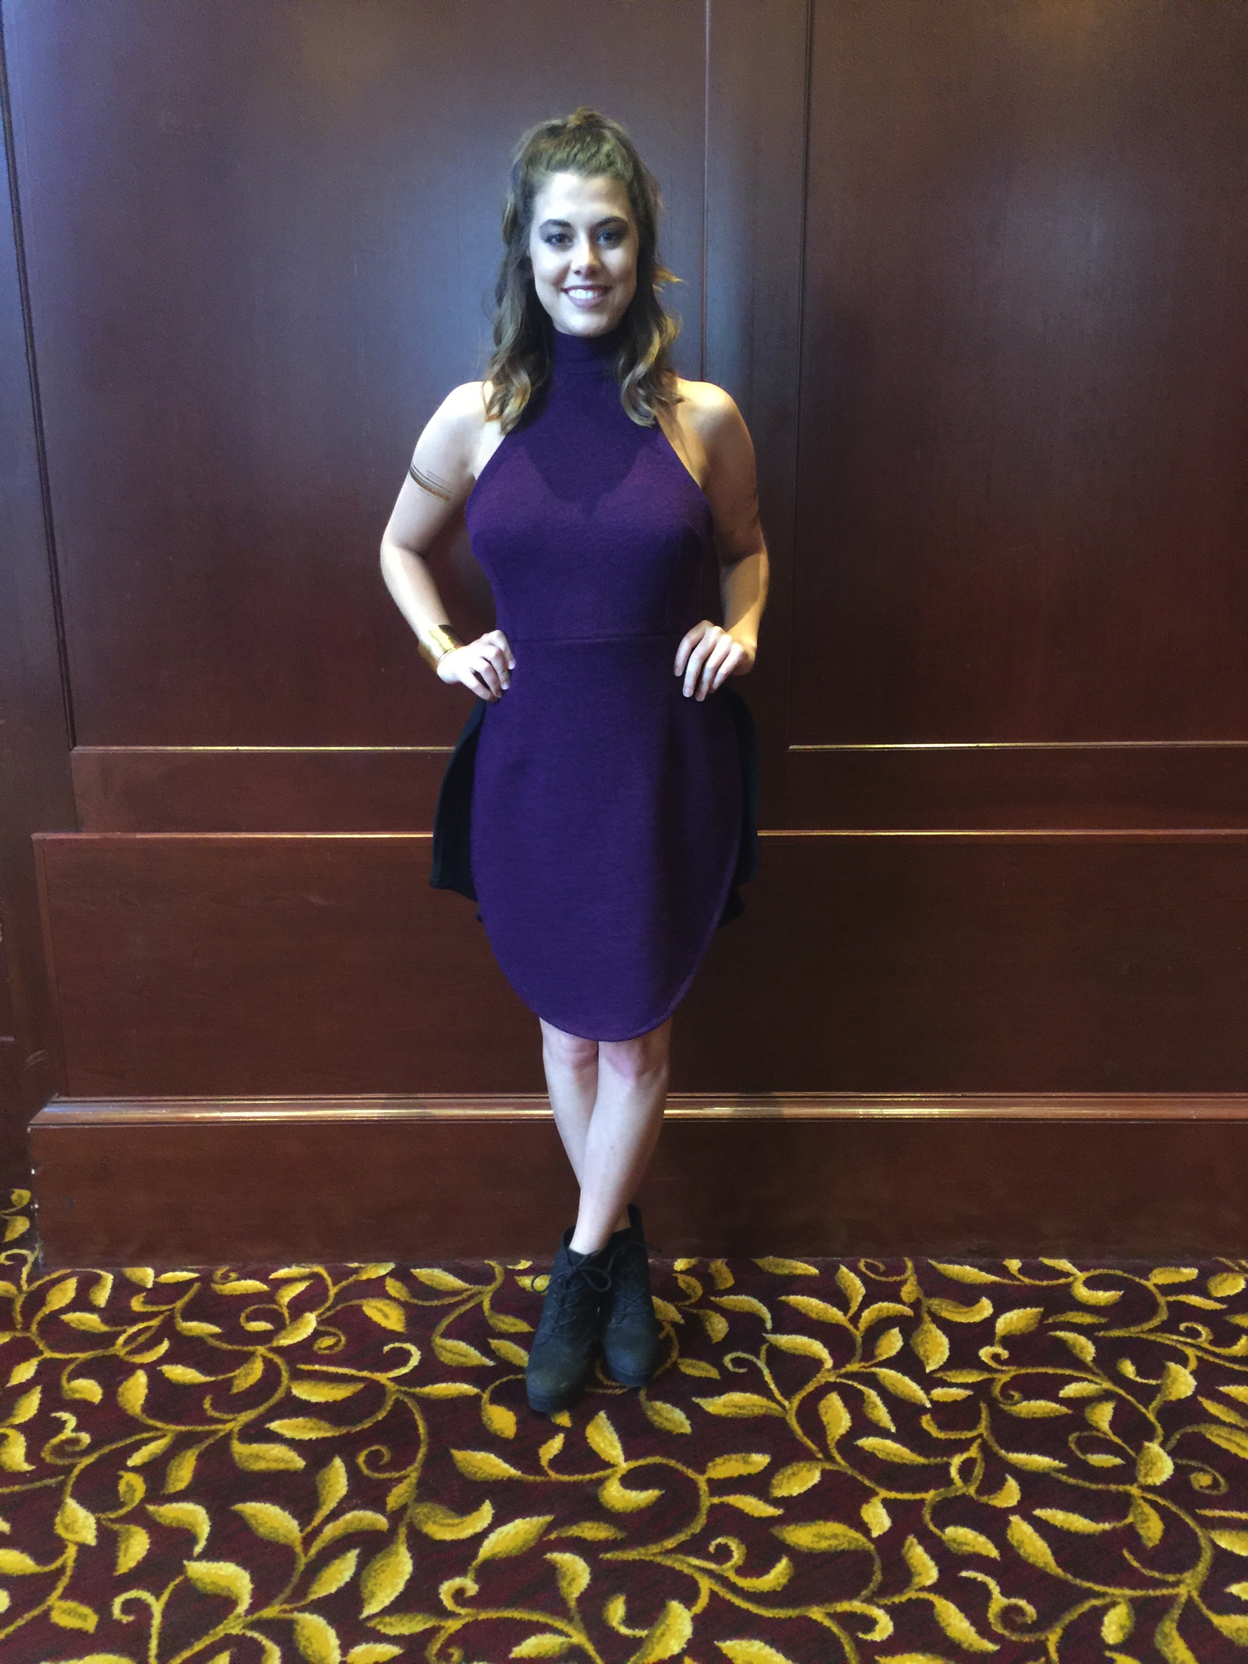
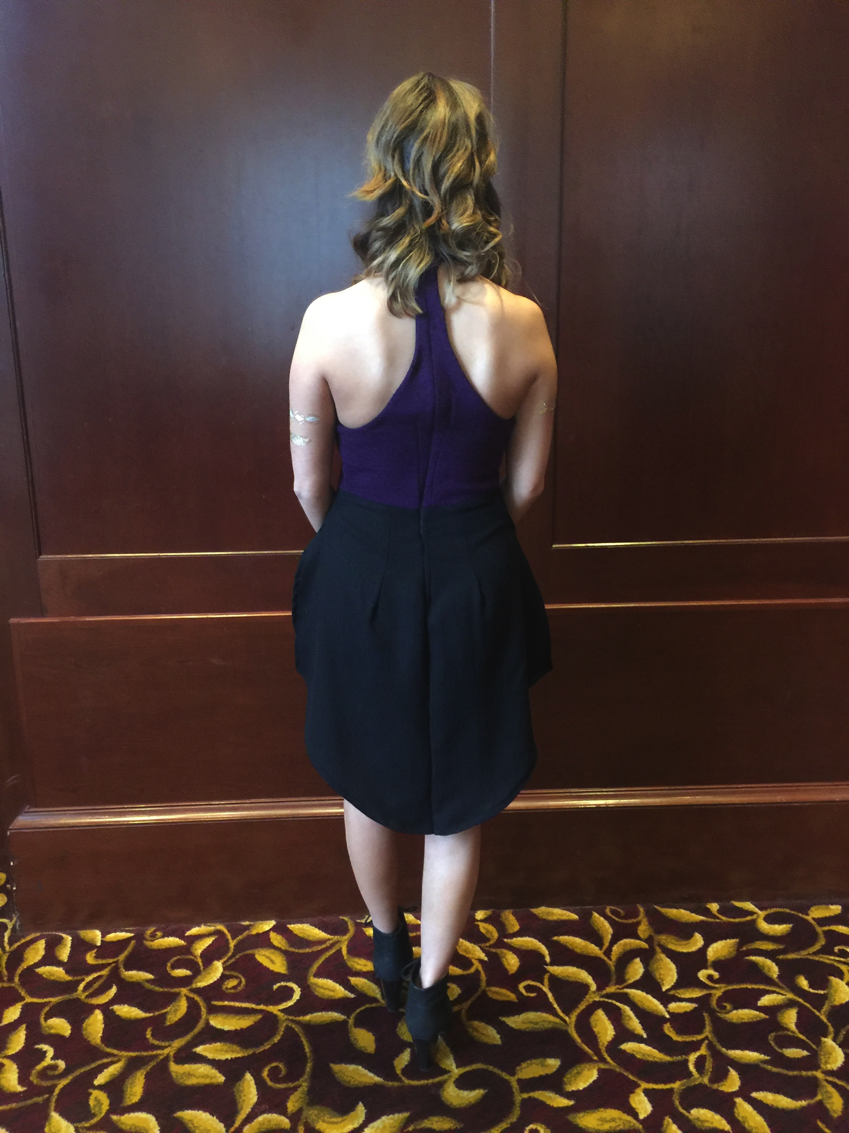
Final Garments

Slide 17
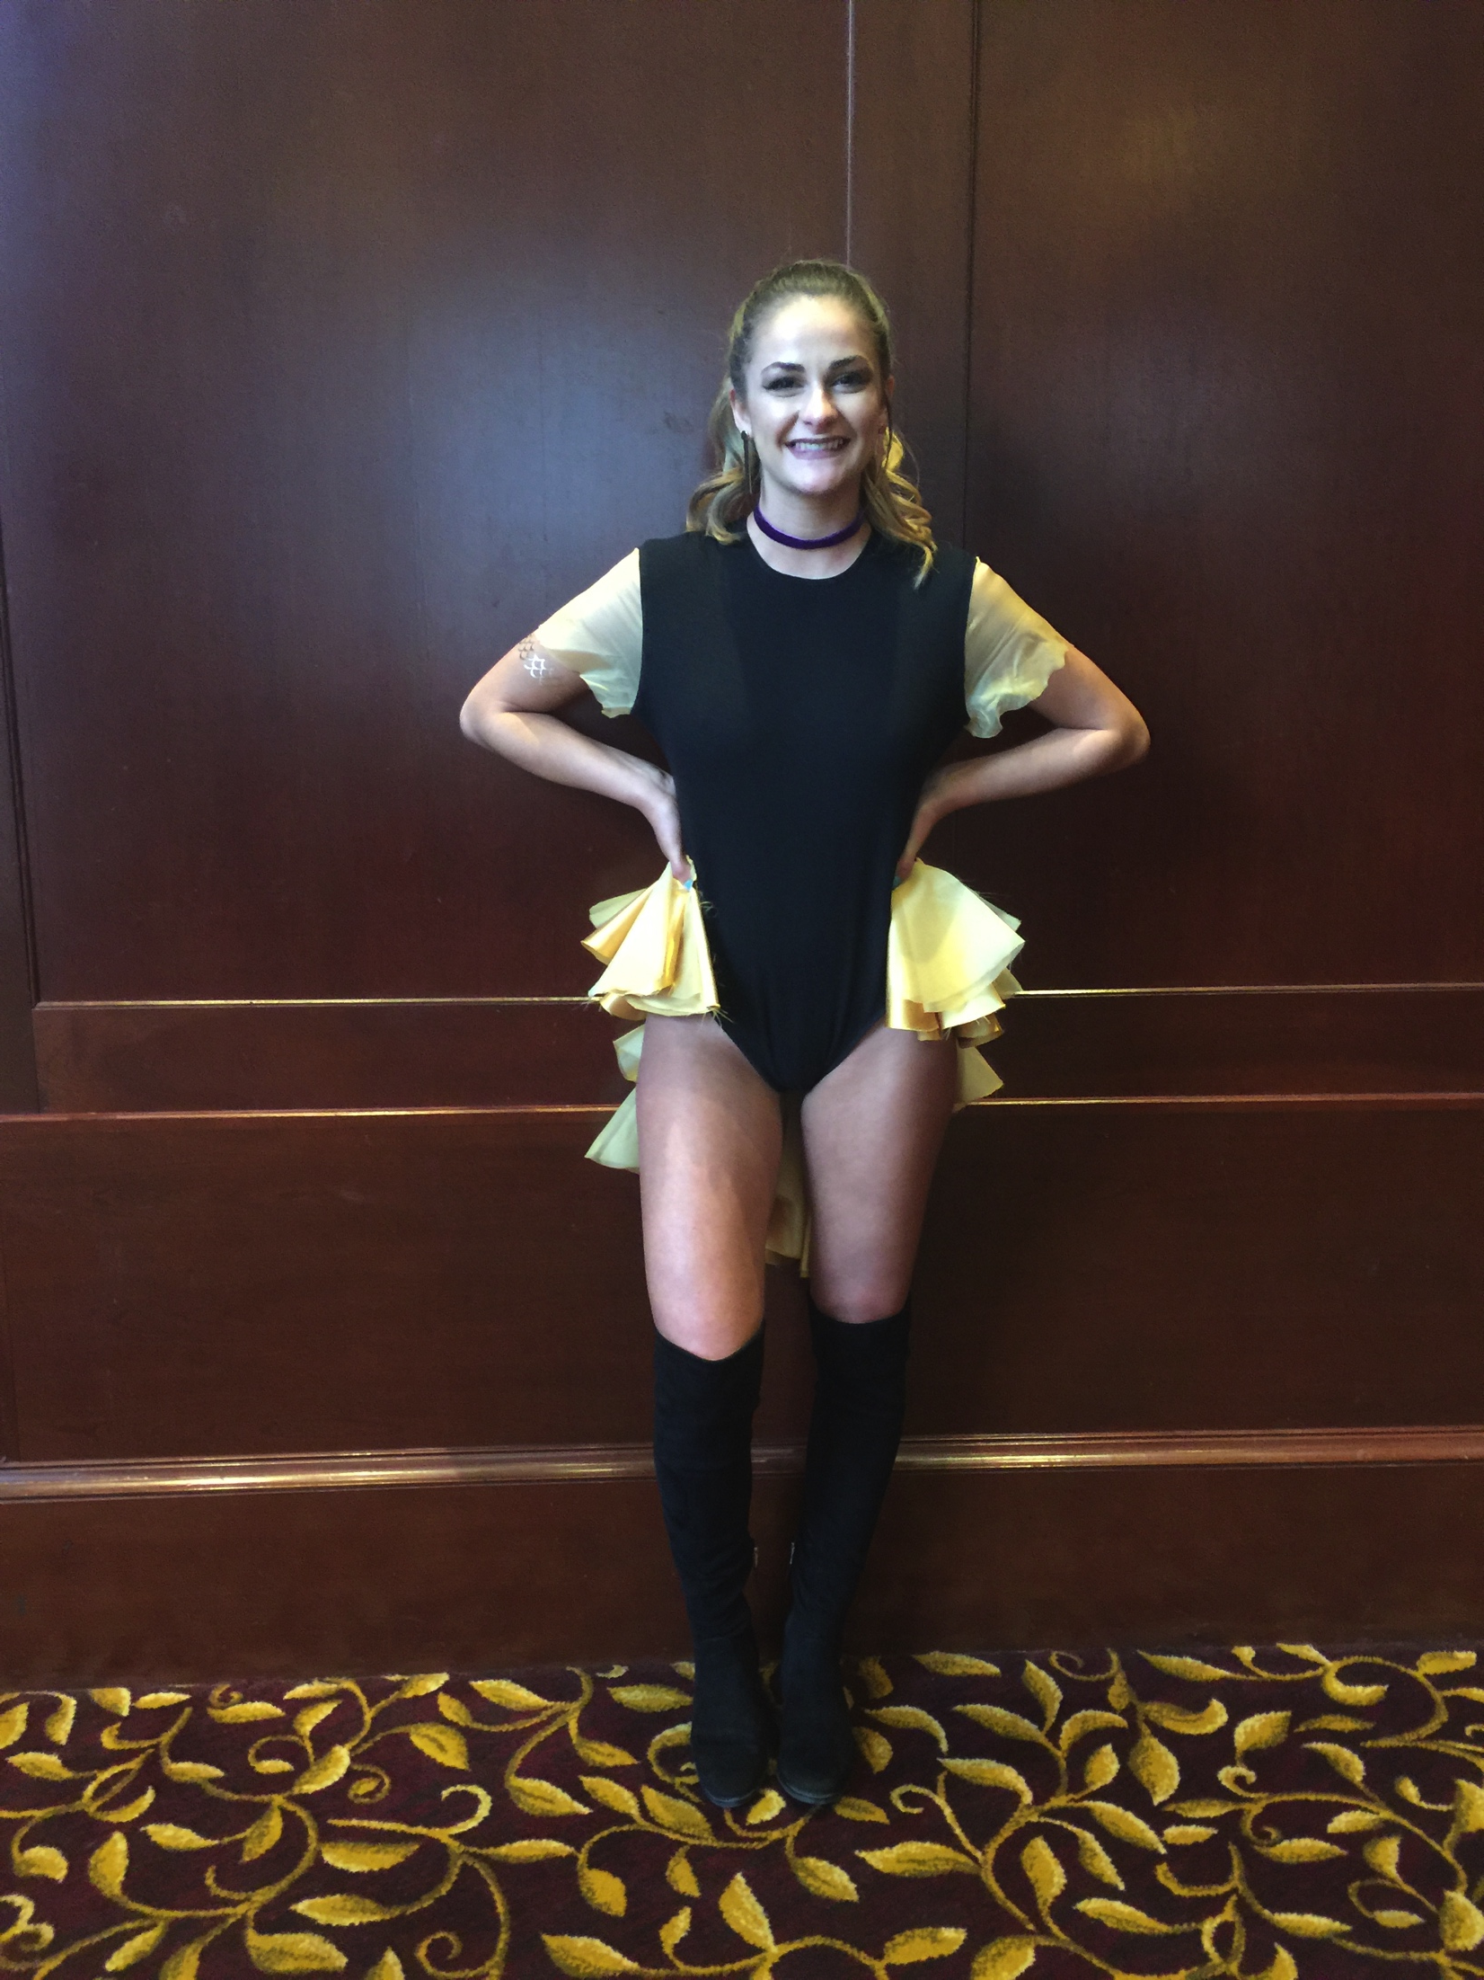
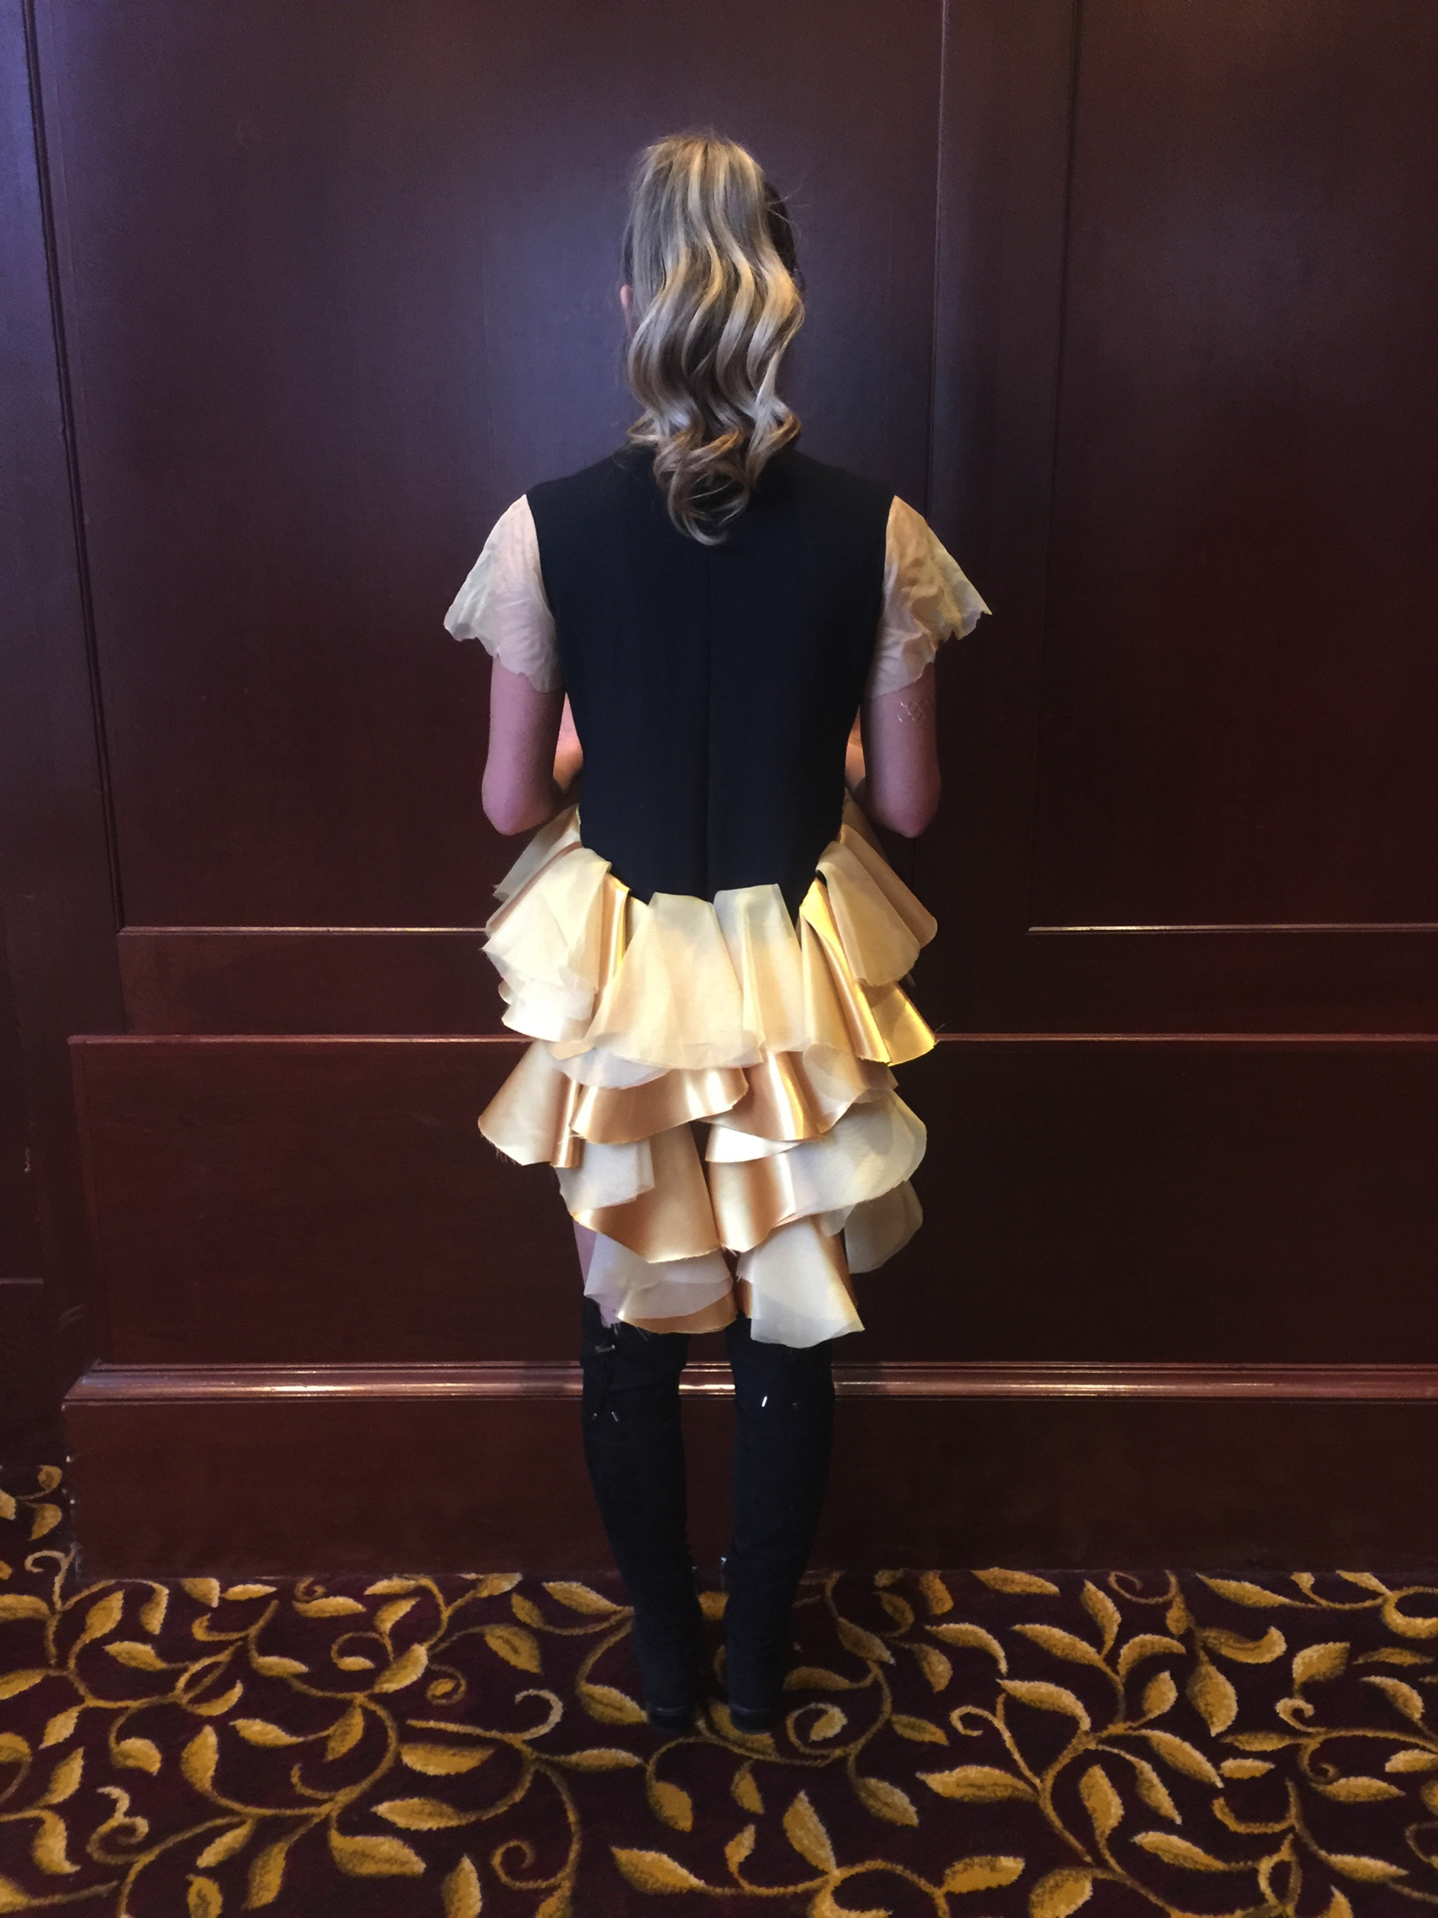
Final Garments

Slide 18
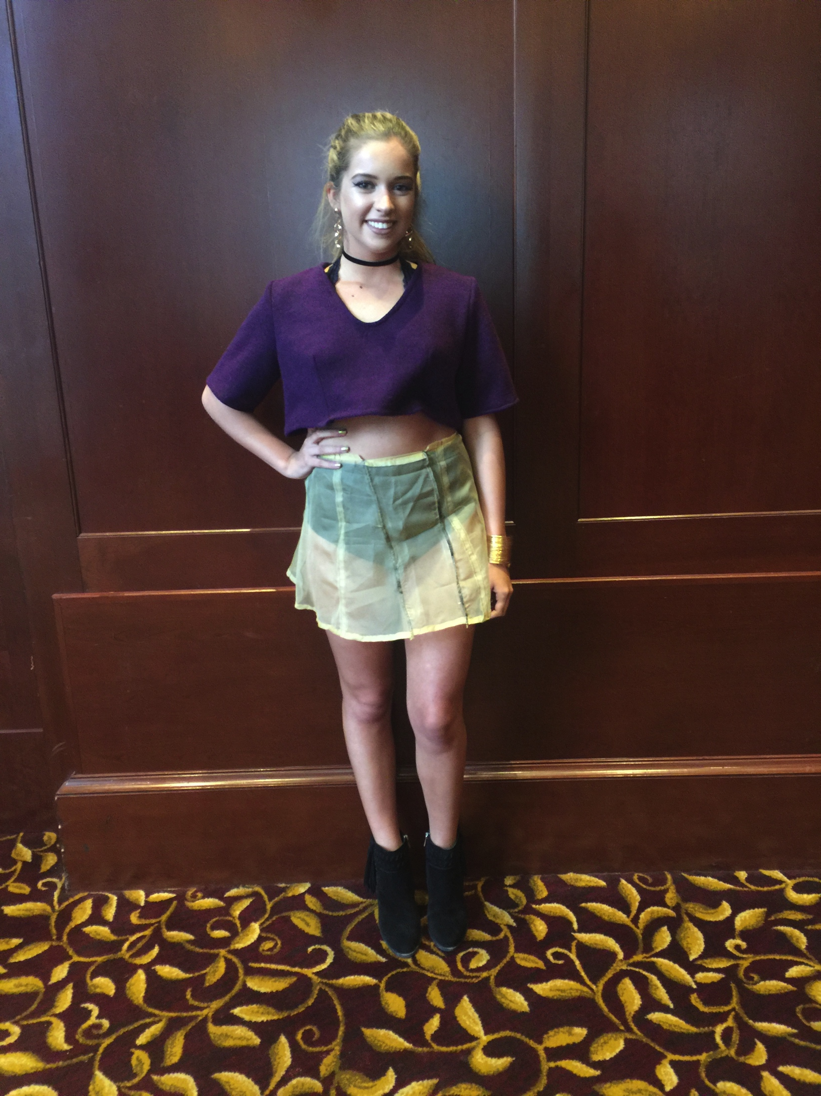
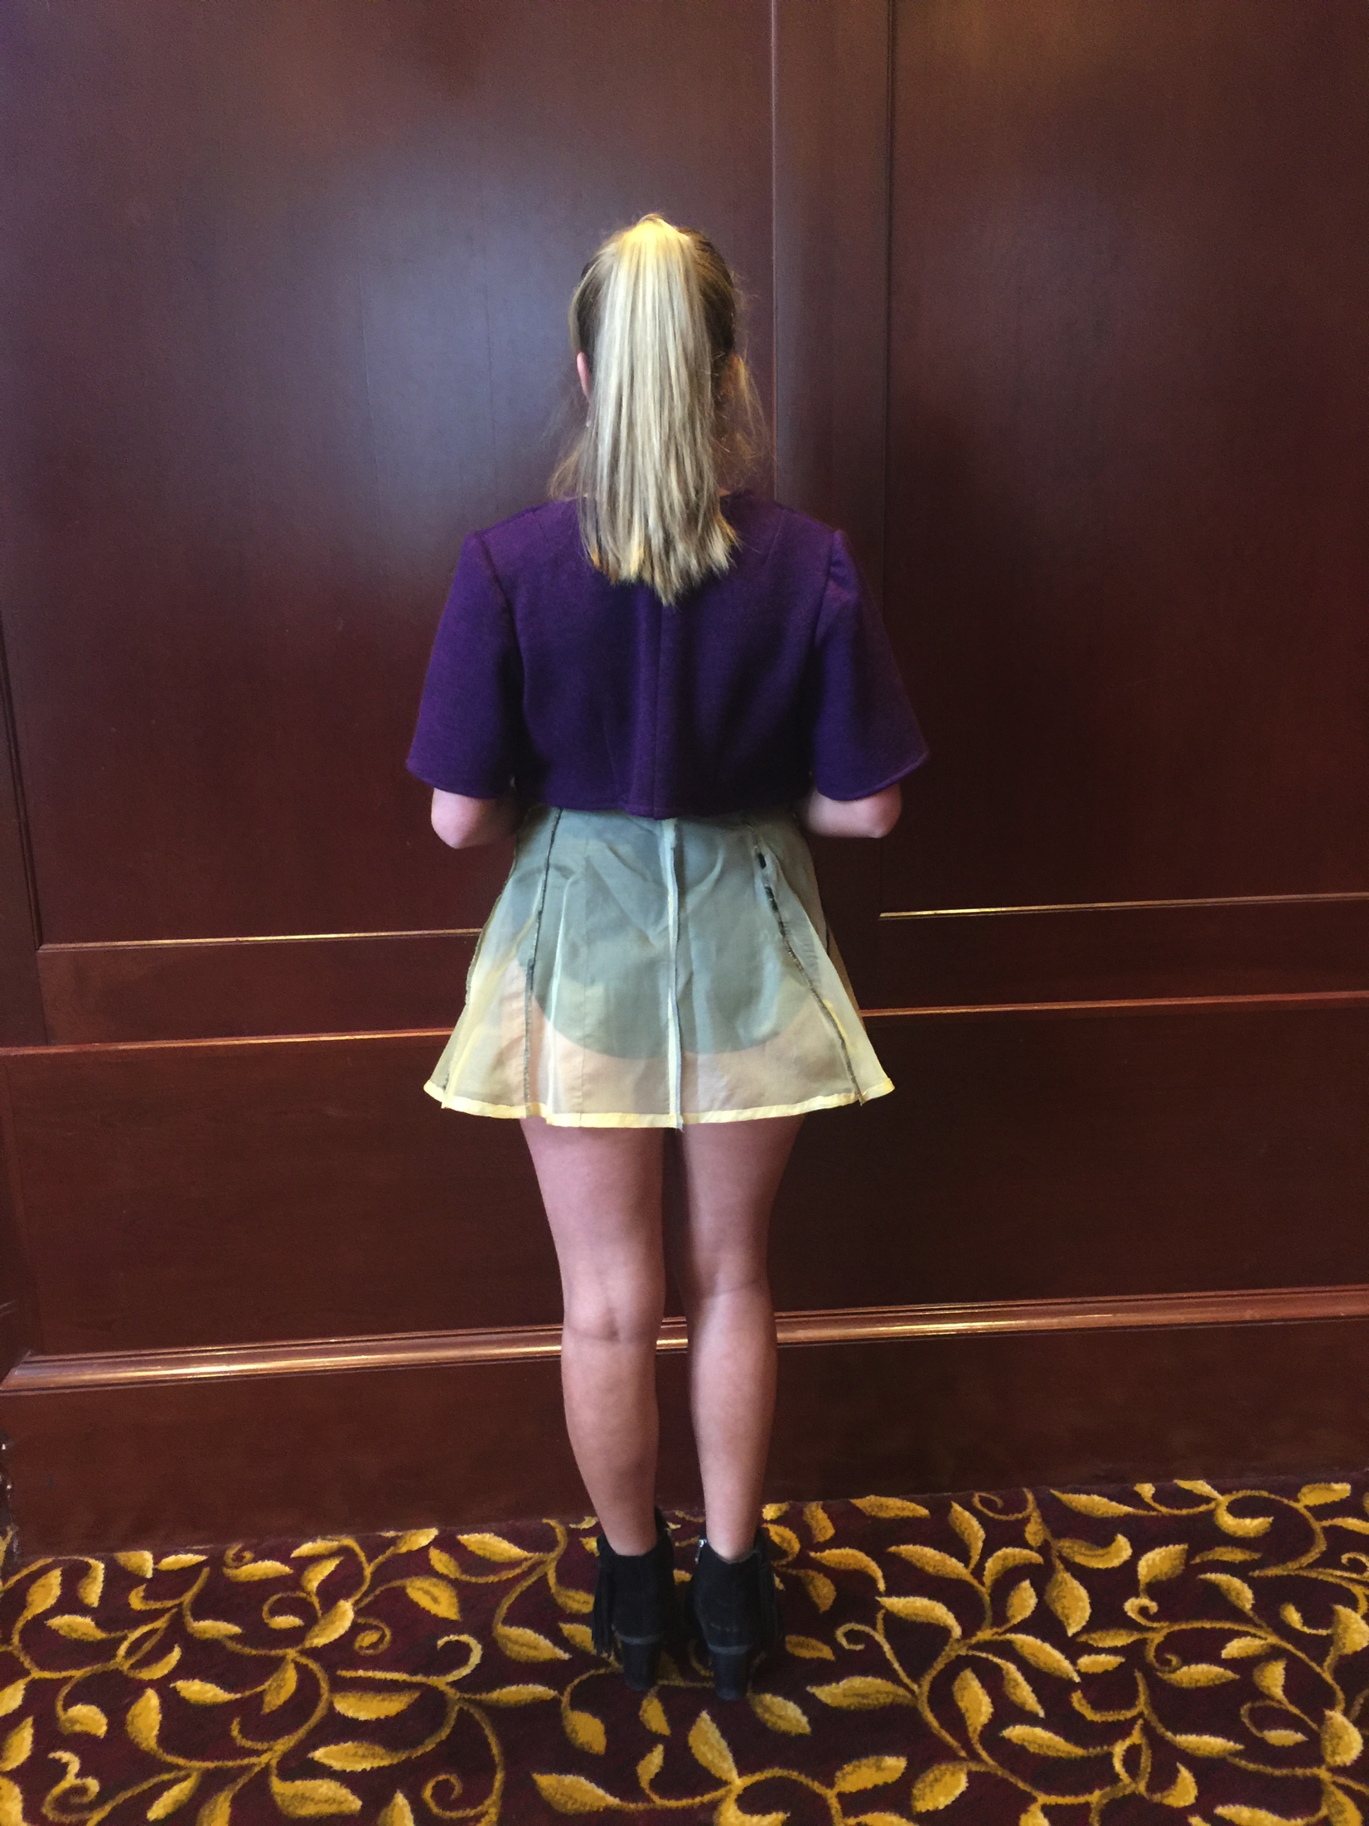
Final Garments

Slide 19
Outcomes
There is a large body of evidence that shows the more you practice, the better you become at something. The completion of this project was extremely challenging. After taking courses in patternmaking and draping, I felt that the I had the knowledge and was completing this for experience. At the end of this project, I realized that I gained not only experience, but more knowledge than ever expected.
Designing Towards a Dream was created in order for me to receive corporate design experience and I can happily say that this was successful. The research and outcomes show that the process of designing a clothing line is extensive, but can be completed with dedication, commitment and skills in the fashion design field.

Slide 20
Acknowledgements
Elizabeth Bentley, Textiles, Fashion Merchandising and Design
Funded by University of Rhode Island’s Honors Program and Undergraduate Research Initiative: Awards for Scholarly, Creative and Artistic Projects

