Slide 1
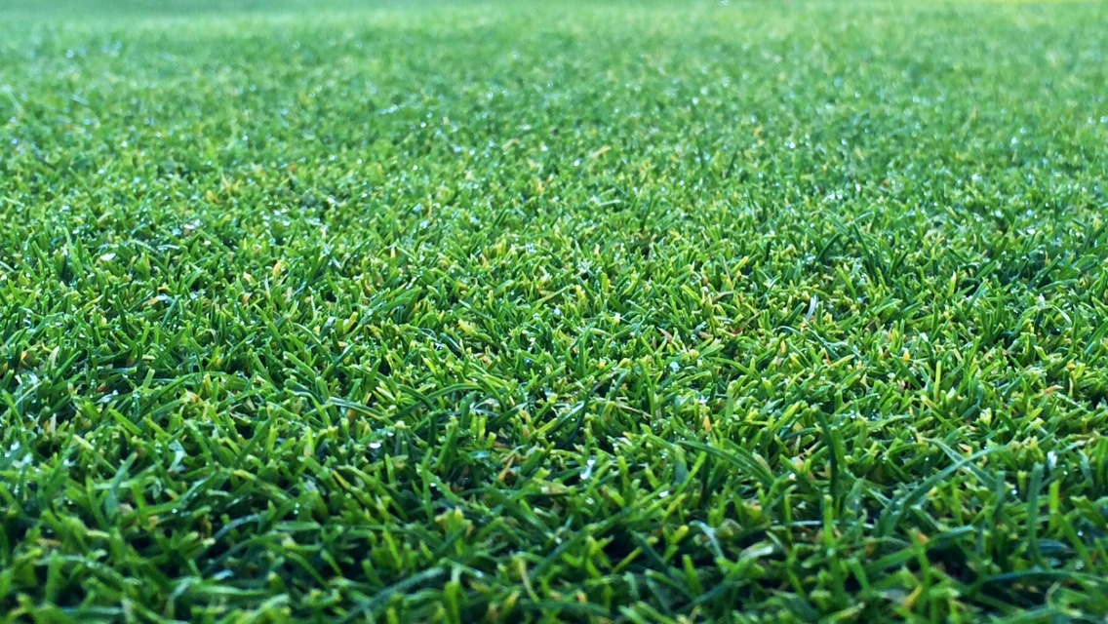
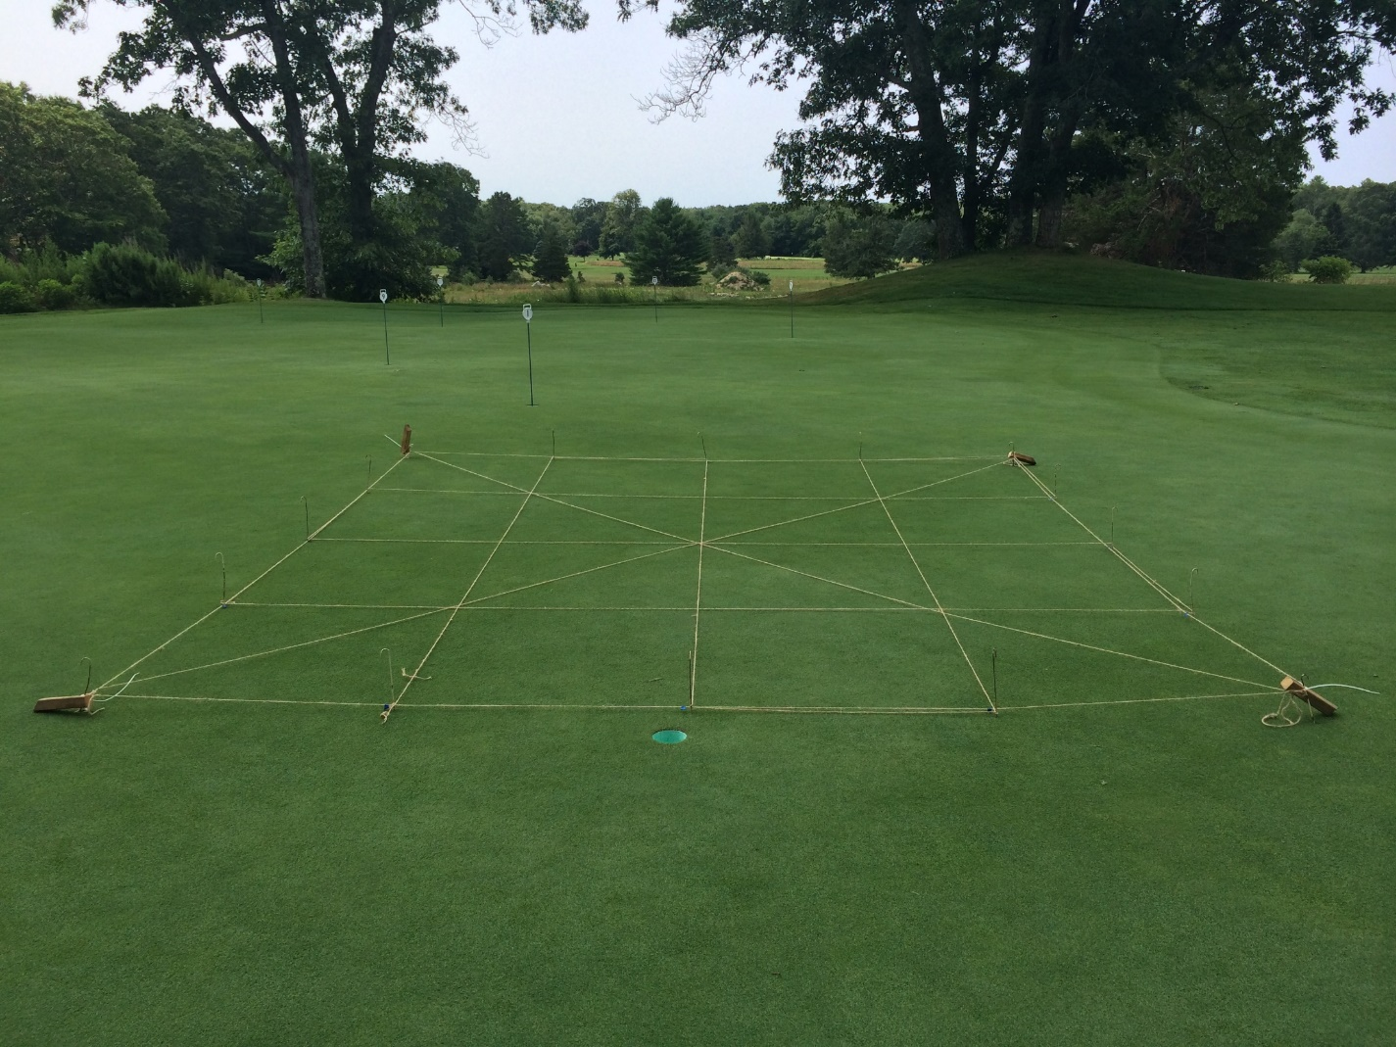
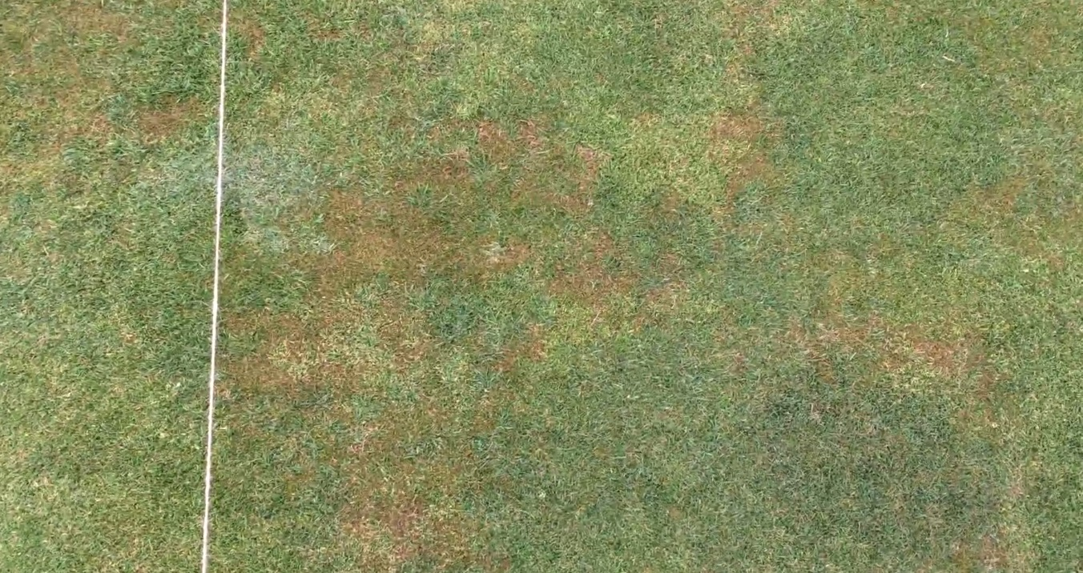
The Effects of Silicon Applications on Wear and Drought Stress of Cool Season Turfgrass
Mike J. Badzmierowski¹, W. Michael Sullivan, Dept. of Plant Sciences and Entomology, Univ. of Rhode Island, Kingston, RI
Introduction
Plot Layout
Brown Patch
The turfgrass manager’s ability to maintain turf quality and functionality during stress periods are important factors. Turfgrass management is a diverse industry spanning home lawns, athletic fields, golf course, cemetery and roadsides, and a wide variety of other uses. Turfgrass quality is important economically and functionally across all these uses.
There are regional and global demands on water and continuing debate on turf applications. Costs have risen dramatically and conflicts increased with divergent priorities for water.
A possible mechanism to increase wear and drought tolerance is through the use of supplemental silicon, (Si), application. While silicon is a major component of many soils, the large fraction of Si is unavailable to plants, with only a small portion, in the form of silicic acid, available to plants.
The most common Si fertilizer is calcium silicate, a byproduct of steel and phosphorus production. Another source of Si is in the crop residues of Si-accumulating plants. Bamboo, Bambuseae, is regarded as a Si accumulator. Little is known of bamboo’s potential efficacy as a Si organic fertilizer, but it quantitatively appears to have the potential to be a source.
An incremental increase in turfgrass drought tolerance and wear resistance with supplemental silicon might serve to reduce global water deficit.
senmike@mail.uri.edu
Figure 1. Experimental design was a randomized complete block, with four treatments, four rates, and four replications at each site (individual plots measured 3’ x 3’). Plots at LLCC shown here. The rates were set as a percentage increase in ambient soil Si-concentration.
Figure 2. Taken on 7/11/14 at PJCC. Brown Patch began strong growth during the first week of the trial.
Objectives
Provide increased knowledge if silicon applications affect drought stressed cool season turfgrass wear tolerance, under foot and vehicular traffic.
Assess the potential of bamboo leaves as an organic source of silicon.
Provide turfgrass managers a way to avoid or mitigate the effects of wear and drought stress or reduced water use, and maintain the visual and functional turfgrass performance.
Results
No significant differences were observed among treatments throughout the duration of the trial.
PJCC plots had Brown Patch, Rhizoctonia solani, during the first week of trial. This can be seen in Figure 2.
LLCC plots showed no signs of stress as it is a regularly sprayed practice green in comparison with PJCC which is a normally untreated fairway.
URI plots were all below acceptable turf rating throughout the trial and no significant differences were observed among the increased concentration of treatments.
Methods
Trial was conducted in 2014 at three sites in Rhode Island.
Point Judith Country Club (PJCC), a private golf course that has less than 12,000 rounds per year on an established creeping bentgrass/Poa annua fairway on a coarse-loamy, mixed, active, mesic Aquic Dystrudepts.
Laurel Lane Country Club (LLCC), a public golf course that has over 50,000 rounds per year on a creeping bentgrass practice green with a sandy-skeletal, mixed, mesic Typic Udorthents.
University of Rhode Island (URI) in Kingston, RI on a newly sodded Quadrangle consisting mostly of Kentucky bluegrass over an urban disturbed soil.
PJCC and LLCC treatments increased estimated soil-Si by 0, 50, 100, and 150 percent and URI received 0, 100, 200, and 300 percent above ambient.
Quality ratings were visually estimated using a 1 to 10 scale, where 1 = poor, 10 = excellent, and 7 = acceptable. Initial ratings were taken as a baseline.
Day of initial treatment (DOIT) was 7/7/14 at PJCC, 7/8/14 at URI and 7/9/14 at LLCC. Each site was rated five times over the next 50 days.
Conclusions
Possible reasons for no differences among treatments vary by site.
PJCC is a highly managed private golf course. Maintenance input standards would include significant fertilizer applications, prophylactic pesticides program and stress avoidance practices (syringing) are deemed essential and normal.
LLCC had been already receiving silica fertilizer as part of the golf course management program. It is possible that the turfgrass had already reached its biological threshold of silicon uptake. The practice green was also watered as needed to prevent stress.
URI plots had a surface bulk density of 1.42 g/cm³ which has caused poor infiltration of the silica fertilizer to reach the root zone. URI plots received no supplemental irrigation and in combination with a dry summer, plots may have not been able to respond to added treatments.
The results do not provide conclusive evidence for whether silicon applications increases wear and drought tolerance.
Further examination and a more controlled environment would be appropriate for determining silicon’s effectiveness as a way to increase stress tolerance in turfgrass.
Treatment | Approx. Silica Concentration
Signature® SST™ 28% Silica | 28%
PlantTuff Silicon Fertilizer | 8%
Vansil® W-10 Wollastonite | 52%
Bamboo Leaves Ash | 60%
Table 1. Bamboo ash (B), VANSIL Wollastonite-10 (powder) (W), and Silicon Stabilized Technology (SST) 28% Silica (liquid) were suspended in 1-liter of water, applied using a CO₂ handheld sprayer calibrated at 34 PSI, fitted tee-jet flat nozzle, and sprayed at a rate of 236 GPA. PlantTuff (PT), a granular fertilizer was mixed with 1mm sand for spreading.
Literature Cited and Acknowledgements
Datnoff, L.E., C.W. Deren, and G.H. Snyder. 1997. Silicon fertilization for disease management of rice in Florida. Crop Prot. 16(6):525-531
Dwivedi, V.N., N.P. Singh, S.S. Das, and N.B. Singh. 2006. A new pozzolanic material for cement industry: Bamboo leaf ash. Int. J. of Physical Sciences 1(3): 106-111.
Funding for this study was provided by the Undergraduate Research Initiative at the University of Rhode Island and the Honors Department at URI.
The authors would like to thank Brett Johnson at Point Judith Country Club and Jay Cummisky at Laurel Lane Country Club for their assistance and use of their grounds.
Contact Information: Mike Badzmierowski¹ email: mbadzmierowski@my.uri.edu Dr. W. Michael Sullivan email: senmike@mail.uri.edu

