Slide 1
Analysis of the chondroitinase operon of Flavobacterium columnare
Erin Sorlien
Mentor: Dr. David Nelson
Honors Undergraduate Research Conference
May 2nd, 2013

Slide 2
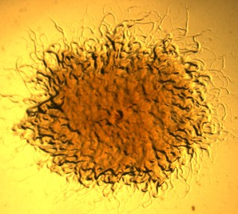
Flavobacterium columnare
Ubiquitous in fresh water
Member of the phylum
Bacteroidetes
General characteristics
Long, thin, tapered rod
“Professional” biofilm producer
Exhibit gliding motility
Grow in yellow pigmented rhizoid colonies
Produce a Chondroitin sulfate degrading enzyme
Causative agent of columnaris disease (1)

Slide 3
Columnaris Disease (CD)
Associated with high stress environments
Low oxygen, high ammonia and nitrite, high water temperatures (2)
Rough handling, injury, and crowding (cages and closed recirculating systems) (3)
Particularly problematic in the commercial catfish industry
About 50% of US catfish farms report cases of columnaris every year (3)
Second leading cause of mortality in pond raised catfish after enteric septicemia (4)
Often precedes secondary infection (5)
80% of farms that experience winter fungus (saprolegniosis) had a columnaris infection in the previous summer/fall
Presents as yellowish-brown lesions on the skin, gills and fins
Advanced lesions often produce white banded with a centered ulcer

Slide 4
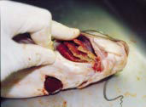
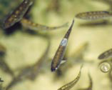
← Channel catfish showing the infectious yellow pigmented lesions of columnaris disease in its gills. (5)
Rainbow trout fingerling showing →
the white saddle-back lesions of
progressed infection. (5)
A vaccine has been developed that gives 57-94% protection against the disease but is not widely used because it is costly versus the cost of losses due to CD and its use has been limited. (6,7)

Slide 5
Virulence Factors
Molecular tools used by pathogens to promote infection in a host
Attachment and dissemination
Immunosuppression or immunoevasion
Nutrient sequestration
Targeted for drug development

Slide 6
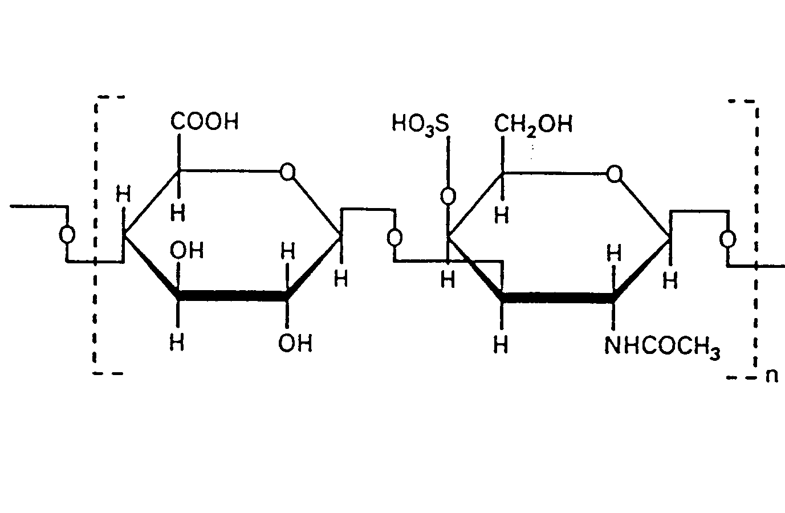
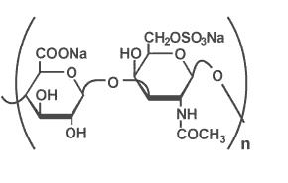
Chondroitin Sulfate
Type of glycosaminoglycan (GAG)
Long unbranched polysaccharides with repeating disaccharide units
N-acetylgalactosamine and glucuronic acid
Prevalent in connective tissues of vertebrates
Chondroitinase is an extracellular lyase
Hydrolyzes the cleavage of the 1,4 linkage
Hypothesized that this
enhances dissemination
Chondroitin Sulfate A
Chondroitin Sulfate C

Slide 7
Mutation and Complementation
cslA gene previously identified to encode chondroitinase
Mutation made by single homologous recombination
Complementation of cslA
Should restore the wild-type phenotype

Slide 8
Assays
The measurement of a target of interest’s functional activity compared to a standard
Qualitative: pass/fail
Quantitative: numerical data
Wild-type F. columnare (standard)
cslA mutant (chondroitinase knockout)
cslA complement (phenotypic restoration)

Slide 9
Chondroitinase Assay
Grow culture to stationary phase in modified Ordal’s broth (18 hours)
Spin down the cells and filter sterilize the supernatant
Dilute supernatant
Incubate the supernatant with 80 μL of chondroitin A solution (at 900 μg/ml ) for 15 minutes at 27ºC
Add 45 μL of a 4% Bovine Serum Albumin (BSA) solution
Using 40 μL of 1N HCl, precipitate the remaining chondroitin
Read optical density (OD) every 5 minutes at 600 nm
OD value is inversely proportional to the chondroitinase activty

Slide 11
cslA Operon
Ascencion No. | Gene Name | Gene Function | Score | E Value
AAX07421.1 | cslA | chondroitinase AC | 1560 | 0.0
YP_001297333.1 | cslB | dTDP-4-dehydrorhamnose 3,5-epimerase | 315 | 2x10⁻⁸⁴
YP_001297332.1 | cslC | dTDP-4-dehydrorhamnose reductase | 402 | 2x10⁻¹¹⁰
YP_001193389.1 | cslD | NAD-dependent epimerase/dehydratase | 624 | 6x10⁻¹⁷⁷
ZP_01049729.1 | cslE | Glycosyltransferase | 413 | 2x10⁻¹¹³
ZP_01062436.1 | cslF | TuaG [Leeuwenhoekiella blandensis MED217] Glycosyltransferase | 330 | 9x10⁻⁸⁹
Notes:
Epimerase: inversion of stereochemistry; Reductase; Dehydratase; Glycosyltransferase: transfer monosaccharide
Blastx: search a protein database using a translated nucleotide sequence

Slide 12
Project Goals
Investigate whether complementation of the complete csl operon in the cslA mutant is necessary to restore full chondroitinase activity.

Slide 13
Shuttle Vector
Plasmid that can propagate in two species
Ability to replicate in E. coli and F. columnare
oriT
pCP1
Complementation using conjugal mating

Slide 14
pCP29: Template Plasmid
Previously used to genetically manipulate F. columnare
Plans to improve efficiency
Original size: 11.263 kb
Remove superfluous sequences to decrease size
Add a new antibiotic resistance cassette to differentiate the mutant and the compliment strains

Slide 15
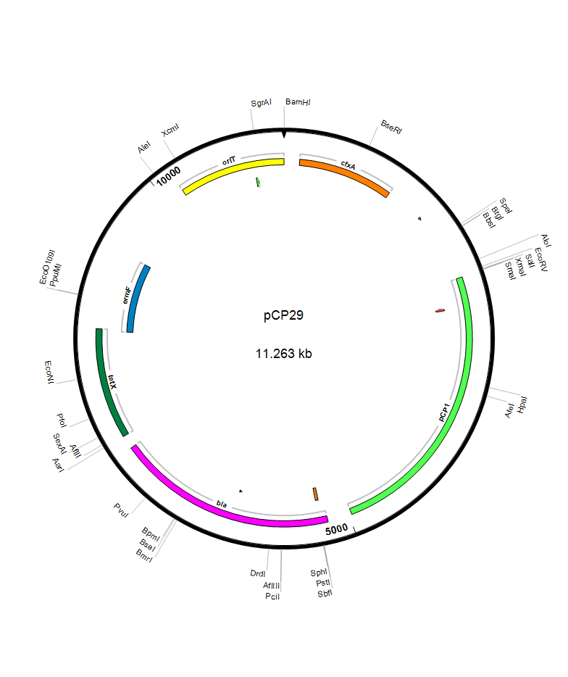
pCP29 Template Plasmid with Unique Cut Sites

Slide 16
Primer Design
Used in PCR to amplify a specific gene product
Should be 18-30 base pairs long
Must have similar T_{m} values (difference of less than 5˚C)
GC content of 40-60% recommended
Incorporate restriction enzyme cut sites
Recognize specific nucleotide sequences
Should create different sticky ends and analyze buffer compatibility

Slide 17
pOmpA promoter region
The native promoter of Kanamycin cannot induce replication in Flavobacterium
F. johanissae contains the pOmpA promoter which is capable of driving transcription of genes (8)
Develop Kan primers to eliminate native promoter
Use restriction sites to align the gene with pOmpA

Slide 18
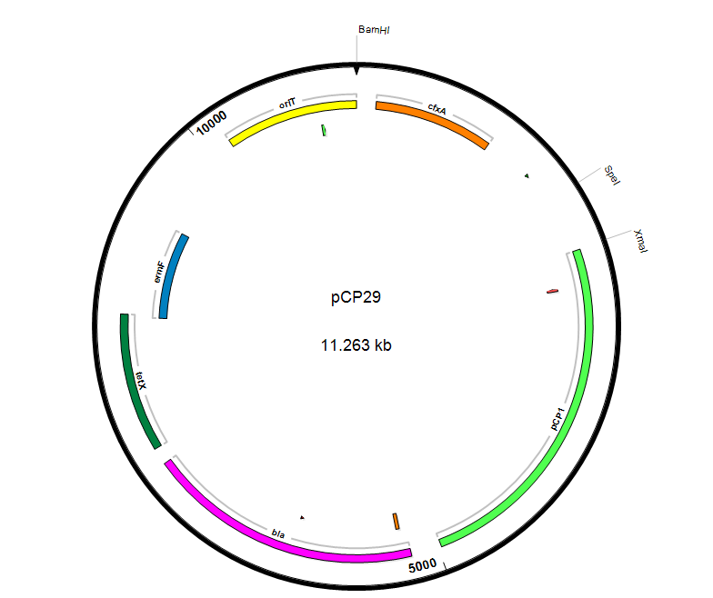
pCP29 Template Plasmid with Targeted Cut Sites

Slide 19
PompA (BamHI/Spe1 cut sites)
1500
1000
900
800
700
600
500
400
300
200
100

Slide 20
Kanamycin (SpeI/XmaI cut sites)
10000
6000
5000
4000
3000
2500
2000
1500
1000
750
500
250

Slide 21
csl Operon (BamHI single cut site)
10000
8000
6000
5000
4000
3000
2000
1500
1000
500

Slide 22
CIAP (Promega)
Calf Intestinal Alkaline Phosphatase
Hydrolysis of the 5’- phosphate groups from DNA, RNA and triphosphates
Prevents recircularization and religation of linearized plasmid with single cut site (BamHI)

Slide 23
CIAP Protocol
Each picomole of DNA ends will require 0.01u CIAP.
1 µl 10x Buffer in 9 µl H20 = 1x Buffer
1 ul CIAP (1u/ µl) into 9 µl 1x Buffer = 0.1 u / µl CIAP
Incubate for 30 minutes at 37C
Add another equivalent aliquot and repeat incubation
Add 300μL of CIAP stop buffer

Slide 24
Transformation/Conjugation
Incorporate the modified plasmid into E. coli
Electroporation
Mate E. coli containing my plasmid with F. columnare
Passage of genetic material from a donor to recipient cell through a conjugation pilus
Conduct chondroitinase assay on new complementation strain

Slide 25
Future Work
cslB mutation
Should be equivalent to the cslA compliment strain
Chondroitinase activity should be about 10%

Slide 27
Resources
Durborow, P. e. a. 1998. Columnaris Disease: A Bacterial Infection Caused by Flavobacterium columnare. SRAC.
Holt, R. A., Sanders, J.E., Zinn, J.L., Fryer, J.L., Pilcher, K.S. 1975. Relation of Water Temperature to Flexibacter columnaris Infection in Steelhead Trout (Salmo gairdneri), Coho (Oncorhynchus kisutch) and Chinook (O. tshawytscha) Salmon. Journal of the FIsheries Research Board of Canada 32:1553-1559.
USDA. 2011. Part II: Health and Production Practices for Foodsize Catfish in the United States, 2009. USDA (United States Department of Agriculture), Animal and Plant Health Inspection Service, Veterinary Services, National Animal Health Monitoring System Publ. No. N595.0711.
Garnjobst, L. 1945. Cytophaga columnaris (Davis) in Pure Culture: A Myxobacterium Pathogenic to Fish. Journal of bacteriology 49:113-128.
1998. Robert M. Durborow, Ronald L. Thune, John P. Hawke and A.C. Camus. Columnaris Disease. A Bacterial Infection Caused by Flavobacterium columnare. SRAC Publication No. 479
Schachte, J. H. 2002. Columnaris Disease. A Guide to Integrated Fish Health Management in the Great Lakes Basin:199-203.
Tkalec, A. L., D. Fink, F. Blain, G. Zhang-Sun, M. Laliberte, D. C. Bennett, K. Gu, J. J. Zimmermann, and H. Su. 2000. Isolation and expression in Escherichia coli of cslA and cslB, genes coding for the chondroitin sulfate-degrading enzymes chondroitinase AC and chondroitinase B, respectively, from Flavobacterium heparinum. Applied and environmental microbiology 66:29-35.
Chen S, Bagdasarian M, Kaufman M, Bates A, Walker E. Mutational analysis of the ompA promoter from Flavobacterium johnsoniae. J Bacteriol. 2007;189:5108–5118. doi: 10.1128/JB.00401-07.

Slide 29
Questions?

