Slide 1
An Analysis of American white Masculinity in 2013
Eddie Pare

Slide 2
Learning Outcomes
Engage in a different field of academia
Cultural and film analysis
Sociology gets at “why”
Personal reflection
Exploration of my dilemma of how I perform my masculinity
Crisis of conscience/search for identity

Slide 3
Theoretical Framework
Hegemony Theory
Social power works through controlling the ideas that circulate in society
Power Bloc
Struggles to decide what ideas get defined as “common sense” ideas

Slide 4
Media as cultural pedagogy
“A media culture has emerged in which images, sounds, and spectacles help produce the fabric of everyday life, dominating leisure time, shaping political views and social behavior, and providing the materials out of which people forge their very identities.”
“Media culture also provides the materials out of which many people construct their sense of class, of ethnicity and race, of nationality, [and ideas] of “us and “them”.
Notes:
Cultural pedagogy for identity formation

Slide 5
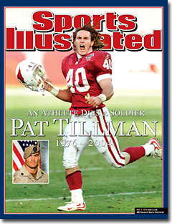
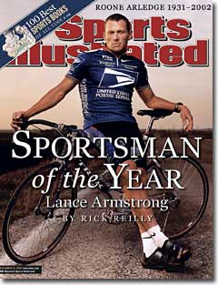
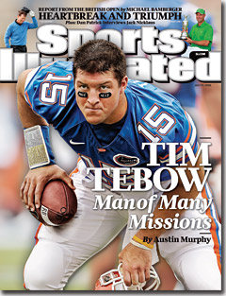
Stories of White Masculinity in American culture
The patterned ways we tell and re-tell stories of white masculinity
As “Cowboys”
Lance Armstrong
Pat Tillman
Tim Tebow
As self-determined individuals whose choices positively improve their situations
Often described as “hard-working” with indomitable will
Accomplishments that seem unlikely
Often displays of physical strength and will
The Problem: These portrayals mask the institutional privileges from which white men benefit

Slide 6
Films
Post-9/11 Culture
Re-masculinization of American men in media
Bring back the cowboy figure
Rise of man-boy figure in American films
Judd Apatow and Will Ferrell
Are their films a comedic attempt to chip away at the white male power structure?
Or, in poking fun at dominant masculine ideals, Apatow and Ferrell are re-producing the very stereotypical ideas about masculinity they think they are ridiculing

Slide 7
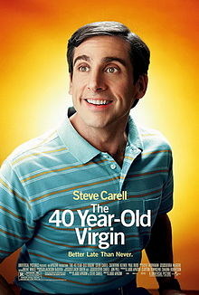
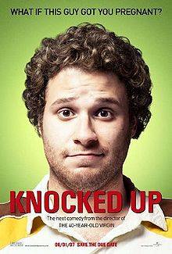
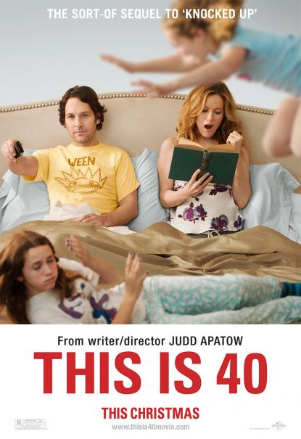
Judd Apatow

Slide 8
Judd Apatow
Apatow began his career with the celebration of a“nerd” figure of white masculinity, but many of his films have featured other more stereotypical white masculinities
“America fears the penis, and that’s something I’m going to help them get over.” Judd Apatow, 2007
Films follow the post-9/11 trend of re-masculinization of American white men in an unique way
His films are predicated on this idea that white masculinity has been disempowerment by feminism
Notes:
Peterson, Latoya. “Judd Apatow and the Art of White Masculinity”. August 2008.
Quote from World Entertainment, “America fears the penis” Dec. 2007

Slide 9
Judd Apatow
“Judd Apatow and the Art of White Masculinity” by Latoya Peterson
“His films…demonstrate the ways in which white masculinity has been ‘wounded’ by the feminist, gay, and civil rights movements. In Apatow’s movies we see an entire generation of white men who rely on each other for a sense of validation and understanding, a generation of men who in many ways by refusing to grow-up are able to avoid the reality of changing power structures in American society.”
Notes:
Peterson, Latoya. “Judd Apatow and the Art of White Masculinity”. August 2008.
Quote from World Entertainment, “America fears the penis” Dec. 2007

Slide 10
Judd Apatow
Films regularly feature a ‘bromosocial’ crew of men who portray different forms of masculinity
Sensitive guy
Everyman
Stereotypical ‘alpha male’
Everyman figure usually wins out in end
Usually learns to be more stereotypically male and to rid self of some sensitive tendencies
Re-produces white masculinities that prefer being an ‘alpha male’ to a ‘sensitive guy’
Notes:
Peterson, Latoya. “Judd Apatow and the Art of White Masculinity”. August 2008.
Quote from World Entertainment, “America fears the penis” Dec. 2007

Slide 11
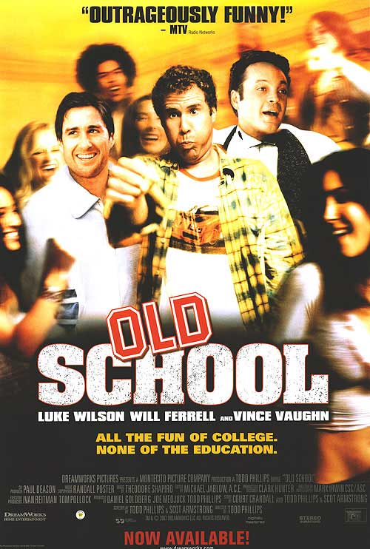
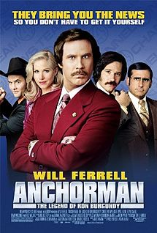
Will Ferrell

Slide 12
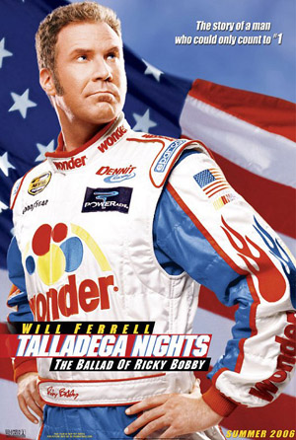
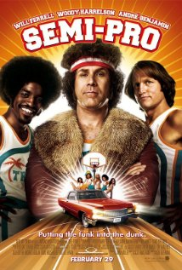
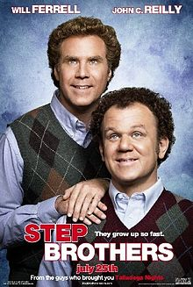
Will Ferrell

Slide 13
Will Ferrell
Similar to Apatow
The white masculinities he performs are seen by some as making fun of stereotypical ways of being white men
White men who define their masculinity by independence, being in control, dominant, a subject, stoic, physically strong, invulnerable

Slide 14
On Apatow and Ferrell’s Films
They provide a popular language for understanding masculinity for white male viewers
Create and generate pleasure in all-male homosocial environments that allow to escape the “feminist onslaught” that leaves men feeling helpless and judged
Deprecation of strong female characters
While supposedly poking fun at these white men, they have actually been a primary generator of this way of being a white man in the last decade

Slide 15
Films
Portrayal of different masculinities
How we are to perceive differences
Sensitive
Everyman
Stereotypical
The homosocial might be called the “bromosocial”
The bro-culture in Apatow and Ferrell films
Perceived “crisis” re-imagined
Continuum of understanding my “crew” of friends
Insecurities downplayed
Conscious effort to mimic the everyman
Hero of Apatow and Ferrell films

Slide 16
The Masquerade of Masculinity
So, coming of age in this context, how has it influenced how my friends and I perform our white masculinities?
Mid-life crisis pressure to act now, while in college
Fear of post-college reality
Social pressure to “man-up” in post-9/11 society
Absence of current movies that portray different white masculinities leaves one searching for sources of masculinity

Slide 17
Personal Reflection
College life
Masculine status with ‘bros’ depends on hooking up
The act itself is secondary to the story with the bros on the morning after
Idea is to be the center of conversation
Those who are “successful” are idealized while those not enjoying “success” are put down
Pressure to sustain “success” in order to sustain status in group

Slide 18
Of Two Minds
Search for alternative masculine performance
Crisis of conscience
Is this stereotypical or hypermasculine version of white masculinity really what it means to be a man?
Relation to everyman figure
Consciously performed
Fear of stereotypical and sensitive

Slide 19
Dr. Kyle Kusz has not only mentored me with this project, but has also served as a personal mentor. For this project I am thankful, but for his lessons I am grateful.

Slide 20
Sources
Goldberg, Michael. "Hegemony." Hegemony. http://faculty.washington.edu/mlg/courses/definitions/hegemony.html. Apr. 2013.
Wise, Tim. http://www.timwise.org/f-a-q-s/.
Wise, Tim. White Like Me: Reflections on Race from a Privileged Son. Brooklyn, NY: Soft Skull Press. 2008
Faludi, Susan. Stiffed: The Betrayal of the American Man. New York, NY: William and Morrow Publishing Company. 1999.
Messner, Michael. Politics of Masculinities: Men in Movements. California: Sage Publications Inc. 1997
Kellner, Douglas. Cultural Studies, Identity and Politics Between the Modern and Postmodern Media Culture. London, England: Routledge . 1995.
Kimmel, Michael and Messner, Michael. Men’s Lives. New York, NY: MacMillan Publishing Company. 1992.
Kusz, Kyle. “Sincere Fictions of Whiteness in New Millenium American Sports Film”, Learning Culture Through Sports: Perspectives on Society and Organized Sports. New York: Rowman & Littlefied Publishers, Inc. 124-142. 2011
McIntosh, Peggy. “White Privilege: Unpacking the Invisible Backpack”. Massachusetts. 1989.
Lance Armstrong, Picture. http://sportsillustrated.cnn.com/vault/cover/toc/9879/
Pat Tillman, Picture. http://sportsillustrated.cnn.com/vault/cover/toc/9986/
Tim Tebow, Picture. http://sportsillustrated.cnn.com/vault/cover/toc/11270/
Tait, R. Colin. “Absurd Masculinity: The Time-Bending Comic Persona of Will Ferrrell”. http://www.annehelenpetersen.com. November 2011.
Alilunas, Peter. “Male Masulinity as the Celebration of Failure: The Frat Pack, Women, and the Trauma of Victimization in the “Dude Flick”. http://www.tft.ucla.edu/mediascape/spring08_malemasculinity.html
Max, Tucker. I Hope They Serve Beer in Hell. New York, NY: Kensington Publishing Co. 2009.
This is 40, Picture. http://www.comingsoon.net/gallery/71249/This_Is_40_8.jpg
The 40 Year Old Virgin, Picture. http://upload.wikimedia.org/wikipedia/en/thumb/4/43/40-Year-OldVirginMoviePoster.jpg/220px-40-Year-OldVirginMoviePoster.jpg
Knocked Up, Picture. http://upload.wikimedia.org/wikipedia/en/thumb/5/51/Knockedupmp.jpg/220px-Knockedupmp.jpg
Anchorman: The Legend of Ron Burgundy, Picture. http://upload.wikimedia.org/wikipedia/en/thumb/6/64/Movie_poster_Anchorman_The_Legend_of_Ron_Burgundy.jpg/215px-Movie_poster_Anchorman_The_Legend_of_Ron_Burgundy.jpg
Step Brothers, Picture. http://upload.wikimedia.org/wikipedia/en/thumb/d/d9/StepbrothersMP08.jpg/220px-StepbrothersMP08.jpg
Talladega Nights: The Ballad of Ricky Bobby, Picture. http://www.thecinemasource.com/moviesdb/images/Talladega_Nights%20-%20Poster%20-%20Will_Ferrell.jpg
Old School, Picture http://images.fanpop.com/images/image_uploads/Old-School-Movie-Poster-old-school-648683_500_742.jpg
Semi-Pro, Picture. http://ia.mediaimdb.com/images/M/MV5BMTc1MjQ4NTc3M15BMl5BanBnXkFtZTcwMTc3NTg1MQ@@._V1_SY317_CR1,0,214,317_.jpg
Dubois, WEB. The Souls of Black Folk: Essays and Sketches. Chicago: A.C. McClurg & Co., 1903.
Kusz, K.W. (2001). ‘I want to be the minority’: The politics of youthful white masculinities in sport and popular culture in 1990s America. Journal of Sport and Social Issues, 25(4), 390-416.
Kusz, K.W. (2006). Why be a ‘Jackass’?: Media Images of Young White Men In and Out of Sport in New Millennium America. In S. Spickard Prettyman & B. Lampman’s (Ed.) Changing the Game (pp. 182-196). Scarecrow Press: Lanham, MD.
Kusz, K.W. (2007). From NASCAR Nation to Pat Tillman: Notes on sport and the politics of white cultural nationalism in post-9/11 America. Journal of Sport and Social Issues, 31(1), 77-88.

