Slide 1
Compassion Meditation vs. Mindfulness Meditation:
Effect on Attitude and Disposition
By Graham Maione
Advisor: Dr. Paul Bueno de Mesquita

Slide 2
Background
Meditation originated in Eastern spiritual traditions over 12,000 years ago.
Numerous types and goals
Usually involves a self-induced state of awareness and reduction of physical/psychological unrest

Slide 3
Background
Compassion (Metta) Meditation utilizes a guided mantra focused on feelings of compassion, positivity and happiness.
Mindfulness (Samatha) Meditation focuses on becoming fully aware of the present

Slide 4
Research Problem
Being an undergraduate student can cause extreme amounts of stress, anxiety, aggression and even depression
Treatments often address symptoms and rather than underlying causes
Lack of awareness exists about the potentials of meditation

Slide 5
Literature Review
In 2013 pilot study, undergraduate participants received a program of Meditation Awareness Training (MAT) and significant improvements were displayed in psychological well being and dispositional mindfulness levels
Emotional regulation improved in areas of stress and anxiety

Slide 6
Literature Review
In 2012 a matched subject design was used to examine levels of mindfulness and self-compassion between a sample of meditators and non meditators
Scores suggest to a significant degree that meditation experience accounted for increased levels of mindfulness and self-compassion

Slide 7
Purpose
Implement two uniquely different types of meditation to two groups of undergraduate students
Survey differing effects on attitude and disposition
Determine respective benefits
Spread Awareness

Slide 8
Hypotheses
Compassion meditation to be most effective in improving attitudes towards peer violence
Mindfulness meditation to be most effective in improving levels of mindful awareness
General improvements

Slide 9
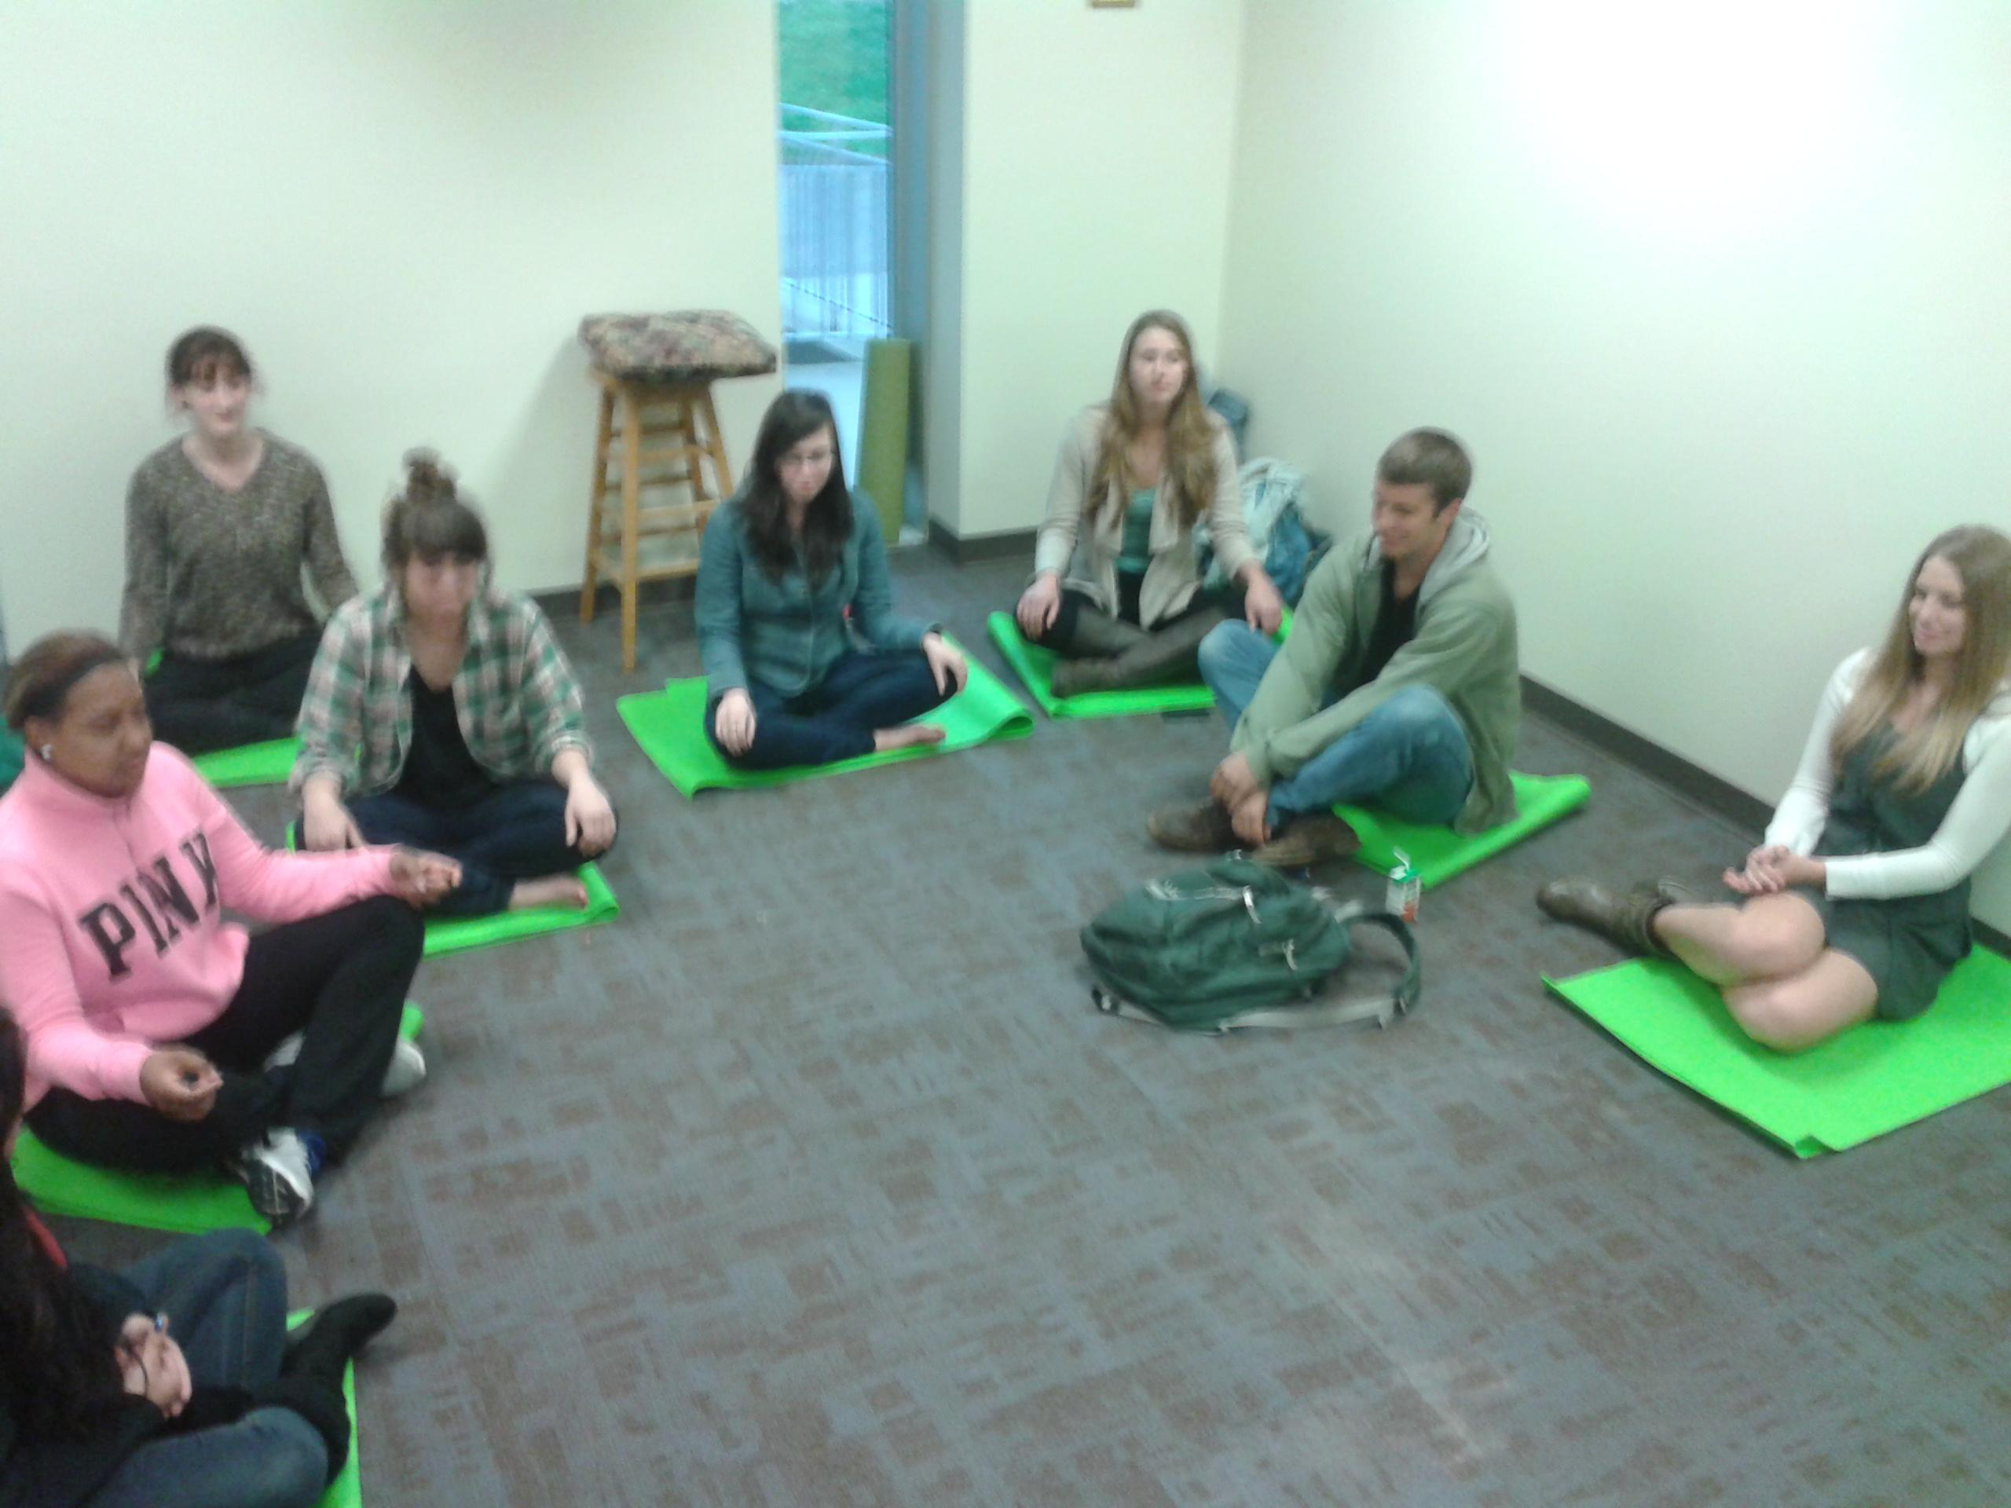
Method: Participants
25 URI undergraduates ages 18-22
15 female, 10 male
20 white, 2 African American, 2 Hispanic, 1 Asian/Pacific Islander
Varying Major
Varying Meditation Experience (5 experienced meditators)

Slide 10
Method: Materials
The Life Orientation Test (LOT-R)
Subjective Happiness Scale (SHS)
The Attitudes Towards Interpersonal Peer Violence Scale (ATIPV)
The Perceived Stress Scale
Mindful Attention Awareness Scale

Slide 11
Method: Procedure
Minimal Risk IRB approval
One month of recruitment
Random Assignment to 1 of 3 groups
Experimental groups met 3 times for 45 once a week for 3 weeks.
Supplemental private meditation assigned
Administered measures before first and after last treatment session
Meditation room used as study location
Control group used as a baseline

Slide 13
Results
Both within-group means improved across all 5 measured categories of attitude and disposition
Not to a significant degree
Differences existed between all 3 group means
Not to a significant degree
Average within subject change score improved across all categories

Slide 14
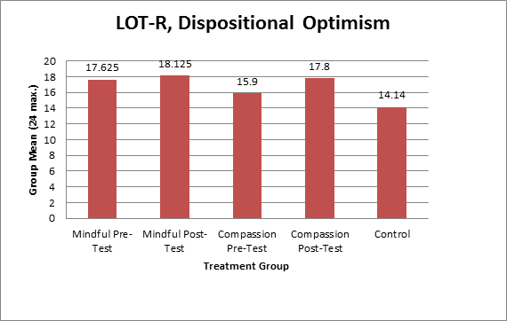
Results
Mindful +0.5 change score
Compassion +3.5 change score

Slide 15
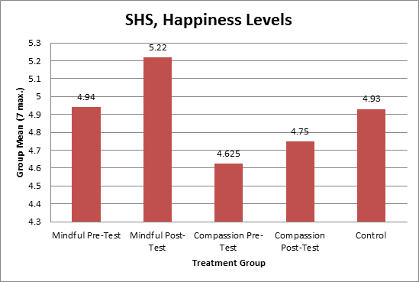
Results
Mindful +0.28 change score
Compassion +0.13 change score

Slide 16
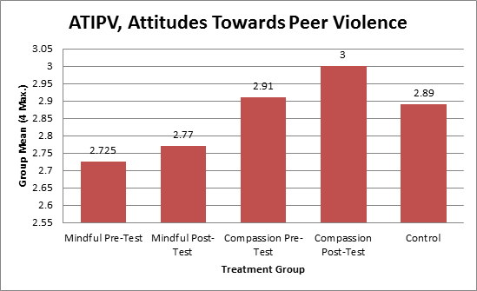
Results
Mindful +.04 change score
Compassion +.09 change score

Slide 17
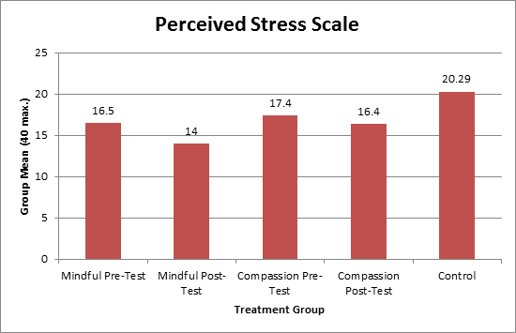
Results
Mindful +2.5 change score
Compassion +1 change score

Slide 18
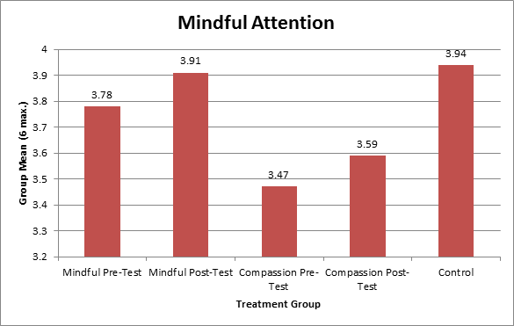
Results
Mindful +0.4 change score
Compassion +.12 change score

Slide 19
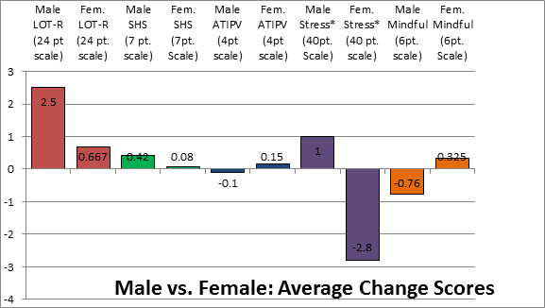
Results
*lower levels indicate less stress

Slide 20
Qualitative Comments
"I found it easier in the past couple weeks to take deep breaths when I felt troubled or stressed. I feel the same, but would like to make a change and continue with meditation."
"Overall I thought this was a really positive experience that has helped me reinstate mindfulness during a stressful time in my life. Could be a great addition to URI 101 curriculum all incoming students."

Slide 21
Discussion
Optimism - relationship between positive feelings towards self and others
Happiness - measure may have been too limited
Peer Violence - measure may have been unrealistic for participants
Stress - relationship between present moment and stress reduction
Mindfulness - more in depth description necessary for goal orientation

Slide 22
Limitations
Sample Size
Sample Diversity
Measures
Duration and Intensity
Participant mortality
Timing of study during semester
Variability of self-report measures

Slide 23
Direction for Future Research
Longitudinal Design
Higher Incentive
Examination of the relationship between optimism and compassion
Differences in effectiveness of meditation for males and females
Focus on 1 category of attitude or disposition at a time
More within subject design to account for score variability

Slide 24
References
Gordon,Shonin, E., Sumich, A., Sundin, E. C., & Griffiths, M. D. (2013). Meditation awareness training (mat) for psychological well-being in a sub-clinical, Sample of university students: A controlled pilot study. Mindfulness, doi:10.1007/s12671-012-0191-5
Mascaro, J. S., Rilling, J. K., Negi, L., & Raison, C. L. (2013). Compassion meditation enhances empathic accuracy and related neural activity. Social Cognitive And Affective Neuroscience, 8(1), 48-55. doi:10.1093/scan/nss095
Baer, R. A., Lykins, E. B., & Peters, J. R. (2012). Mindfulness and self-compassion as predictors of psychological wellbeing in long-term meditators and matched nonmeditators. The Journal Of Positive Psychology, 7(3), 230-238. doi:10.1080/17439760.2012.674548

