Slide 1
China's 80后 and 90后: The Next Generation of Leaders in the World's Next Superpower A Students-Teaching-Students Course
Pat Slavin

Slide 2
About me
Graduating May 2013
BA: Chinese
BS: Marketing
Studied abroad 3 times
Summer 2009: Zhejiang University
Summer 2010: Qingdao University
Fall 2011: Zhejiang University
Interned 2 times
Summer 2011: Diavibe Medical， Providence
Spring 2012: Hengtian Software, Hangzhou, China

Slide 3
About this project
Designed and taught an introductory-level honors course focused on China’s 80后 and 90后 generations

Slide 4
Student-Educator Goals
Project aimed to enhance:
Planning skills
Critical thinking skills
Teaching skills
Communications skills
Time-Management skills

Slide 5
Student Goals
Students should be able to:
Think critically about the ways in which technology, innovation and government action can influence culture
Explain major events that shaped the 80后 and 90后 generations
Identify and explain the defining characteristics of the 80后 and 90后 generations
Explain the ways in which the 80后 and 90后 generations may change China
Realize the complexity of Chinese culture
Compare and contrast Chinese and American culture
Communicate through effective oral and written communication

Slide 6
Student-Educator Goal: Planning Skills
Tasks completed:
Planned class lessons and readings
Obstacles encountered:
No experience teaching
Unsure how long it would take to teach certain topics
Winter storm Nemo
Evidenced through:
Syllabus
Class schedule
Student Surveys

Slide 7
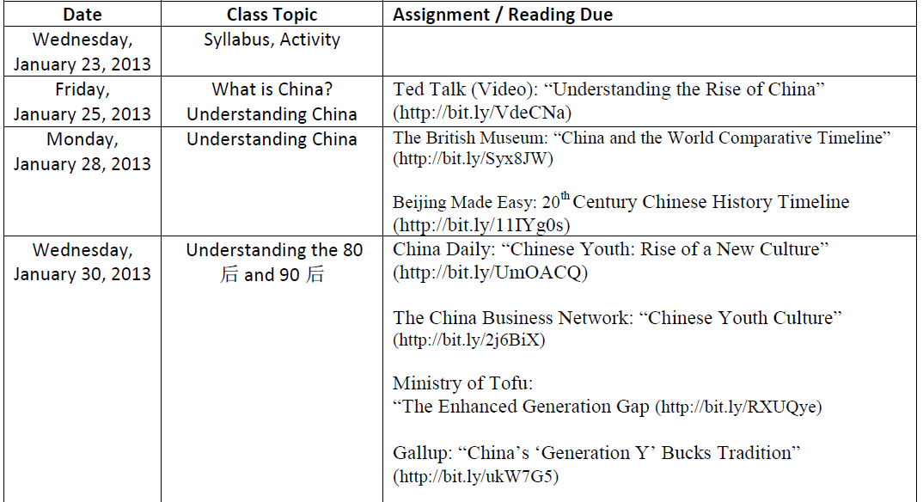
Student-Educator Goal: Planning Skills

Slide 8
Student-Educator Goal: Planning Skills

Slide 9
Student-Educator Goal: Critical Thinking Skills
Tasks completed:
Subject matter research
Course planning
What should and should not be a part of the course?
Subject matter
Assignments
Obstacles:
Constantly changing subject
Evidenced through:
Syllabus and class schedule
Student Surveys

Slide 10
Student-Educator Goal: Critical Thinking Skills

Slide 11
Student-Educator Goal: Critical Thinking Skills

Slide 12
Student-Educator Goal: Critical Thinking Skills

Slide 13
Student-Educator Goal: Teaching Skills
Tasks completed:
Taught HPR 107, a 3-credit honors program course on Chinese Youth Culture
Obstacles:
Lack of experience
Knowledge gap among students
Some Chinese majors, some just completing Gen Eds
Evidenced through:
Student surveys
Student Reflections

Slide 14
“This class was so discussion based and involved that I couldn’t help but be interested.”

Slide 15
Student-Educator Goal: Teaching Skills

Slide 16
Student-Educator Goal: Teaching Skills

Slide 17
Student-Educator Goal: Teaching Skills

Slide 18
Student-Educator Goal: Teaching Skills

Slide 19
Student-Educator Goal: Teaching Skills

Slide 20
Student-Educator Goals: Planning and Teaching Skills

Slide 21
Student-Educator Goal: Communications Skills
Tasks completed:
Actively taught 23 50-minute classes
Facilitated discussions and presentations in remaining class periods
Created class syllabus and schedule to communicate critical class information
Posted Sakai announcements to provide periodic updates
Obstacles
Periodic technical issues
Sakai
Evidenced through:
Syllabus and class schedule
Student Survey

Slide 22
Student-Educator Goal: Communications Skills

Slide 23
Student-Educator Goal: Communications Skills

Slide 24
Student-Educator Goal: Communications Skills
Assignment-specific instructions and guidelines were posted on Sakai for each graded assignment

Slide 25
Student-Educator Goal: Time Management Skills
Tasks completed:
Balanced commitments of extracurricular activities, job, other classes with this project
Obstacles:
Classes
Internship with State Senator
VP URI American Marketing Association
RA: Aldrich Hall
Evidenced through:
Everything got done
All research papers graded and returned in less than 24 hours

Slide 26
Student Goals
Students should be able to:
Think critically about the ways in which technology, innovation and government action can influence culture
Explain major events that shaped the 80后 and 90后 generations
Identify and explain the defining characteristics of the 80后 and 90后 generations
Explain the ways in which the 80后 and 90后 generations may change China
Realize the complexity of Chinese culture
Compare and contrast Chinese and American culture
Communicate through effective oral and written communication

Slide 27
Student Goal: Think critically about the ways in which technology, innovation and government action can influence culture
Relevant lessons:
Understanding China
Cultural Revolution
Great Leap Forward
Reform and Opening
One Child Policy
Internet Language and Culture
Evidence of learning:
Debates
Exam

Slide 28
Student Goal: Think critically about the ways in which technology, innovation and government action can influence culture
Assignment Spotlight:
Debate 2: Does the one child policy have a net positive or net negative effect on Chinese society?
Debate 4: Does the Chinese government’s censorship of the internet help or hurt Chinese society?

Slide 29
Student Goal: Explain major events that shaped the 80后 and 90后 generations
Relevant Lessons:
Understanding China
Cultural Revolution
Great Leap Forward
Reform and Opening
One Child Policy
Evidence of learning:
Exam

Slide 30
Student Goal: Explain major events that shaped the 80后 and 90后 generations
Assignment Spotlight
Midterm Exam Essay Question
What was China’s economic/political situation in the late 1970s? How did that ‘set the stage’ for the 改革开放 and One Child Policy?

Slide 31
Student Goal: Identify and explain the defining characteristics of the 80后 and 90后 generations
Relevant Lessons:
Understanding the 80后 and 90后
Consumer Behavior of the 80后 and 90后
Evidence of Learning
Presentations

Slide 32
Student Goal: Identify and explain the defining characteristics of the 80后 and 90后 generations
Assignment Spotlight:
Presentation 1: Find any American advertisement. Rework advertisement to appeal to Chinese 80后 and/or 90后 audience. Present to the class what changes you have made and why you made them.
One student altered a Crest ad to appeal to 90后 living in lower-tier cities

Slide 33
Original Ad

Slide 34
“Crest White changed my life. It gave me the confidence to further my career and a reason to smile again. Let Crest White change your life too. Tell your story at crestwhite.com and you could be the next face of Crest White!”
-Samantha

Slide 35
Contest
90s Generation Chinese are more self- centered than other generations and are concerned with the betterment of themselves and their standing
The possibility of winning a contest, therefore becoming famous, would appeal to 90s teens

Slide 36
Student Goal: Identify and explain the defining characteristics of the 80后 and 90后 generations
Assignment Spotlight
Presentation 2: Create an original meme that would be warmly received by Chinese netizens. What about your creation makes it appealing to a Chinese audience?
One student focused on the studious nature of Chinese high school students

Slide 37
Overly Studious Chinese Student
Only 7 words
Problem- Social Interaction
Outcome- Extreme

Slide 38
Student Goal: Explain the ways in which the 80后 and 90后 generations may change China
Relevant Lessons:
Consumer Behavior of the 80后 and 90后
The Chinese Education System
Internet Language and Culture
Sex, Cohabitation and Marriage
Views of the West
Evidence of Learning
Presentations
Debates

Slide 39
Student Goal: Explain the ways in which the 80后 and 90后 generations may change China
Assignment Spotlight:
Presentation 2: Create an original meme that would be warmly received by Chinese netizens. What about your creation makes it appealing to a Chinese audience?
One student made use of Deng Xiaoping’s quote: "If you open the window for fresh air, you have to expect some flies to blow in.“
This quote is often used to justify government cesorship of the internet
Her conclusion: The flies are up to no good

Slide 40
Pornographic Websites
Discordant Fly browses pornography.

Slide 41
Facebook
Discordant Fly blows up your newsfeed.

Slide 42
Student Goal: Realize the complexity of Chinese culture
Relevant Lessons:
All
Evidence of Learning:
Student Reflections

Slide 43
“Learning about ‘face’ changed the way I view Chinese culture”

Slide 44
“The more I learn, the more I believe it’s probably impossible to know everything about China, much less understand it.”

Slide 45
Student Goal: Compare and contrast Chinese and American culture
Relevant Lessons:
Consumer Behavior of the 80后 and 90后
The Chinese Education System
Internet Language and Culture
Sex, Cohabitation and Marriage
Evidence of Learning
Debates
Exams
Student Reflections

Slide 46
Student Goal: Compare and contrast Chinese and American culture
Assignment Spotlight
Debate 3： Which education system most adequately prepares students to succeed later in life: the Chinese or American system?

Slide 47
“This class has brought up the small, but important, cultural differences that can really affect the way you’re viewed in a foreign country.”

Slide 48
Student Goal: Communicate through effective oral and written communication
Evidence of Learning:
Each Student:
Participated in 2 debates
Wrote 2 debate critiques
Gave 4 presentations
Wrote a research paper on a topic of their choice

Slide 49
“I also wrote my first true research paper in this class, on the education systems in China and America. I believe it improved my research and writing skills immensely.”

