Slide 1
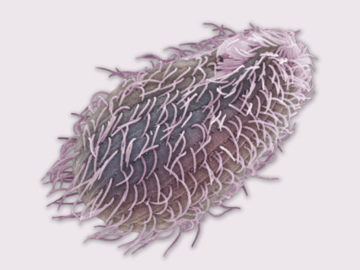
A search for light-detecting proteins in the free-living protist, Tetrahymena thermophila: Does Tetrahymena have opsin-like or bacteriorhodopsin-like proteins?
By: Jillian Rainville
Faculty Sponsor: Linda Hufnagel

Slide 2
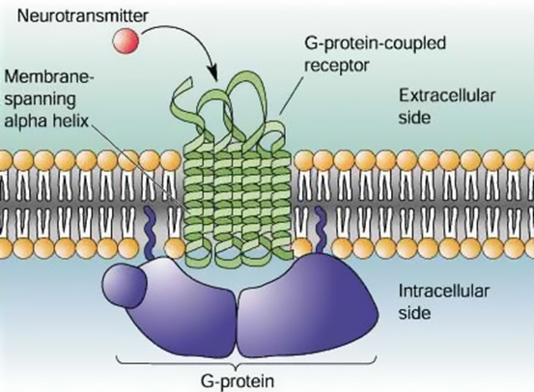
G-Protein Coupled Receptors (GPCRs)
Stimuli from outside → signals inside of cell
Superfamily, many functions, categorized in distinct groups.
large protein family: include hormone, neurotransmitter, and light receptors
Most GPCRs bind extracellular
ligands and undergo
conformational changes.
Activate different signaling
pathways.
Notes:
G-Protein Coupled Receptors or (GPCRs) for short, function in transducing stimuli from the outside of the cell into signals that can be used by the inside of the cell.
GPCRs make up a large protein family that varies and functions and may be categorized in distinct groups. The members of the family include rhodopsin-like GPCRS which we will further analyze, secretin-like GPCRS, cAMP receptors, mating receptors and more. GPCRs also respond to a multitude of stimuli including light, neurotransmittiers, lipids, proteins, and more and activate different signaling pathways. Most commonly they bind to extracellular ligands such as neurotransmitters and undergo confirmational changes that allow them to activate such pathways.
As you can see in the picture the GPCR is bound to a G-protein and is embeeded within a cell membrane. The side bound to the G-protein is within the cell, and the other part of the receptor is on the extracellular side, available to bind the ligand stimulus.

Slide 3
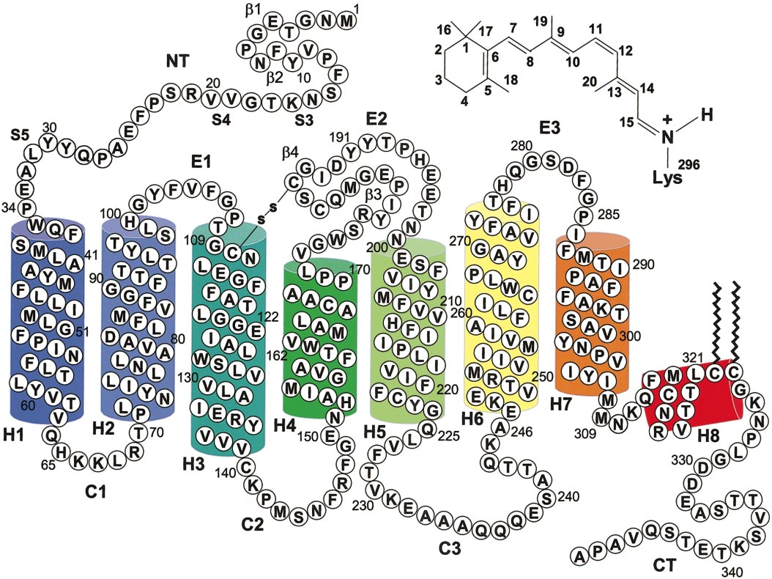
Rhodopsin-like GPCRs
Visual pigments made up of opsin and chromophore
Detect photons in rod receptor cells.
Integral membrane protein
7-alpha helix domains.
Conserved Lys residue links
covalently to chromophore.
Binding site for retinal
= retinal binding pocket.
Light absorbed by retinal,
opsin undergoes
conformational change.
Carboxyl tail phosphorylates
G-protein interacts with Rhodopsin.
Notes:
Rhodopsin-like GPCRs are highly specialized and detect photons in rod receptor cells. Rhodopsin like GPCRs are also termed class A, which share primary structural similarites with other GPCRs but still has major differences. Like all GPCRs they are composed of a seven transmembrane segments which are marked off in the picture as (h1-H7). With the amino terminus in the extracellular portion and carboxyl inside of the cell. Within H7 there is a Lysine residue that is a linkage site for chromophore. The molecule undergoes a sequence of light dependent reactions. The GPCR interacts with G proteins at sites of light-dependent phosphorylation on the carboxyl tail of visual pigments. The visual pigments themselves are composed of opsin and chromophore which is actually just covalently bonds to the structure so it is a nonclassical ligand. The helical segments also contain a region for retinal binding referred to as the retinal binding pocket. When light is detected it is absorbed by retinal and the structure undergoes a conformational change.

Slide 4
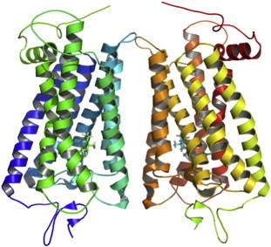
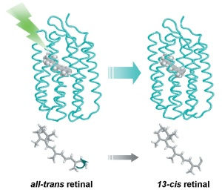
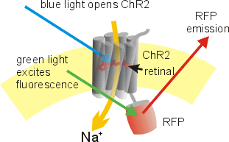
Rhodopsins
Typically found in rod photoreceptors
of the vertebrate eye.
Consist of opsin and retinal
Rhodopsin structure
Retinal binding pocket
Ion channel --H⁺, Na⁺, K⁺, and Ca²⁺ ions.
Notes:
Classical Rhodopsins are members of the Rhodopsin like family of GPCRS that detect photons in the rod photoreceptors in the retina of the vertebrate eye.
Similarly to other rhodopsin like photoceptors they consist of opsin and retinal, the light absorbing molecule that is typically found in the rod photoreceptor.
. They form homodimers as shown above, so two rhodopsin molecules come together. Rhodopsin is activated when light hits the molecule and it switches to a cis conformation. So in the above picture, the molecule on the right would be an example of an active rhodopsin and the image on the left represents an inactive molecule. Rhodopsin forms a covalent bond to the retinal, and the chromophore ligand is deep in the core of the helices. Enclosing the chromophore is a retinal binding pocket formed by the N-terminal regions of the opsin subunits, a characteristic that we sought to identify throughout this project. The molecule also has an ion channel located down the center that becomes activated when the molecule is in the cis position. When light hits the molecule the pore opens allowing the flow of hydrogen, sodium, potassium, and calcium ions.

Slide 5
Opsins
Transmit signals from light to create
visual images in the eye.
Different photoreceptors contain
different types of opsins.
Retina captures and records
image, transmitted to the brain.
.
Notes:
Opsins the protein portion of light-sensitive GPCRS. They often are involved in the transmission of signals from light to create visual images. Different types of photoreceptor cells contain different types of opsins. Large class of proteins, some are used in receiving light signals, others are neurotransmitter receptors, enzymes (other functions). The etina captures and records the image, and then the captured signals are transmitted to the brain where you get a perceived image in the brain.

Slide 6
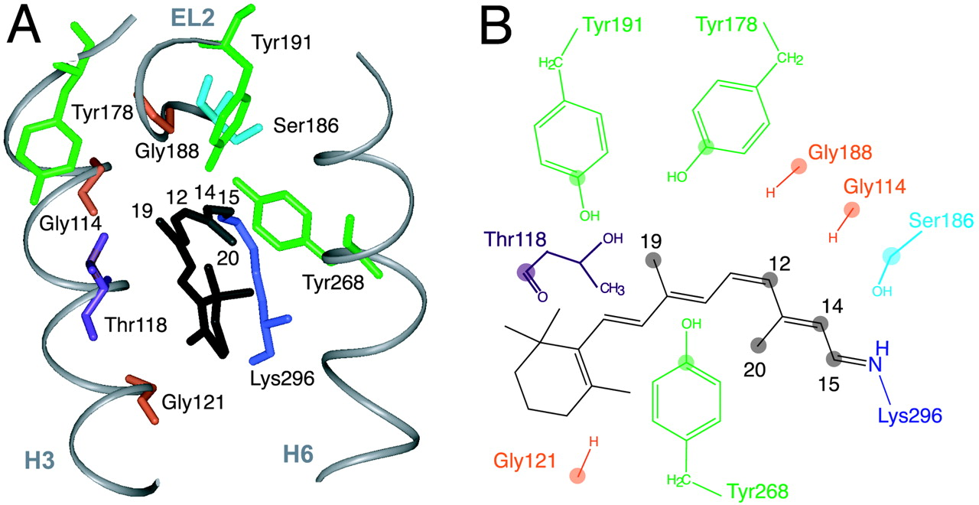
Retinal Binding Pocket Domain
Architecture of several amino acids in the region.
Formed within helices 3 through 7.
Notes:
The retinal binding pocket is the stucture that surrounds the chromophore. It is a structure made up of several amino acids in the opsin molecule. Some of these amino acids are critical to forming the pocket and interacting with the retinal. In the picture above, helix H3 and H6 are shown with the specific amino acids in those helices alone. So you can see the variance, with a glycine, tyrosine, serine, threosine (etc.) The retinal binding pocket is formed within helices 3-7 and are 3 dimensional structures.

Slide 7
Tetrahymena
Ciliated Protozoans, unicellular
Inhabit lakes, streams and ponds
Relation to multicellular organisms.
Chromalveolates
Do they contain opsins?
Evidence that they respond to light?
Notes:
Tetrahymena fall under the phylum of ciliated protozoans which is boxed off in red on the above diagram. They are unicellular eukaryotes that live in freshwater, so they inhabit lakes, streams and ponds. This is an example of a more recent Eukaryotic tree of life. The branches represent major groups, so you may see unikonts, rhizaria, excavates, plantae, and the chromalveolates which Tetrahymena belong under. Even though they are on a distinctly different branch of the eukaryotic tree of life they have many similar features to multicellular organisms. We began the project by assuming that Tetrahymena contain opsins for responding to light based on research from Professor Hufnagel and Dr. Kass-Simons lab.

Slide 8
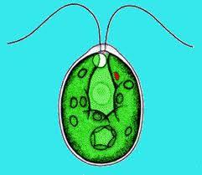
Compared Organisms
Two different organisms were used from
eukaryotic tree of life.
  Chlamydomonas
  Eukaryotic tree – Plantae
  Unicellular flagellate
  Contain ion channels activated by light
  Conserved Vertebrate Consensus Sequence
  Eukaryotic tree- Unikonts
Notes:
Two different organisms were used to try to identify a group of opsins that would also occur in Tetrahymena. There is little evidence thus far of chromeoalveolates with identified opsins, so we had to stray outside of that branch for comparisons. The first organism used was Chlamydomonas, which falls under plantae on the eukaryotic tree. It is a unicellular flagellate, so it was a good choice to compatre to tetrahymena. What is interesting about Chlamy is that they contain ion channels that are activated by light such as channelrhodopsin so I would providwe good indication if we could identify a retinal binding pocket within chlamy alignment sequences. The second used was a conserved vertebrate sequence which falls under a different branch, unikonts. This would help provide insight to whether or not tetrahymena had association to the opsins of these well characterized and studied organisms.

Slide 9
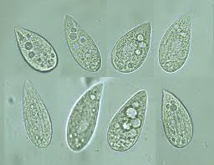
Research Goals
To determine if Tetrahymena contains rhodopsin-like receptors.
Identify rhodopsin and opsin families related to GPCRs.
Determine if Tetrahymena contains a retinal binding pocket.
Notes:
The project was based off a hypothesis that emerged from lab evidence that there may be rhodopsin-like receptors in Tetrahymenas Initally I wanted to identfy rhodopsin and opsin family memers in tetrahymena by comparing proteins. Difficulties in this approach led us to look more closely at proteins with retinal binding pockets.
. Using NCBI protein searches I was able to find rhodopsin- related opsin genes in Chlamy and the conserved vertebrate consensus sequence to identify orthologous genes in Tetrahymena. Using a number of tools such as blast experiments, sequence alignments, and expression profiles were used in order to analyze compiled data.

Slide 10
Research Strategies – BLAST
Yeast opsin 1 sequence
Notes:
This is an example of a BLAST search I conducted using yeast opsins. In a BLAST search you take a protien amino acid sequence you would like to analyze such a yeast opsin and you enter the sequence as shown above. You then select the genus you would like to run the BLAST analysis against (Tetrahymen) and a picture like the one above results.
The yeast opsins are the query sequence so it is shown in red, and the Tetrahymena sequences are shown in black.
, this does not show strong similarity between the 2, because the results showed weak homology in two very short sequences. If there were more homology between the two we would see a longer span with pink red and green lines.
Unfortunately, many of the BLAST searches did not yield strong evidence so began to take a different approach.
We decided to focus our search on just the retinal binding pocket because it was more specific, in hopes that we would get more results.

Slide 11
BLAST
Notes:
Using ciliate.org a BLAST was conducted against the identified FASTA sequence that we found for Chlamydomonas retinal binding domain.
This is an example of 1 of 6 different alignments we chose to analyze. The query portion represents the region in Chlamydomonas that showed significant alignment with a region in Tetrahymena. There is 34% idenity which is where the sequences are identical and 51% similarity (positives) which show amino acids that are not identical but are similar in function.
These were encouraging numbers that allowed us to continue our anaylsis.

Slide 12
Research Strategies – Alignments
TTHERM_1_protein_ QYDERIVKNT---SVLFFKIK----------------------SEKDLKE 210
ChlamydomonasOpsinA VWGTTAALSKGYVRVIFFLMGLCYGIYTFFNAAKVYIEAYHTVPKGICRD 249
:. . .. *:** : .: ::
TTHERM_1 protein_ LNRYLSYTNIPYSTKMPTQGQQITTISSPFGILSSQLYHNILGQGVIANV 260
ChlamydomonasOpsinA LVRYLAWLYFCSWAMFPVLFLLGPEGFGHINQFNSAIAHAILDLASKN-A 298
* ***:: : : :*. . . :. :.* : * **. . .
TTHERM_1_protein_ FDIEANSKLKKFHKHILMLDMIN-------FGGKEGGLVLDEEQNVIGMM 303
ChlamydomonasOpsinA WSMMGHFLRVKIHEHILLYGDIRKKQKVNVAGQEMEVETMVHEEDDETQK 348
:.: .: *:*:***: . *. * : .: .*::
TTHERM_1_protein_ LPSFSFQGANSVYFSFAISAKTVLELAATRLDKFKSVKKEQPKEFLETNK 353
ChlamydomonasOpsinA VPTAKYANRDSFIIMRDRLKEKGFETRASLDGDPNGDAEANAAAGGKPGM 398
:*: .: . :*. : :. :* *: .. :. : :. :..
Notes:
Alignment programs are used to compare protein sequences and analyze where they show high conservation between species. It takes each species entered so in this example, a protein sequence from Tetrahymena was aligned against a Chlamydomonas Sensory opsin/
A star indicates an identical match between the positions on each sequence
2 dots show very close similarities, and 1 dot shows fair similarities
The highlighted regions in the example the yellow represents the retinal binding pocket sequence expressed in this particaluar sensory opsin of Chlamy, the blue region is the sequence in tetrahymena that corresponds to the Chlamy retinal binding pocket.
This also shows strongs homology outside of the sequence which is interesting to see in comparison.

Slide 13
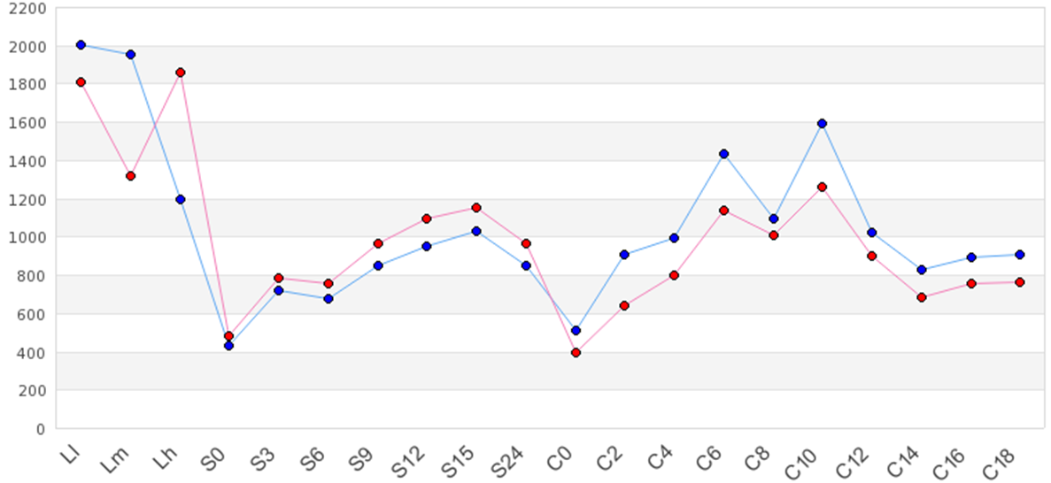
Results – Expression Profiles
Notes:
I found expression profiles using TFGD the Tetrahymena Functional Genome Database. I identified 5 different sequences through alignments and BLASTs that showed evidence for a possible retinal binding pocket. The next 2 slides will show examples of two of the results. This is TTHERM_00509040. It is showing high expression at all times which is indicated by the level of expression on the y axis of the graph. The x axis shows different time points during exponential grown (L), Stravation (s) and conjugation (c). This shows evidence that it may be a housekeeping gene, a gene that functions in regular activites of the proteins because the expression values are relatively high. Based on the low points of the graph the expression seems lowest when nutrients are reduced or absent as shown in the first stage of starvation phase, so when the nutrients are first taken away and the first conjugation phase which occurs late in starvation when indogenous sources of nutrients are depleted.

Slide 14
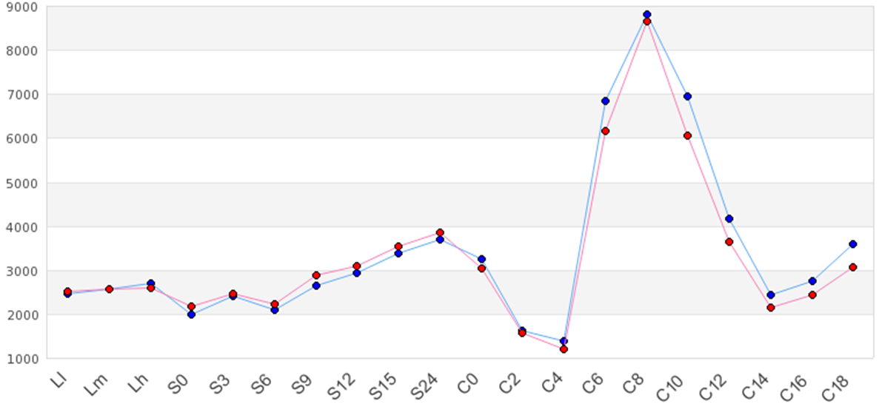
Results
Notes:
This particular sequence shows that during conjugation there is a particular role evident in the graph. Expression isstill relatively high but shows a defined peak within the conjugation phase. Expressions were different for each of the 5 alignments indicating that they each have different roles throughout the life cycle.

Slide 15
Conclusions
A conserved retinal binding pocket sequence, identified in both Chlamydomonas and conserved vertebrate opsin sequences, was useful in the identification of opsin-like proteins in Tetrahymena.
Due to the homology of the Tetrahymena proteins we identified with known Chlamydomonas and vertebrate opsins, it appears that Tetrahymena may have light responsive opsins.
Further experimental research is needed in order to establish that these proteins do have light responsive functions.

Slide 16
References
Ballesteros, J. A., Jensen, A. D., Liapakis, G., Rasmussen, S. G., Shi, L., Gether, U. and Javitch, J. A. (2001). Activation of the beta 2-adrenergic receptor involves disruption of an ionic lock between the cytoplasmic ends of transmembrane segments 3 and 6. J. Biol. Chem. 276, 29171-29177.
Salom, David, David T. Lodowski, and et al. "Crystal Structure of a Photoactivated Deprotonated Intermediate of Rhodopsin." Crystal Structure of a Photoactivated Deprotonated Intermediate of Rhodopsin. PNAS, 23 Oct. 2006. Web. 09 Dec. 2012.
D. C. Teller, T. Okada C. A. Behnke, K. Palczewski, R. E. Stenkamp, Biochemistry 40, 776 (2001)
Hall, R. A. and Lefkowitz, R. J. (2002). Regulation of G protein-coupled receptor signaling by scaffold proteins. Circ. Res. 91, 672-680.
Harel, Michael. "Rhodopsin." -- Proteopedia, Life in 3D. N.p., 14 Nov. 2012. Web. 09 Dec. 2012
Hufnagel, Linda, Dr. "Personal Conversation." Personal interview. Nov. 2012.
"Ligand." - Definition from Biology-Online.org. N.p., n.d. Web. 23 Nov. 2012. <http://www.biology-online.org/dictionary/Ligand>.
Neves, and et al. "G Protein Pathways." Science 31 296 (2002): 1636-639.
"Summary: 7 Transmembrane Receptor (rhodopsin Family)." Introduction. Pfam the Pfam Database of Protein Domains and HMMs. Cambridge, England: Pfam Consortium, 1996. N. pag. Sanger Institute. Web. 23 Nov. 2012. <http://pfam.sanger.ac.uk/family/PF00001>.
"TGD Tetrahymena Genome Database Wiki." TGD Tetrahymena Genome Database Wiki. N.p., n.d. Web. 24 Nov. 2012. <http://www.ciliate.org/>.

