Slide 1
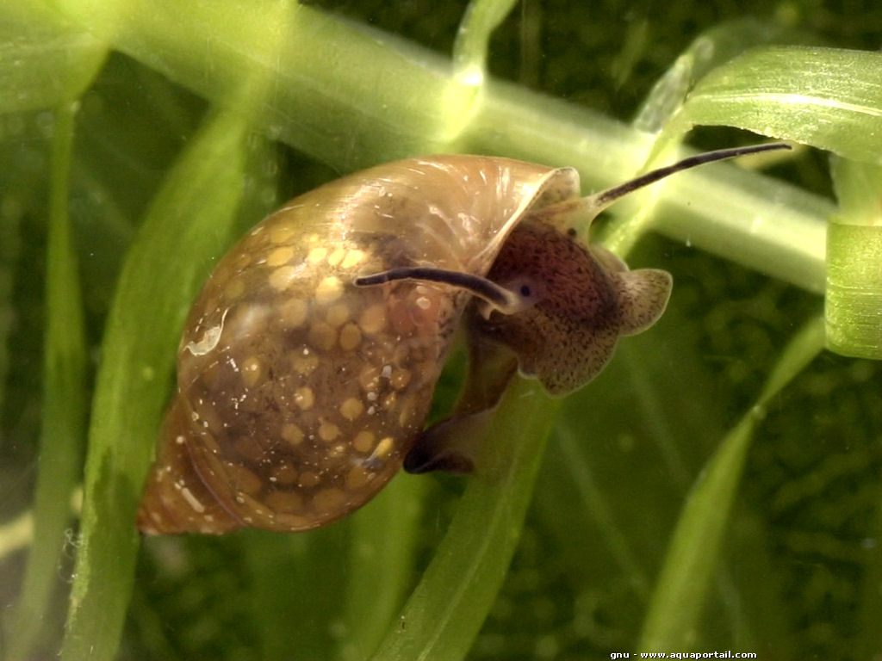
Change in juvenile Physa acuta behavior in the presence of crushed conspecific cue
Justin Vendettuoli
HPR 401
Advisor: Evan Preisser
Preisser Labs

Slide 2
Project Evolution
How do Prey Refuges Affect Predator-Prey Interactions?
The fun of science!
Adapting to new conditions and making the best of what you have
New project…

Slide 3
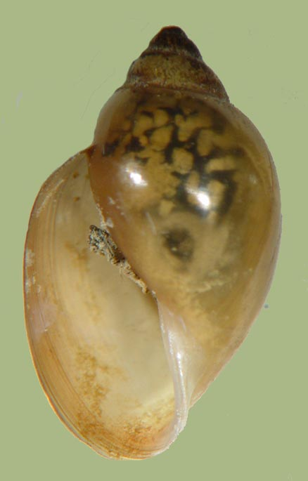
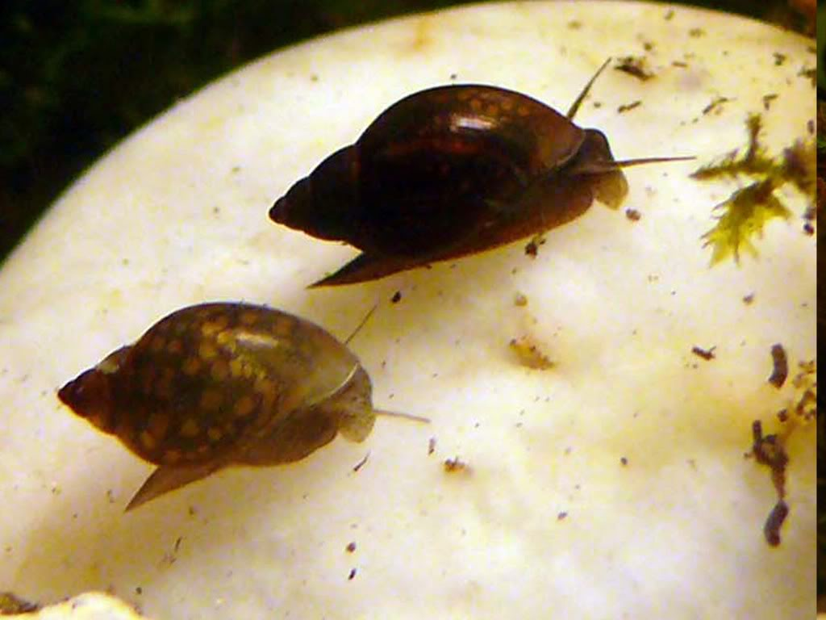
Introduction: Physa Acuta
Freshwater snail
Sinistral shell
Can be an aquarium pest

Slide 4
Interesting Behavior
Noticed a shell-shaking behavior (Townsend and McCarthy 1980)
Anti-predator defense
Anti-social behavior
Juveniles in same genus show less shell-shaking (Brönmark 1992)
Do Physa acuta juveniles show similar behaviors in the presence of a crushed conspecific cue?

Slide 5
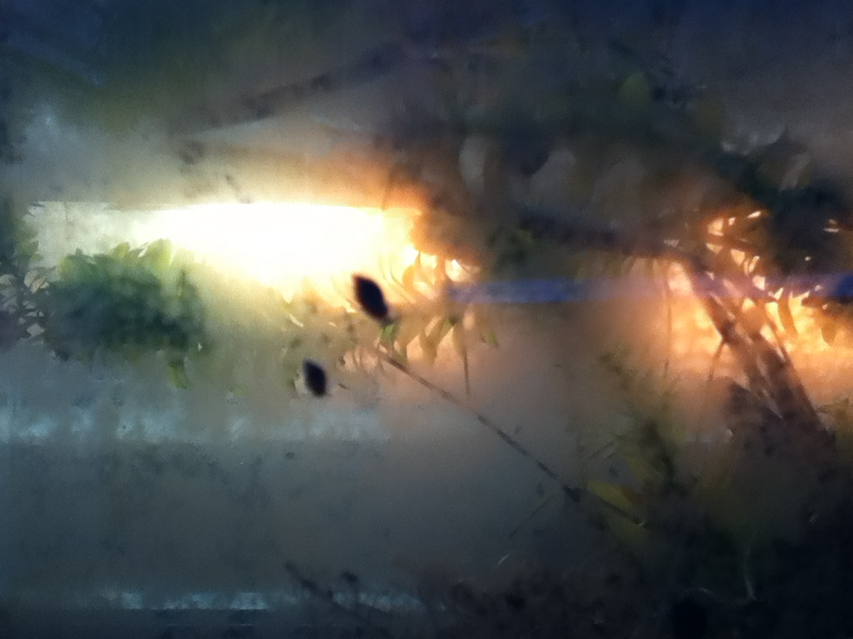
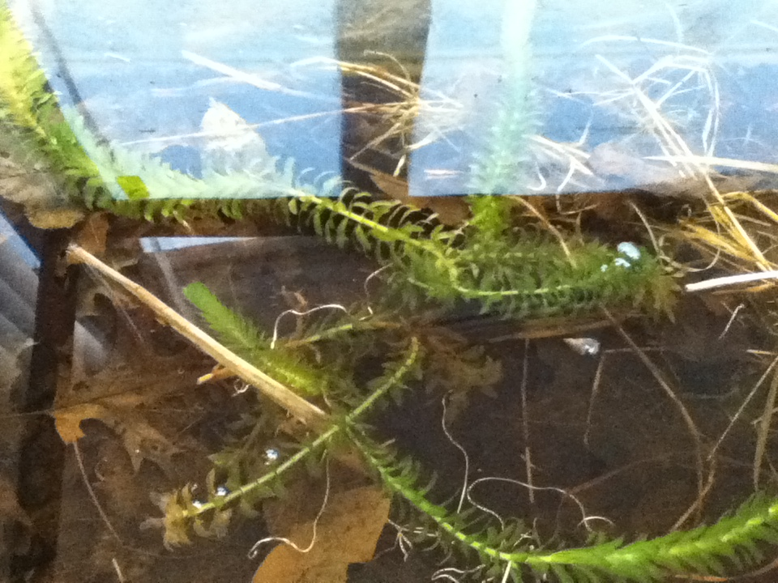
Methods
Raised Physa acuta in aquaria in the lab from Fall 2012
Developed 30mm x 30mm x 10mm copper enclosure to conduct trials
10 snails per trial, 5 trials per treatment of control and crushed conspecifics

Slide 6
Methods
Snail shell length measured and averaged before each trial
10mL of aquarium water added to enclosure
Snails acclimate for 2 minutes
5mL of cue added (aquarium for control, filtered crushed conspecifics water for experimental)
Behaviors observed for 15 minutes per trials: interactions, shell-shaking, shell-avoidance, hiding, release from substrate, bailing

Slide 7
Shell- shaking
Behaviors
Behaviors:

Slide 8
Shell- avoidance
Behaviors
Behaviors:

Slide 9
Sustained mount
Behaviors:
Water surface

Slide 10
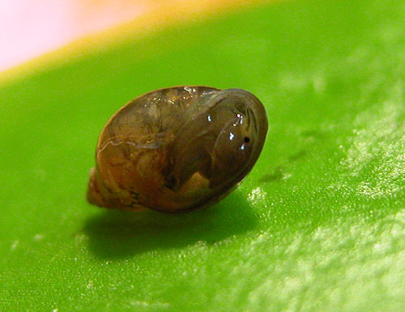
Hide
Behaviors:

Slide 11
Bail
Behaviors:
Water surface

Slide 12
Release from Substrate
Behaviors:
Water surface

Slide 13
Results

Slide 14
Results

Slide 15
Results
t-test used to analyze results
Number of interactions, sustained mountings, and releases from substrate were not significant
Significant results
Shell-shake (P=0.0185)
Shell-avoidance (P=0.0067)
Hide (P=0.0493)
Bail (P=0.0368)

Slide 16
Discussion
Shell-shaking and Shell-avoidance could draw attention/cost energy
Hiding less costly than bailing
Bailing possibly more prevalent in adults, more effective
Anti-social behavior vs. Fear of predators
Presence of predator can result in nonconsumptives effects (Preisser and Orrock 2012)

Slide 17
Improvements & Future Research
More data and better recording
Research sociability between treatments
Research how adult snails react
Average speed of snails after cue

Slide 18
Questions?

