Slide 1
Brown Algal Diversity in Bermuda Revealed using Molecular Tools
Honors Project
May 2, 2013
By: Alyssa Rogers
Mentor:
Dr. Christopher Lane

Slide 2
A Brief Introduction to the Bermuda Seaweed Project
Crypsis: Convergent Morphologies
Main objective is to integrate molecular and morphological data to produce thorough classifications of all of the marine macroalgae (red, green, and brown algae) of Bermuda
Related species “look” identical, but aren’t
Without comparative DNA sequences,
impossible to distinguish with any certainty
Notes:
This project aims to produce robust classifications to correctly identify the macroalgal flora in Bermuda and differentiate between closely relates species.
Most of the work thus far has focused on the red algae.
Different Scenarios:
2 things that look the same and are really the same.
2 things that look different and are really different.
2 things that look different but are really the same
2 things that look the same but are really different (crypic species…convergent evolution=acquisition of the same biological trait in unrelated lineages)…cannot tell the difference by looking at them…need to use molecular tools to determine this difference

Slide 3
What is a DNA Barcode?
A ‘fingerprint’ for identification of life
DNA barcodes are
Short
Universal
Variable enough to distinguish between species
Notes:
Short for ease of amplification, universal across broad group of organisms, but variable enough to distinguish between species
A small fragment of DNA used for identifying species
Characteristics of a good barcode sequence:
mutation rate is often fast enough to distinguish closely related species
its sequence is conserved among conspecifics (members of the same species)

Slide 4
Why Bermuda?
32˚ 14-25’N 64˚ 38-52’W
1000 km east of NC in the N. Atlantic
1350 km northeast of Bahamas
Water temp range = 18-28°C
Bermuda
Notes:
Manageable in size
Isolated enough to have a small number of endemic species
Endemic = species found in one specific region and nowhere else…. Are likely to develop on islands because of their geographical isolation
Hypothesis=more endemic species than currently recognized
Resides ~1000km off the coast of North Carolina
influenced by the cool water from the north during winter
Influenced by the warm water eddies from the Gulf Stream for much of the other seasons
Warm water from caribean carried by gulf stream…Yellow swirly up the east coast is gulf stream (these are April temps, so still cool in BDA)
18-28 Celsius….wide range in temperature creates unique diversity in the flora

Slide 5
Why are Biodiversity Studies Important?
To figure out what is out there
Can be used as a reference and/or comparison for later studies
To identify species that may have been introduced to the area
To identify novel species that have not been seen before

Slide 6
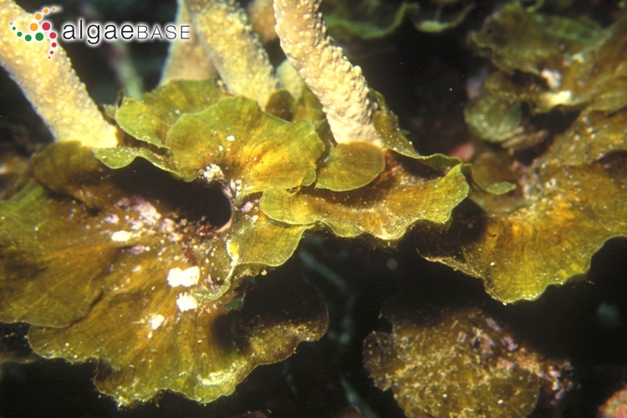
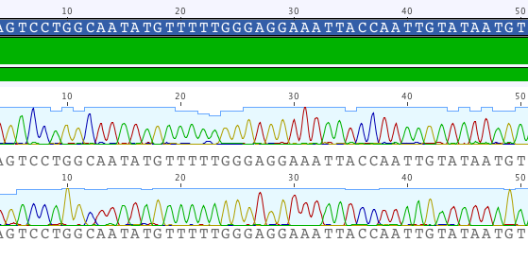
Project Goals
Conduct a phylogenetic investigation to assess the diversity of the brown algae of Bermuda
How?
Notes:
Picture= Lobophora variegata
For each sample, produce barcode data from a portion of the cox1 and rbcL genes
Use the barcode data to assemble phylogenetic trees
Use other data available from online sources to put the Bermudian brown algal data in a global perspective

Slide 7
Brown Algae (Phaeophyceae)
Evolutionarily distinct from the red and green algae who share an ancient common ancestor
Challenges when studying them due to their divergent DNA sequences and cellular chemistry compared to the reds and greens
Notes:
Red and Green in the Kingdom Plantae
Chlorophyta and Rhodophyta commom ancestor ~2 billion years ago
Browns in the Kingdom Chromalveolata (Phaeophyta groups within stramenopiles)
Browns more divergent and evolved later (they’ve had less time to evolve)…leads to challenges to study them
Divergent DNA sequences and cellular chemistry= challenges

Slide 8
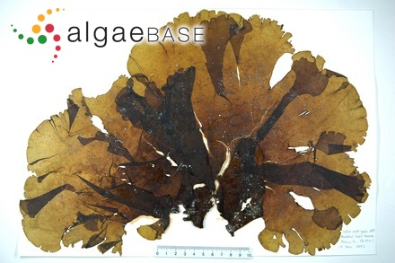
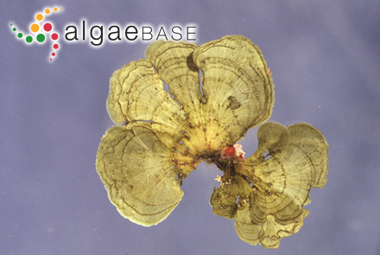
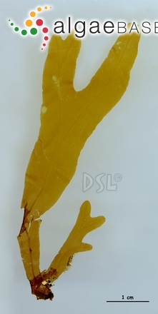
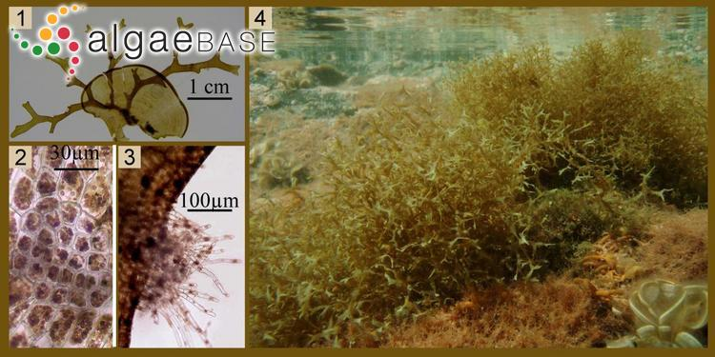
Lobophora variegata
Stypopodium zonale
Canistrocarpus cervicornis
Dictyopteris plagiogramma
Notes:
Examples of some of the genera found in Bermuda. Various morphologies (shapes, size, color, etc)

Slide 9
Genes of Interest
cox1 – cytochrome c oxidase subunit 1
rbcL – large subunit of ribulose 1, 5 bisphosphate carboxylase/oxygenase (RUBISCO)
Notes:
Cox1 (mitochondrial-encoded gene approximately 750basepairs in length) and rbcL (plastid-encoded gene approximately 1500 basepairs in length) are two organellar genes found in almost all photosynthetic organisms. They are frequently used for barcoding because their sequences are highly conserved among conspecifics (belonging to the same species). Replicating the phylogeny from two different cellular compartments increases the robustness of the algal classifications

Slide 10
Collection of the Samples
URI graduate student, Thea Popolizio, performed a year-long collection of samples in Bermuda
Variety of habitats (different locations, depths, etc.)
Various seasonal climates
Over 1500 samples of macroalgae were collected
About 20% of those samples are brown algae
Notes:
Recall how warm water/cold water influences

Slide 11
Methods and Materials
Grinding of Samples
Genomic DNA Extraction
PCR
Gel Electrophoresis
Purification of PCR
Analysis
Geneious v5.6.5
Sequencing
Notes:
Silica-dried samples flash frozen with liquid nitrogen and ground using mortar and pestle
Extraction of Genomic DNA using a GenElute Plant Genomic DNA Miniprep Kit
PCR to amplify cox1 and rcbL gene sequences for analysis
Gel electrophoresis to visualize PCR product
Purification of PCR products using a Qiagen DNA purification kit
Purified PCR DNA submitted to the Rhode Island Genomics and Sequencing Center
Using Geneious v4.8.1, the gene sequences were assembled and used to build phylogenetic trees.
Analysis of trees

Slide 12
Using Geneious (V 5.6.5): Assembling Sequences
Notes:
Cox1 sequence – Cystoseira compressa
Geneious has three main purposes in this phylogenetic investication. The first purpose is to assemble the sequences. Using Geneious, the sequences produced by the forward and reverse primers are aligned. We do this as quality control measure to ensure that the same sequence was produced from both DNA strands. The high, defined peaks show that there is a high confidence that this is the correct sequence. If the sample submitted for sequencing was not entirely pure, it is likely that the peaks would be much more noisy. In the instance that the forward and reverse sequences do not match up, the nucleotide that differs would be highlighted. If a specific nucleotide could not be determined during sequencing, this would be indicated by the letter “N”.
Consensus sequence in blue

Slide 13
Using Geneious (V 5.6.5): Alignment of Consensus Sequences
Notes:
The second purpose is to align the consensus sequences of all the samples for comparison. This alignment contains all Sargassum samples. Zooming into the alignment you can see that a change in a single base pair creates structure within the phylogenetic tree (to be discussed next).

Slide 14
Using Geneious (V 5.6.5): Creating Phylogenetic Trees
Notes:
The third purpose is to create Phylogenetic trees. You input the specifications for the type of phylogenetic tree you want to make and Geneious runs the specific algorithms, producing a phylogenetic tree for the samples. The phylogenetic trees are analyzed to asses the evolutionary relationships between the species.
A phylogenetic tree is a branching diagram or “tree" showing the inferred evolutionary relationships among various biological species based upon similarities and differences in their physical and/or genetic characteristics. The clades (groups) joined together in the tree at a node are implied to have descended from a common ancestor. The branch lengths in some trees may be interpreted as time estimates.
Each color represents a different genus.
These are two different trees representing the same cox1 data. The first tree it’s a UPGMA Neighbor Joining Tree and the second tree is a PhyML Maximum Likelihood tree. The topologies are identical, providing an indication of support for the nodes. Each Genus is color coded as indicated by the legend. The numbers on Figure 1 indicate the clades present for each genus. The numbers on Figure 2 are bootstrap values. Basically, this ML tree was ran through geneious 500 times, making 500 different trees. The number represents the percent of trees out of the 500 that resolved that specific clade. Thus, a bootstrap value of 100 means that all 500 trees resolved the same clade, which means there is 100% support for that clade. The bootstrap values tend decrease as the species become more evolutionarily more distant (there is less support for these nodes since the evolutionaly relationships are less clear).
Figure 1. A UPGMA neighbor-joining tree of cox1 barcode data. Numbers indicate the clades present for each genus, colored as designated in the legend. Sequence data show that species diversity for many of the genera, including Dictyota, Lobophora and Padina, has been historically underestimated.
Figure 2. A PhyML maximum-likelihood tree of the cox1 barcode data that uses a GTR substitution model and 500 bootstrap replicates. The ML tree topology is identical to the UPGMA topology and provides an indication of support for nodes, given the data.

Slide 15
cox1 Data Analysis
L. variegata
Notes:
Picture=Lobophora variegata. This is the only species that has ever been recognized in Bermuda; however the cox1 data resolves two clades, which shows that two distinct species are present

Slide 16
cox1 Data Analysis
P. gymnospora
Notes:
Picture=Padina gymnospora
Four species of Padina are currently recognized in Bermuda
Four clades of Padina are shown by the cox1
BUT…we have only collected two distinct morphologies

Slide 17
cox1 Data Analysis
D. humifusa
Notes:
Picture=Dictyota humifusa
We have only collected five out of the nine morphologies of Dictyota
Yet there are eight clades shown by the cox1 data

Slide 18
A Closer Look at Dictyota
Notes:
The second tree is another ML tree using 500 bootstrap replicates, but it looks at the Genus Dictyota specifically. The samples in black are cox1 sequences available on GenBank, an online database of published sequences from a network of scientists around the world. They sumbit the sequences there so they can be used by other researchers. The inclusion of these sequences help put the Bermuda species in a global perspective. The ML tree topology for the genus Dictyota is identical to the UPGMA topology and provides an indication of support for nodes, given the data.

Slide 19
What Does All This Mean?
These analyses indicate that there are more species in the genera Lobophora, Padina, and Dictyota than currently documented for the Bermudian brown algae
Notes:
Historically underestimated
Recall how until three years ago the majority of the classifications were based on morphological works…now finding cryptic species

Slide 20
Problems Encountered
Troubleshooting primers for the rbcL gene
The rbcL data currently being assembled agrees with the cox1 data
However, as of now, there is an insufficient amount of rbcL data to create a tree
rbcL
Spacer
rbcS
Notes:
Finding primers that will sequence the entire rcbL sequence, including the spacer and rbcS (All three pieces put together ~1500bp). Working on designing primers that will sequence a fragment of the sequence, and the overlapping fragments can later be assembled together to give the entire sequence.

Slide 21
Future Directions
cox1 and rbcL barcode data will be produced for the remaining brown algae samples
Barcode data will be produced for the red (cox1 and rbcL) and green (cox1 and tufA) Bermudian algae
Morphological data and molecular data will be combined to form robust classifications of the entire macroalgal flora of Bermuda
Notes:
Project is on-going.

Slide 22
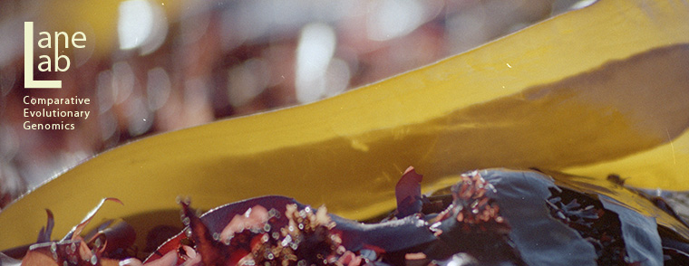
Acknowledgements
Dr. Christopher Lane
Thea Popolizio
Eric Salomaki
Tom Shamp
Funding:
National Science Foundation award #1120652 to the Lane Lab
The Rhode Island Genomics and Sequencing Center which is supported in part by the National Science Foundation (MRI Grant No. DBI-0215393 and EPSCoR Grant Nos. 0554548 & EPS-1004057), the US Department of Agriculture (Grant Nos. 2002-34438-12688 and 2003-34438-13111), and the University of Rhode Island
Picture Credits:
algaebase.org

