Slide 1
“A hero is born among a hundred, a wise man is found among a thousand, but an accomplished one might not be found even among a hundred thousand men. ” -Plato

Slide 2
Methods of Justice
Through Virginia Woolf & Michel Foucault
By: Elizabeth Doré

Slide 3
How it came to be…

Slide 4
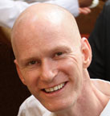
Kindred Spirits

Slide 5
The Process
Write. Write. Write.
Research
Decide

Slide 6
Lessons Learned
Notes:
What you have learned from your research and writing?---- the framing of thoughts, time management

Slide 8
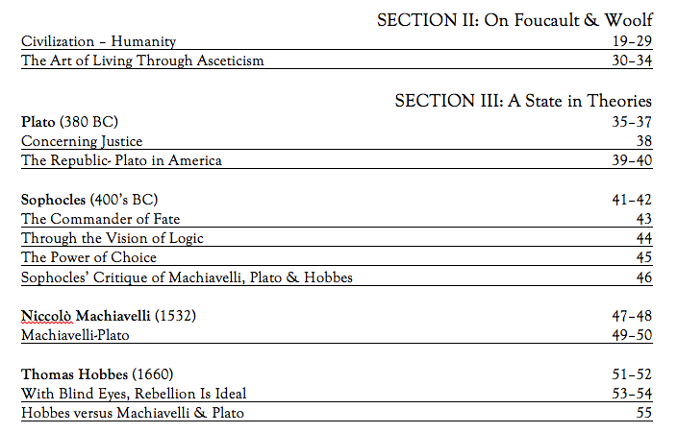

Slide 9
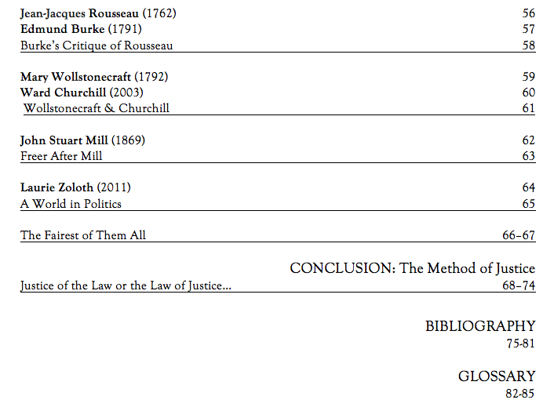

Slide 10
My Intentions
Dig and DIG Deep
Understand
Publish
Educate
They say only the strong survive… graduate school.
Notes:
Where you'd like next to go with this -- further research, publication, social justice activism, etc.

Slide 11
What Happened?

Slide 14
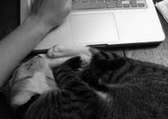

Slide 15
a thesis is born… Methods of Justice

Slide 16
Terminology

Slide 17
From Methods of Justice

Slide 18
Notes:
Return briefly as to where you want to go from here: research-wise, scholarship-wise, activism-wise

Slide 19
Works Cited
"AMP." The Latest From the USA Rock Paper Scissors League. Web. 23 Apr. 2013. <http://roshamblog.wordpress.com/tag/amp/>.
"Five Tips for Standing Out in Your First Job." College Graduate Now What. Web. 28 Apr. 2013.
"How to Organize a Book Collection." WikiHow. Web. 23 Apr. 2013.
<http://www.wikihow.com/Organize-a-Book-Collection>.
"I've Got Designer Bags, under My Eyes." All That Spam. Web. 23 Apr. 2013. <http://allthatspam.blogspot.com/2013/02/ive-got-designer-bags-under-my- eyes.html>.
Jang, Larry, Christina Jang, and Alberta Edmonton. "J² Studios: "Vintage Typewriter"" J² Studios. Apr. 2011. Web. 23 Apr. 2013.
<http://www.j2-studios.com/keyword/ colorful/1239176075_JdFKjTh>.
"Kathy Griffin Gif." Tumblr. Web. 23 Apr. 2013.
<http://www.tumblr.com/tagged/kathy griffin gif>.

Slide 20
Works Cited
"Lorna's Voice." Lornas Voice. Web. 23 Apr. 2013.
<http://lornasvoice.com2012 /01/22/lorna-for-such-a-smart-girl/>.
Oefner, Fabian. "Millefiori: Captures Colorful Brain-Like Images." TrendHunter.com. Web. 23 Apr. 2013.
<http://www.trendhunter.com/trends/millefiori-by-fabian-oefner>.
"Operation Organize Simplify Contest Winners Announced." SA Homebuilders RSS. Web. 23 Apr. 2013. <http://www.sahomesblog.com/2010/12/operation- organize-simplify-contest-winners-announced/>.
"Plato." Goodreads. Web. 23 Apr. 2013. <http://www.goodreads.com/quotes/25220-a- hero-is-born-among-a-hundred-a-wise-man>.
Warner, Rex. "4. Plato: The Greek Philosophers by Rex Warner (1958)." Plato from The Greek Philosophers by Rex Warner (1958). Web. 23 Apr. 2013.
<http://www.ourcivilisation.com/smartboard/shop/warnerr/plato.htm>.

