Slide 1
Bond Volatility Transmissions Between U.S. and European Government Bond Markets
Seth Kulman
Faculty Sponsor: Professor Gordon H. Dash

Slide 2
Agenda
Neural Network Overview
ANN Applied to International Bond Markets
Conclusions
Questions
Notes:
SETH

Slide 3
Artificial Neural Network (ANN)
ANN is structured after a biological neural network
A mathematical model that attempts to mine, predict, and forecast data
Provides Artificial Intelligence (AI)
Notes:
MIKE -Applied Problems – Financial Time Series Mapping (Stochastic), Decision Making, Context-Dependent Analysis
Neuroinformatics – Modern theory about new mathematical models of information processing, based on biological prototypes and mechanisms of human brain.

Slide 4
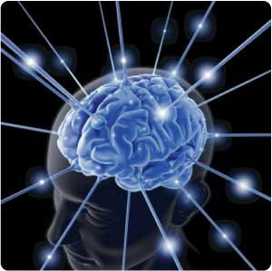
Principles of Brain Processing
A process of pattern recognition and manipulation is based on:
Massive Parallelism
Connectionism
Associative Distributed Memory
Notes:
SETH - MP – brain processes info with neurons (simple processing elements) – interconnected with connection in order to perform parallel distributed processing (PDP) in order to sort desired computation tasks
C – So highly connected that one neuron can have a huge effect on a lot of others depending on size and weight – functional capacity of biological neural networks depends more on connections than particular neurons.
ADM – Storage of info in brain is concentrated in a synaptic connections of NN, more precisely, in the pattern of these connections and strengths (weights) of the synaptic connections

Slide 5
Brain Computer
Brain contains an interconnected net of approximately 10 billion neurons (cortical cells)
Biological Neuron
The simple “arithmetic computing” element
Notes:
MIKE

Slide 6
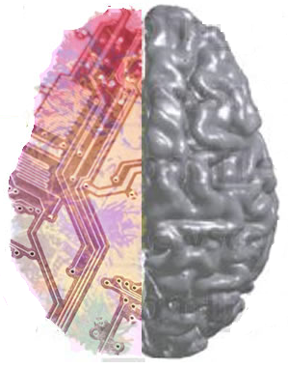
Brain-like Computer
Mathematical Model of human-brain principles of computations
Consists of elements called the biological neuron prototype
Interconnected by direct links (connections)
Cooperate to perform PDP to solve a computational task
Notes:
SETH

Slide 7
Brain-like Computer
New paradigms of computing mathematics consists of the combination of artificial neurons into artificial neural net
Brain-Like Computer
?
Notes:
MIKE

Slide 8
Intelligent Data Analysis Example
Interpretation
and
Decision Making
Rules
&
Knowledge
Productions
A Computational Finance Experiment
Data
Analysis
Characteristics
&
Estimations
Data
Acquisition
Signals
&
parameters
Adaptive Machine Learning
via Neural Network
Data
Acquisition
Data
Analysis
Decision Making
Knowledge
Base
Notes:
SETH

Slide 9
Artificial Neural Network
WinORSe-AI
Windows Operating Research System with e-data and artificial intelligence capabilities
Developed by NKD-Group, Inc.
Notes:
MIKE

Slide 10
Neural Network Process
Data Transformation Method
RBF Method
Transfer Function
Notes:
SETH

Slide 11
Training and Validating
Neural Network is not programmed – it learns
Training = Learning
Validating = Testing
33.3%
Notes:
MIKE Overtrain vs Undertrain

Slide 12
Radial Basis Function tabs
RBF – Parameters
RBF – Weights
RBF - Predicted
Notes:
SETH

Slide 13
Artificial Neural Network
Composed of many artificial neurons
Linked together according to specified architecture
Objective is to transform inputs into meaningful outputs
Notes:
SETH

Slide 14
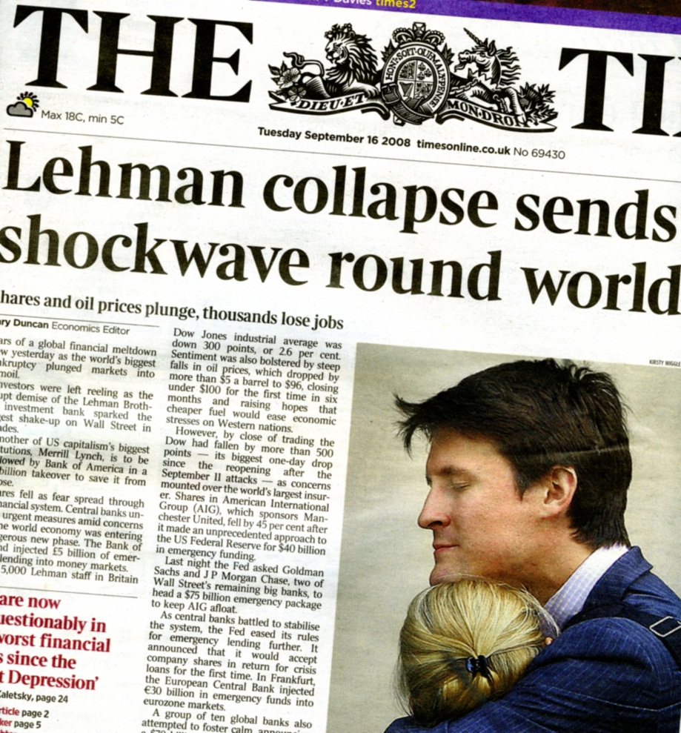
Background
‘Global Economy’
No markets isolated
Financial Crisis of 2008
European Debt Crisis
How are bond markets interconnected?
Notes:
Global Economy – general background on interconnectedness of markets (foreign trade, t-bonds, etc.) Financial Crisis – impacts globally, led to European debt crisis How – study aims to identify in what ways markets interact, specifically in Global bond markets

Slide 15
Selection of Variables
Dependent Variable
‘Lagged Excess Returns’
Independent Variables
JP Morgan European Bond Index
Merrill Lynch U.S. Government Bond Return Index
Notes:
Dependent – Returns from country of study in ‘current’ time period
Lag Excess Returns – Explain this concept, how we use these returns to identify spillover effects
Independent Variables – JP consistent, Merrill Consistent, lag return of country
Coefficients – explain end results after testing through neural network
Example - Germany

Slide 16
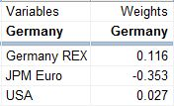
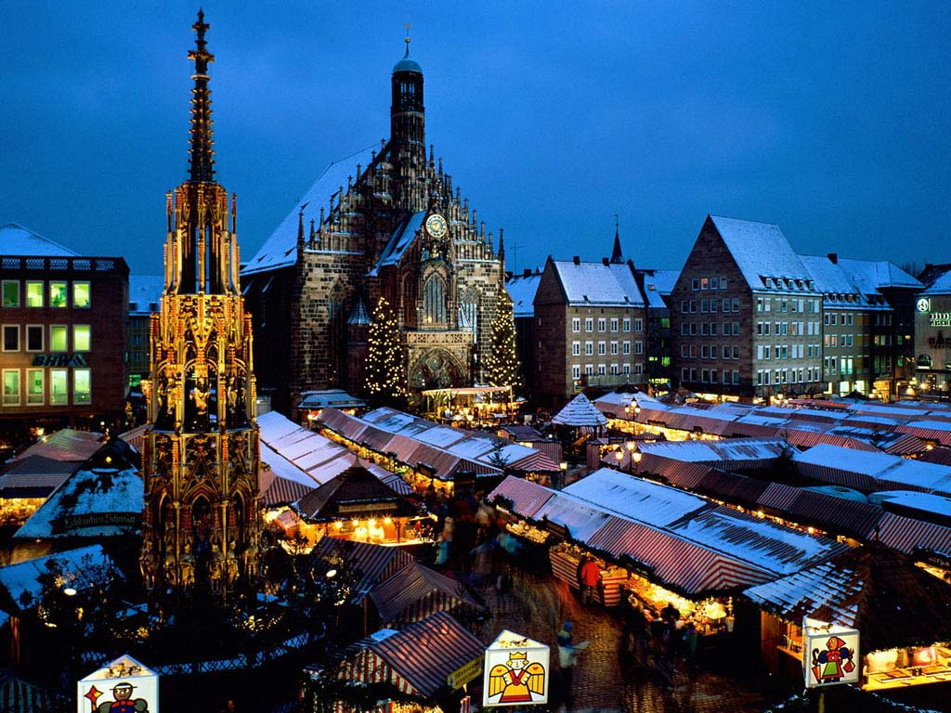
Germany
High weighted correlation to JPM European Bond Index
Strong weighted correlation to prior period German returns
Little spillover from US returns
Largest player in European Union
Fiscal policy based on EU

Slide 17
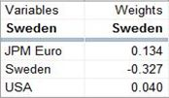
Sweden
Strongest weighted correlation to Swedish lagged returns
JPM Euro bond index significant
Little spillover from US
Export oriented economy
Imports primarily from Europe

Slide 18
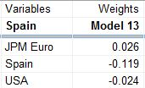
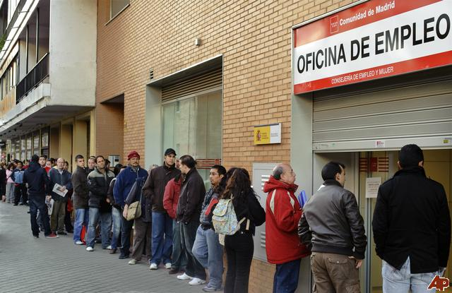
Spain
Significant weighted correlation to Spanish lagged returns
Little spillover from JPM index
Little spillover from US
Likely due to Spain’s exploding economy at time of study (2003-2005)
Spain produced more than half of new jobs in EU in this period
Economy rapidly growing

Slide 19
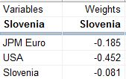
Slovenia
Very strong spillover effects from US
Moderate spillover from JPM index
Least spillover from Slovenian lagged returns
US is largest non-European trading partner

Slide 20
Principal Component Analysis
PCA used to determine validity of results
94.3% Cumulative Variance Explained
Suggests statistically strong study

Slide 21
Conclusions
Neural Network allows for statistically strong studies in Finance
Bond market volatility does spillover between European countries and the United States
Some countries more affected by volatility of outside indexes than own lag returns

Slide 22
Questions
Notes:
SETH

Slide 23
Thank You
Notes:
MIKE

