Slide 1
Senior Honors Recital
Mark Maguire
4 – 30 – 2008
Sponsor: Dr. Brian Cardany
The euphonium invented in 1843 by Ferdinand Sommer de Weimer

Slide 2
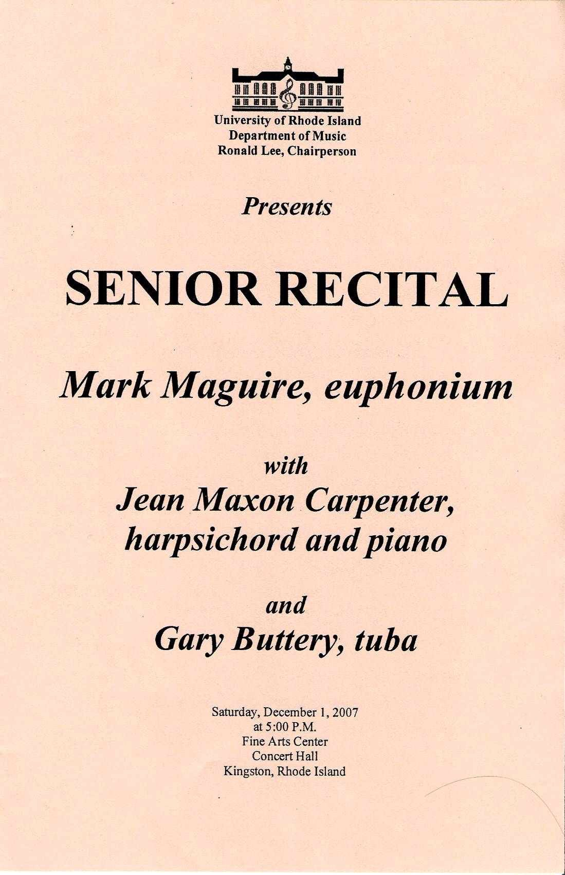
Preparation
Abstract
“Through college I was learning about the education process and how music education fits into a curriculum. It was all very interesting but I had never had much of an opportunity to write much music. Writing music was homework exercises for music theory classes. Practical, yet not emotional. As I started to plan for my senior recital and my honors project, I saw an opportunity to fulfill my desire to write music, specifically for my euphonium (Greek for sweetly sounded). The solo euphonium repertoire is so limited since the instrument has only existed for 140 years and its purpose in an ensemble is more functional and harmonic rather than melodic. There was a unique convergence of needs; a desire to write music, performing a recital, and completing my senior project. “

Slide 3
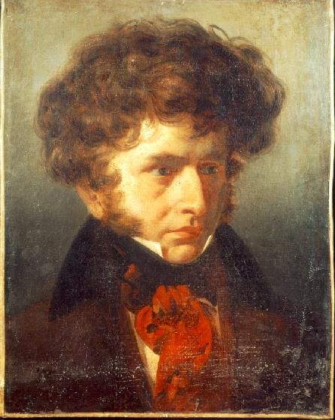
Shepherd's Duet
“Emotional (imitation) is designed to arouse in us by means of sound the notion of the several passions of the heart, and to awaken solely through the sense of hearing the impressions that human beings experience only through the other senses. Such is the goal of expression, depiction or musical metaphors.” "On Imitation in Music“, An essay by Berlioz
Hector Berlioz’s Symphonie Fantastique Mvt. III – In the Country
Original Sheet Music
Recording of Original
Sheet Music
Recording of electronics
Recording of performance
Comparison Paper
Hector Berlioz (1803 – 1869)

Slide 4
Chaconne
“On one stave, for a small instrument, the man writes a whole world of the deepest thoughts and most powerful feelings. If I imagined that I could have created, even conceived the piece, I am quite certain that the excess of excitement and earth-shattering experience would have driven me out of my mind.” – Johannes Brahms
Johann Sebastian Bach’s Partita No. 2 in d minor
Original Sheet Music
Recording of Original
Sheet Music
Recording of Performance
Comparison Paper
Johann Sebastian Bach (1685 – 1750)

Slide 5
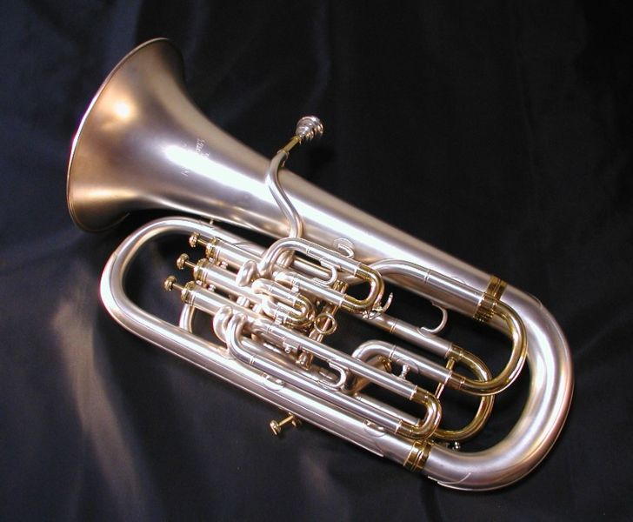
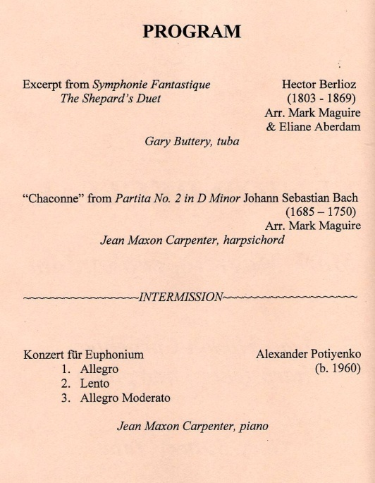
Konzert
Mvt. I – Allegro
Mvt. II – Lento
Mvt. III – Allegro Moderato

Slide 6
Works cited
Bach, Johann Sebastian & Zehetmair, Thomas. Bach: The Chamber Music Volume 11: Sonatas and Partitas. Track 5; Ciaccona. BWV 1004. Elektra / WEA © 2002.
Berlioz, Hector & Davis, Sir Colin. Symphonie Fantastique, Op. 14. LSO: Live © 2002. (London Symphony Orchestra)
Burkhart, Charles. Anthology for Musical Analysis, Sixth Edition. Wadsworth Group / Thomson Learning, Belmont, California. © 2004.
Lang, Paul Henry. The Symphony (1800 – 1900). W. W. Norton & Company, Inc., New York, NY. © 1969.
Recital recordings are taken from Mark Maguire’s Senior Recital. December 1, 2007. University of Rhode Island Fine Arts Recital Hall.
Electronics, and Arrangements for the Chaconne and Duet are © of Mark Maguire, 2007.

